Slide 1
The PICASSO experiment - searching for cold dark matter
Institute of Experimental and Applied Physics, CTU in Prague
Robert Filgas
on behalf of the PICASSO collaboration
77. Jahrestagung der DPG und DPG-Frühjahrstagung, Dresden, March 2013

Slide 2
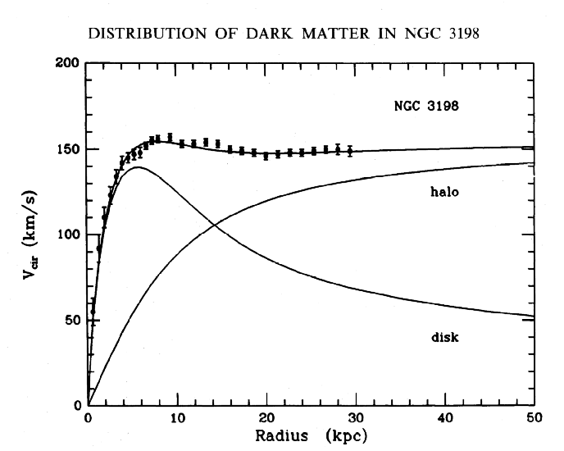
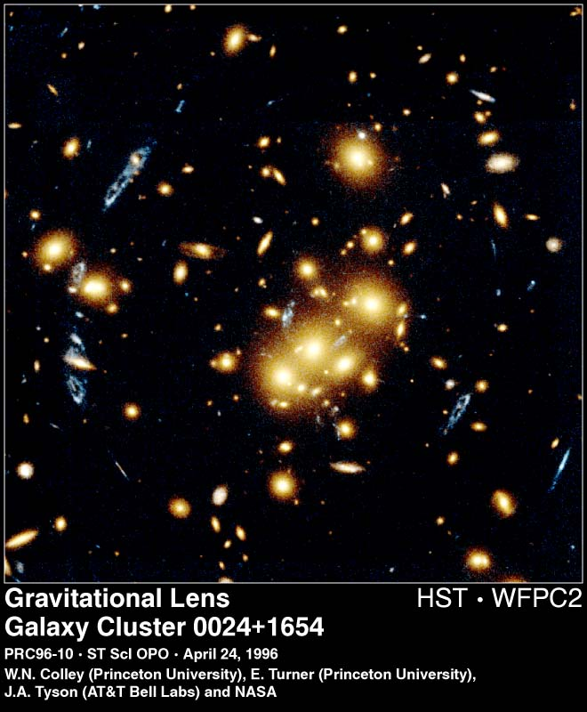
What is Dark Matter?
Observed gravitational effects vs. calculated luminous mass
Rotation curves of galaxies
Gravitational lensing by galaxy clusters

Slide 3
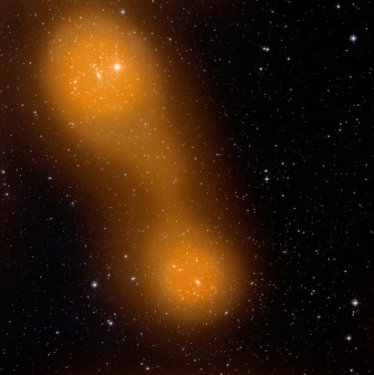
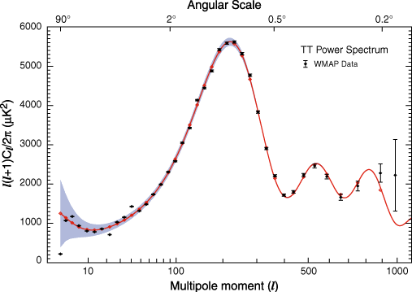
What is Dark Matter?
Observed gravitational effects vs. calculated luminous mass
CMB temperature perturbations measured by WMAP
Hot gas distribution of galaxy clusters

Slide 4
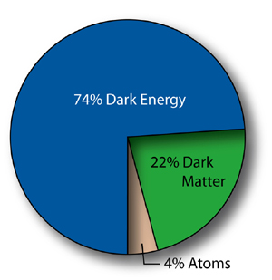
What is Dark Matter?
Slow – bottom up Universe -> Cold Dark Matter
Does not interact strongly (no atoms) or electromagnetically (dark)
Only weak and gravitational interaction – difficult to detect
WIMP – Weakly Interacting Massive Particle
In Supersymmetry WIMP = neutralino (majorana, massive, slow)
Indirect – neutrinos & gammas from WIMP annihilation
Detection
Direct – scattering of WIMPs off atomic nuclei within a detector
Cryogenic – T<100mK, detect heat produced when WIMP hits atom in crystal absorber (Ge)
Scintillation – detect scintillation light produced by WIMP collision in liquid noble gases (Xe, Ar)
Bubble detectors – detect phase transition in superheated liquids, PICASSO

Slide 5
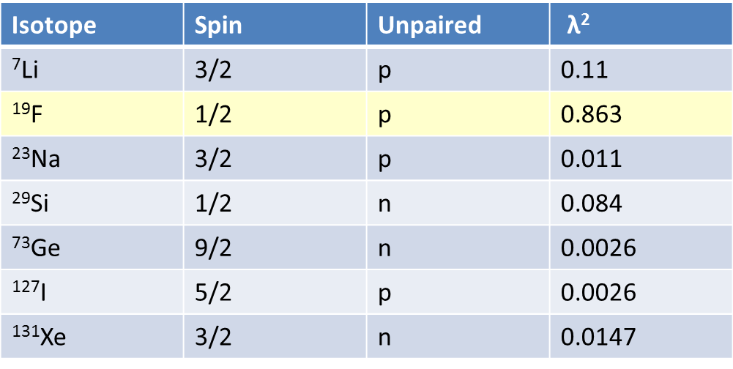
PICASSO
Project In CAnada to Search for Supersymmetric Objects
Canada
USA
Czech Republic
India
Active liquid C₄F₁₀ : large amount of fluorine ¹⁹F
WIMP interaction with matter:
Depending on target nucleus and WIMP composition, the interaction can be:
$$σ_{A}=4G_{F}^{2}{\left(\frac{M_{χ}M_{A}}{M_{χ}+M_{A}}\right)}^{2}C_{A}$$
Spin-independent interaction:
$$C_{A}∝A^{2}$$
^{Enhancement factor}
Spin-dependent interaction:
$$C_{A}=\left(\frac{8}{π}\right){\left(a_{p}<S_{p}>+a_{n}<S_{n}>\right)}^{2}(J+1)/J$$
λ
¹⁹F is the most favorable target for spin dependent
interactions due to spin enhancement factor
Notes:
GF is the Fermi constant, ap,n are the effective proton (neutron) coupling strengths, Sp,n are the expectation values for the nucleon spins in the target nucleus and J is the nuclear spin

Slide 6
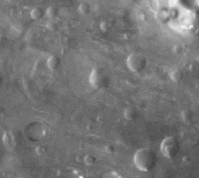
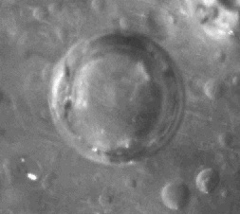
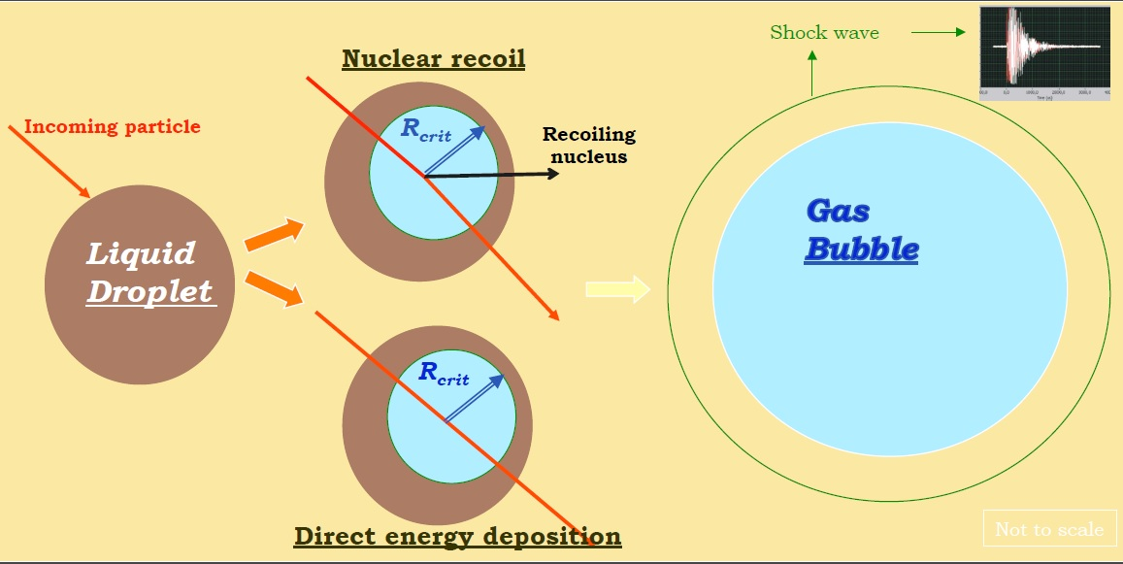
Operational Principle
Superheated liquid detector based on bubble chamber
If sufficient energy is deposited within minimal radius directly or via nuclear recoil:
Phase transition occurs and a bubble is formed
The explosion is measured acoustically
Threshold detector, dependent on temperature

Slide 7
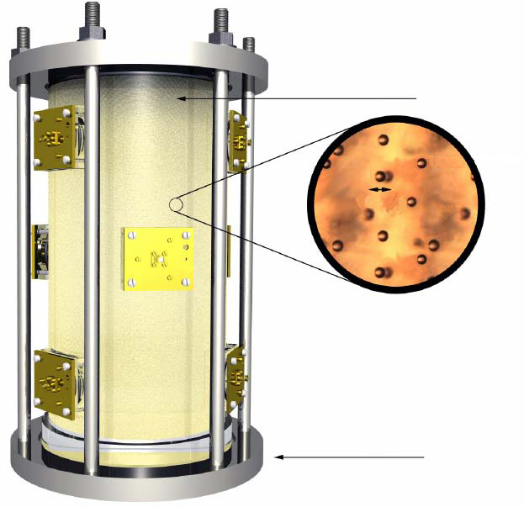
The PICASSO Detector
Acrylic container
ø14 × 40 cm
200 µm droplets of C4F10 dispersed in polymerised gel
Droplets superheated at ambient temperature and pressure (T_{b}= -1.7 °C)
Operating temperature determines energy threshold (20 °C – 50 °C)
Events recorded by 9 piezo-electric transducers
Bubbles recompressed back to droplets by pressurization (6 bar)
4.5 liters
200 µm droplets
of C4F10
Stainless steel frame
Main features of the detector:
- each droplet is independent
bubble chamber
- low threshold E_{th} (45 °C) = 2 keV
- insensitive to γ-background
- inexpensive
90 g of C4F10
̴72 g of ¹⁹F
9 piezo-sensors

Slide 8
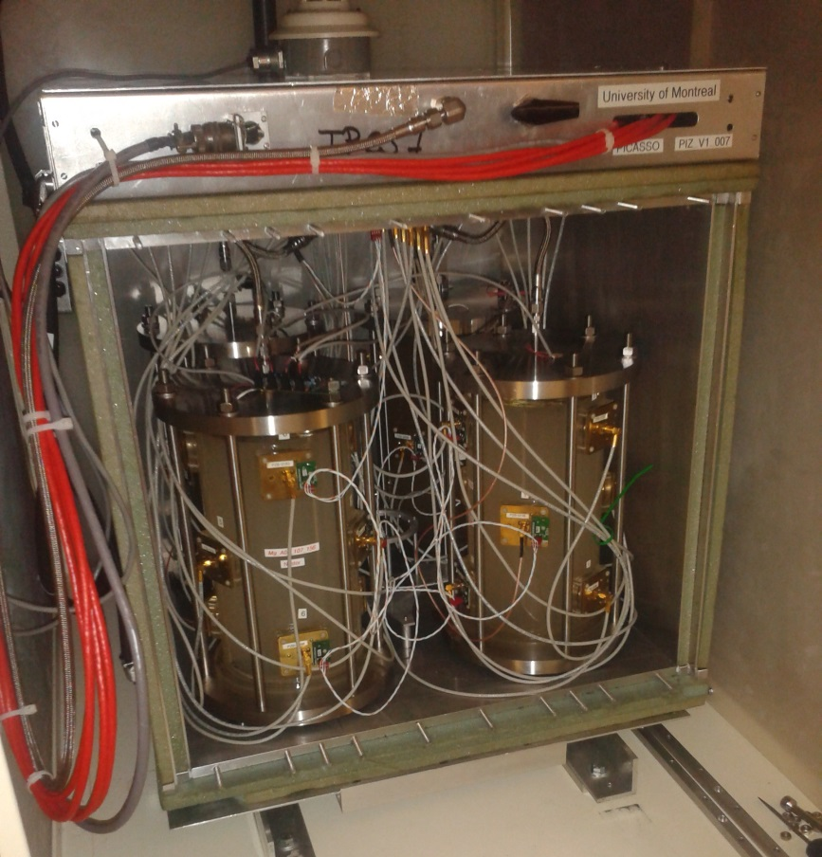
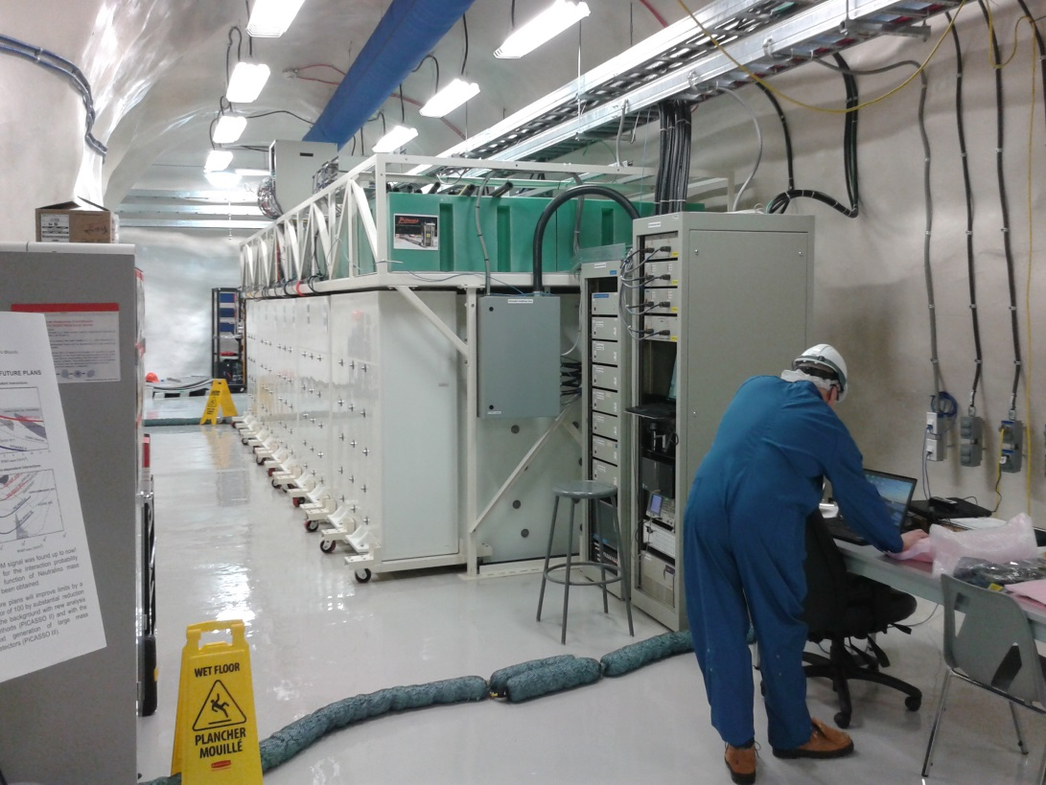
The PICASSO Detector
8 TCPS – Temperature and Pressure Control System – each with 4 detectors
Total of 2.6 kg of active mass
Controlled remotely by shift operators
40 hours runs of data-taking followed by 15 hours of recompression
50 cm UPW neutron shielding
Located at SNOlab

Slide 9
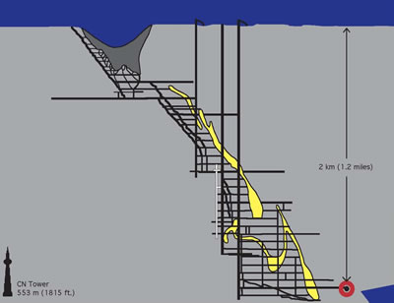
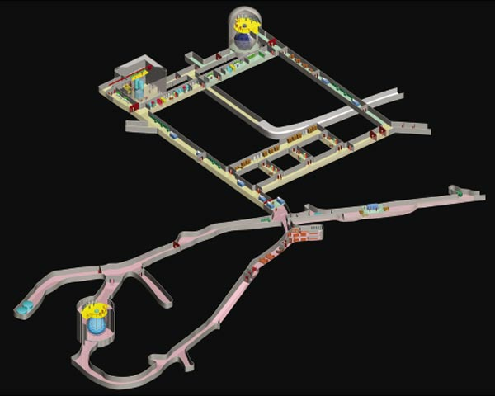
SNOlab
Follow-up of the Sudbury Neutrino Observatory
2 km underground in a nickel mine
Rock shields against cosmic rays

Slide 10
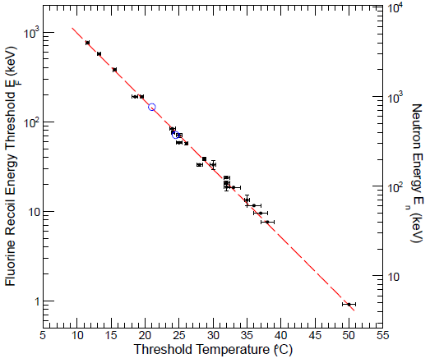
Energy threshold
PICASSO detectors are threshold detectors
Calibration with mono-energetic neutron beam
Neutron inducted nuclear recoils similar to WIMPs
Alpha measurements consistent with calibration
²¹⁰Pb recoil
α Bragg peak
$$E_{Rec}^{F}=0.18∙E_{n}$$

Slide 11
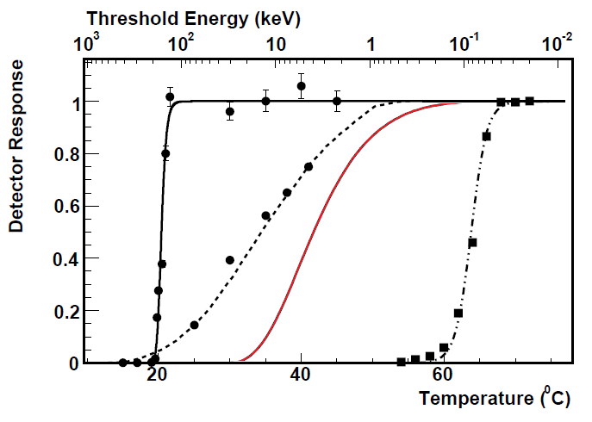
Detector response
α – particles
5.6 MeV of ²²⁶Ra
Nuclear recoils from
fast neutrons of
AmBe source
¹⁹F recoils modeled a
assuming the scattering
of 50 GeV/ c² WIMP
Response to
1.275 MeV
gamma of ²²Na

Slide 12
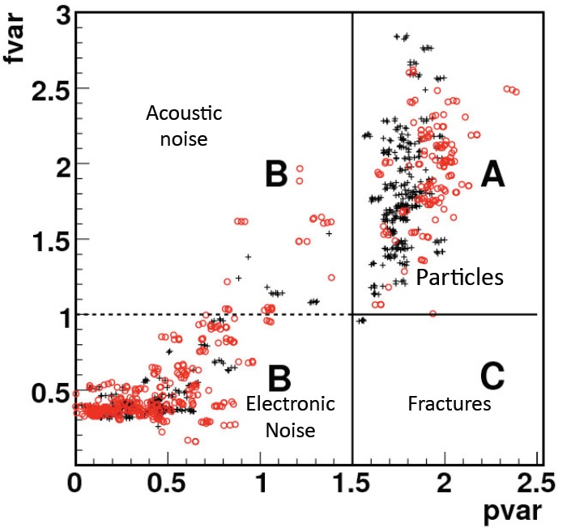
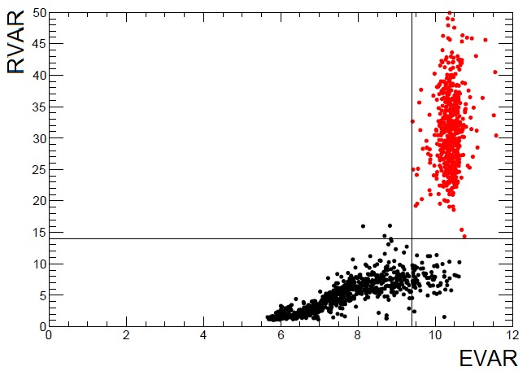
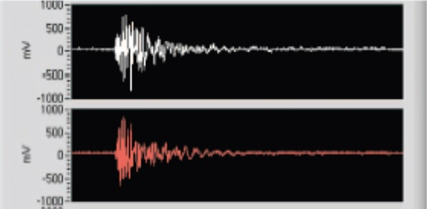
Background discrimination
The acoustic signal from bubble formation is recorded and used for analysis
Events are selected using:
Acoustic energy from signal amplitude (pvar)
Frequency (fvar)
Signal rise time (rvar)
Particle inducted events
(neutrons)
Other acoustic signals inducted
in detector matrix

Slide 13
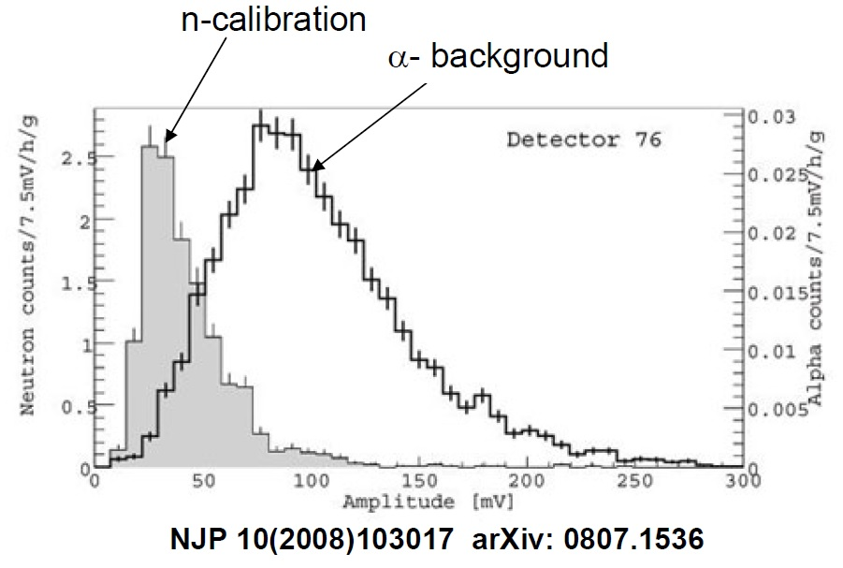
Alpha - neutron discrimination
PICASSO discovered difference between amplitudes neutron and alpha-particle induced events
Confirmed by COUPP
Alpha particles are “louder” than neutrons
More than one nucleation site for the alpha?

Slide 14
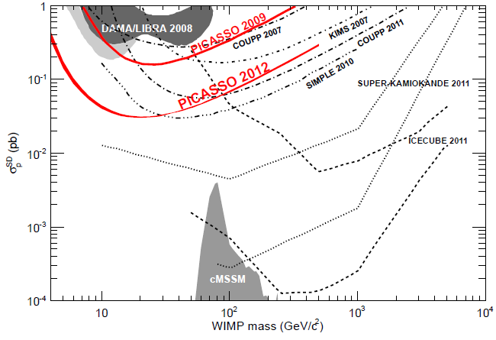
Results in SD sector
Most recent result from start of 2012 (Archambault et. al. Phys Lett B 711(2) (153‐161))
Improvement by factor 5 on previous results
SD cross section (90% C.L.) σ_{p} = 0.032 pb with m_{χ}=20 GeV/c²

Slide 15
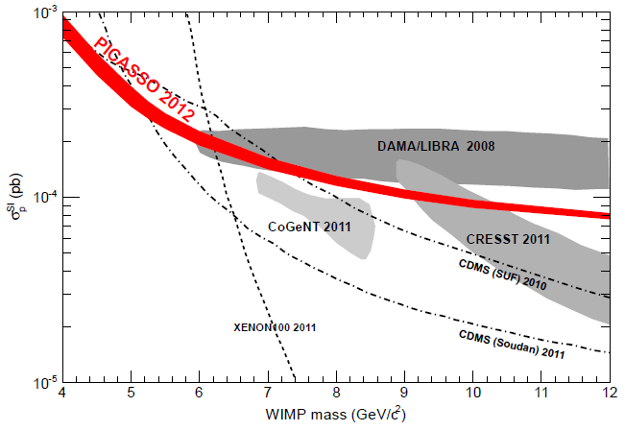
Results in SI sector
PICASSO competitive also in spin-independent sector
SI cross section (90% C.L.) σ_{p} = 1.41·10⁻⁴ pb with m_{χ}=7 GeV/c²

Slide 16
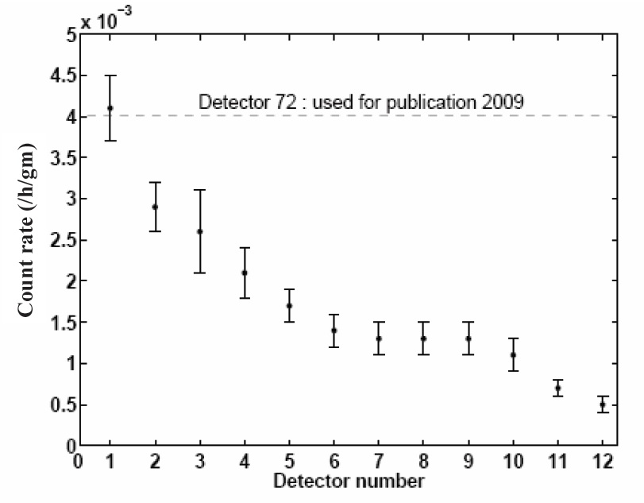
PICASSO near-future plans
PICASSO in cruising regime obtaining data
Improved exposure (2 more years and more detectors)
Improved radiopurity in detector construction
New localization to improve resolution of signals
Progress in alpha-neutron discrimination
New results prepared for this year
Meanwhile – R&D for a new detector

Slide 17
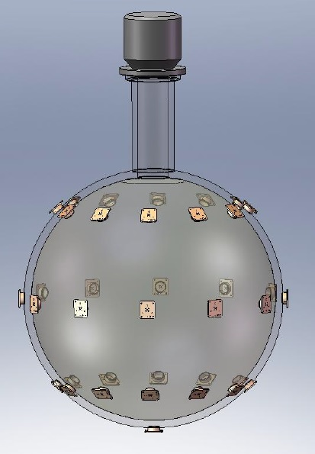
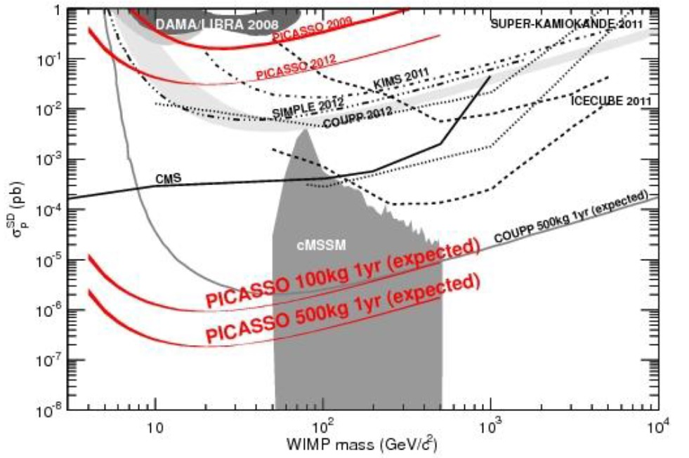
PICASSO+ and beyond
Work underway to build large detector (500 kg of active mass)
New technique using condensation chamber (geyser)
Ambition: become world leading experiment in SD sector
Advantages:
- low cost
- scalable to large volumes
- simple, self regulating system (ambient T&P)
The PICASSO and COUPP collaborations have recently joined to explore ton scale superheated detector options.

Slide 18
Conclusions
¹⁹F target useful for exploration of spin-dependent dark matter interactions at very low energy thresholds.
Use of superheated liquid technique allows very low background detectors (only alphas and neutrons).
PICASSO has made leading limits in SD dark matter searches, and probes interesting SI physics results.
Possibility of alpha discrimination using acoustic energy.
Large scale detector PICASSO+ (and beyond in collaboration with COUPP) R&D underway.

