Slide 1
DPG Meeting Dresden
The optimized stellarator as a candidate for a fusion power plant
Thomas Klinger
C. Beidler, J. Boscary, H.S. Bosch, A. Dinklage, P. Helander, H. Maaßberg T.S. Pedersen, T. Rummel, F. Schauer, L. Wegener, R. Wolf
and the Wendelstein 7-X team
Max-Planck Institute for Plasma Physics, Greifswald
DPG 2013

Slide 2
Outline of the talk
Max-Planck Society
Challenges
Stellarators
Wendelstein 7-X
Research program
Fusion power plant
National funding via the Helmholtz Association
Co-Funded by the European Commission
DPG 2013

Slide 3
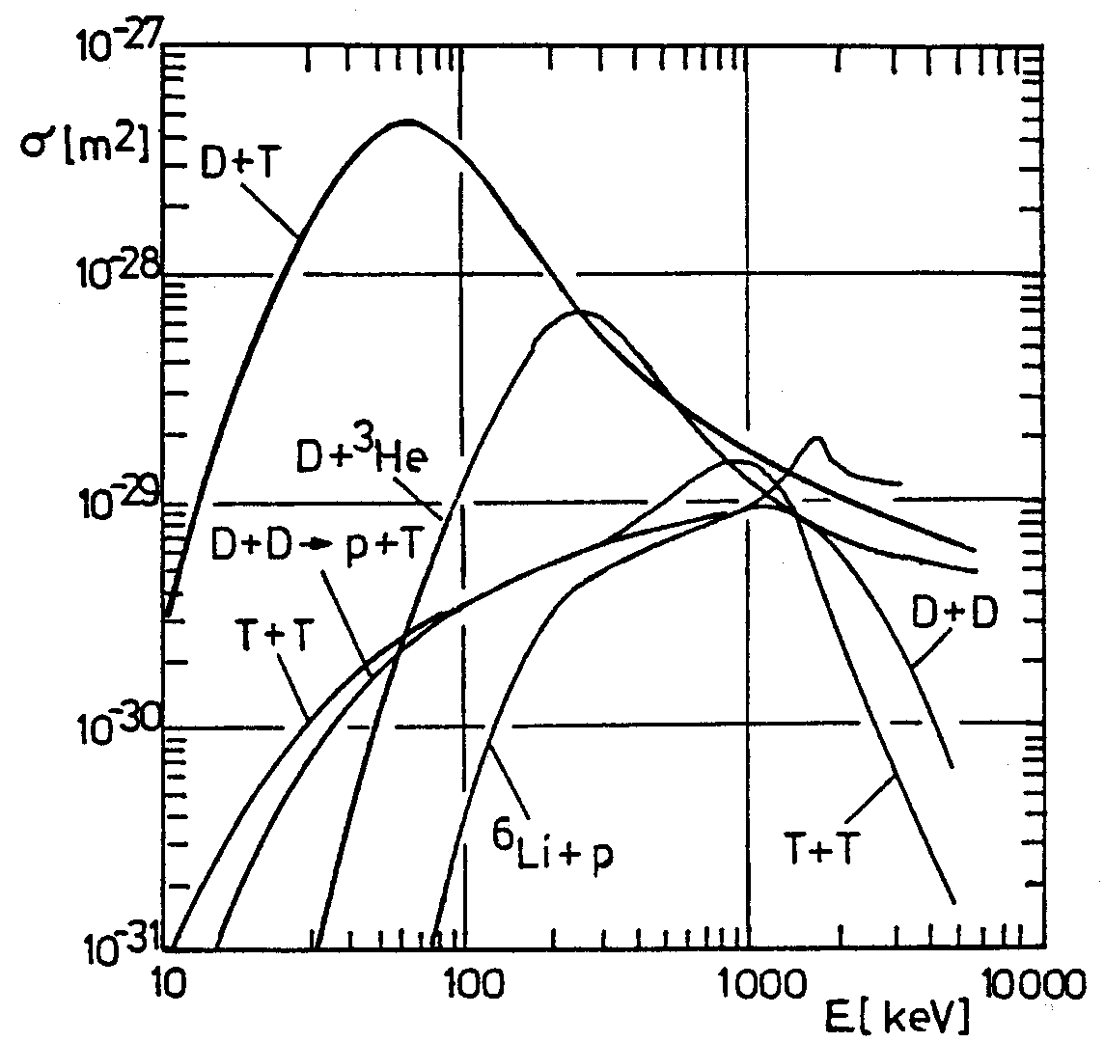
Challenges in fusion research
nuclear fusion of D and T
nuclear physics well understood
high temperature plasma
inertial confinement
magnetic confinement
temperatures > 10 keV ✓
densities > 10²⁰ m⁻³ ✓
confinement > 10 s × 10
steady state operation O(s)
superconductivity LHe
tritium breeding
wall materials
₁D² + ₁T³ → ₂He ⁴ (3.5 MeV) + ₀ n¹ (14.1 MeV)
T. Klinger on Wendelstein 7-X 3

Slide 4
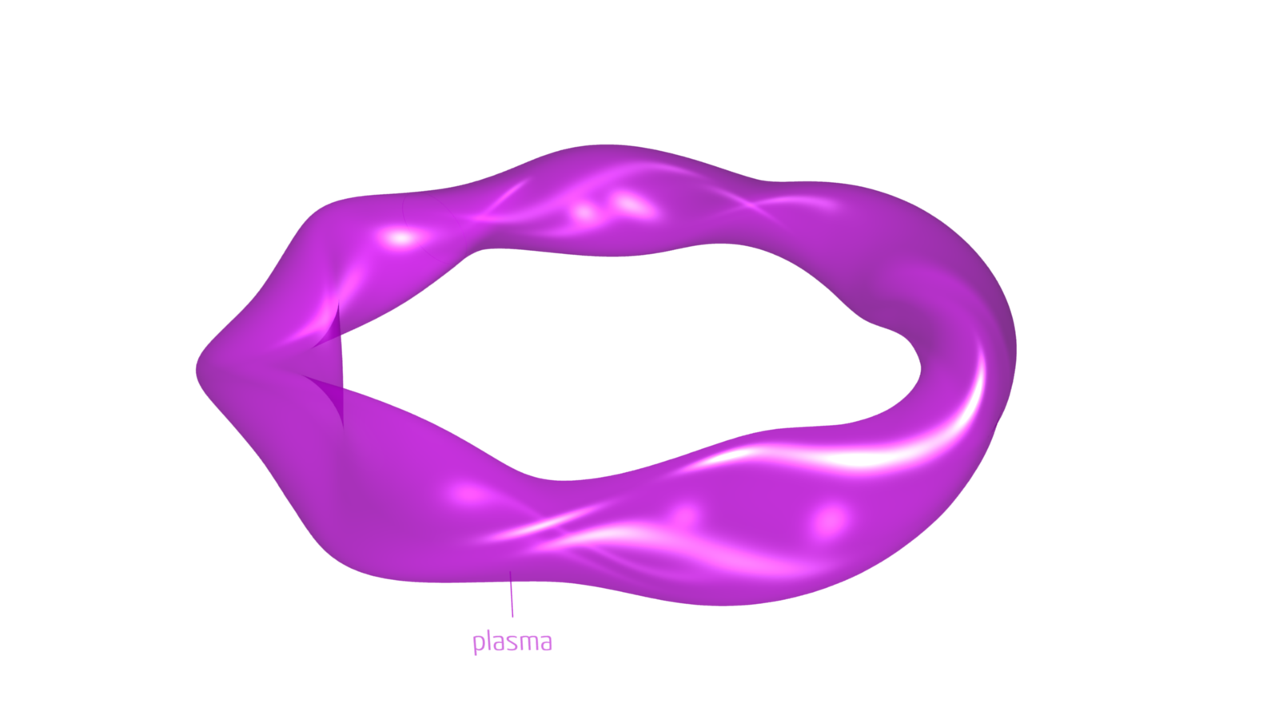
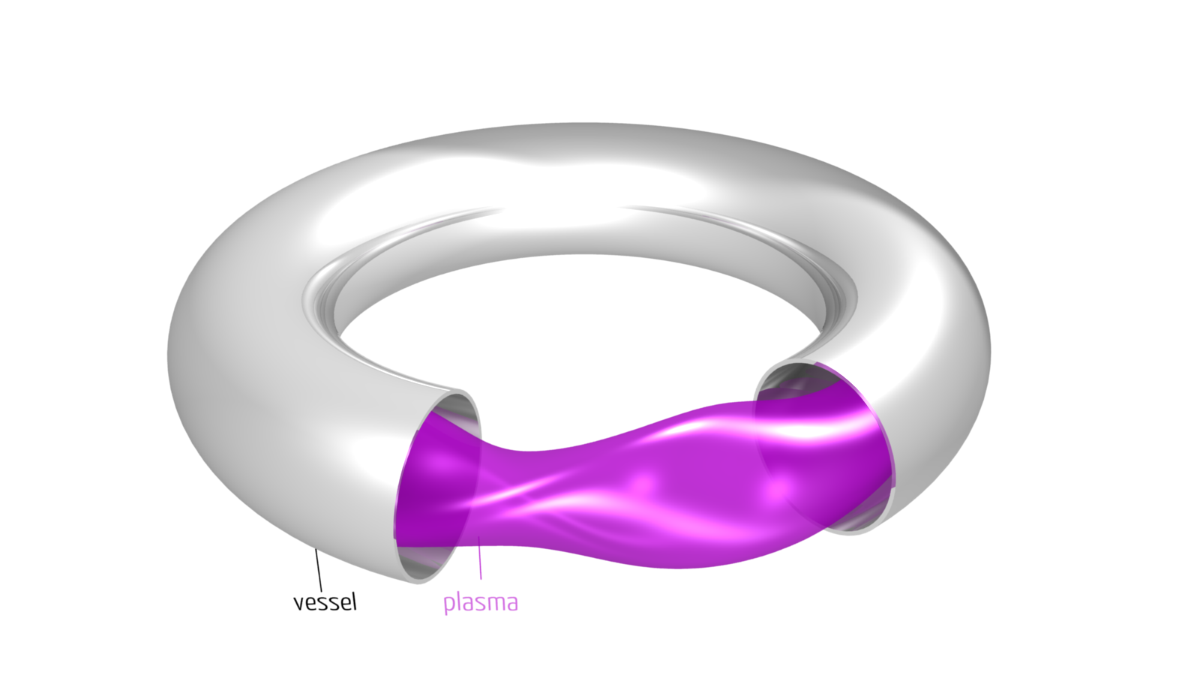
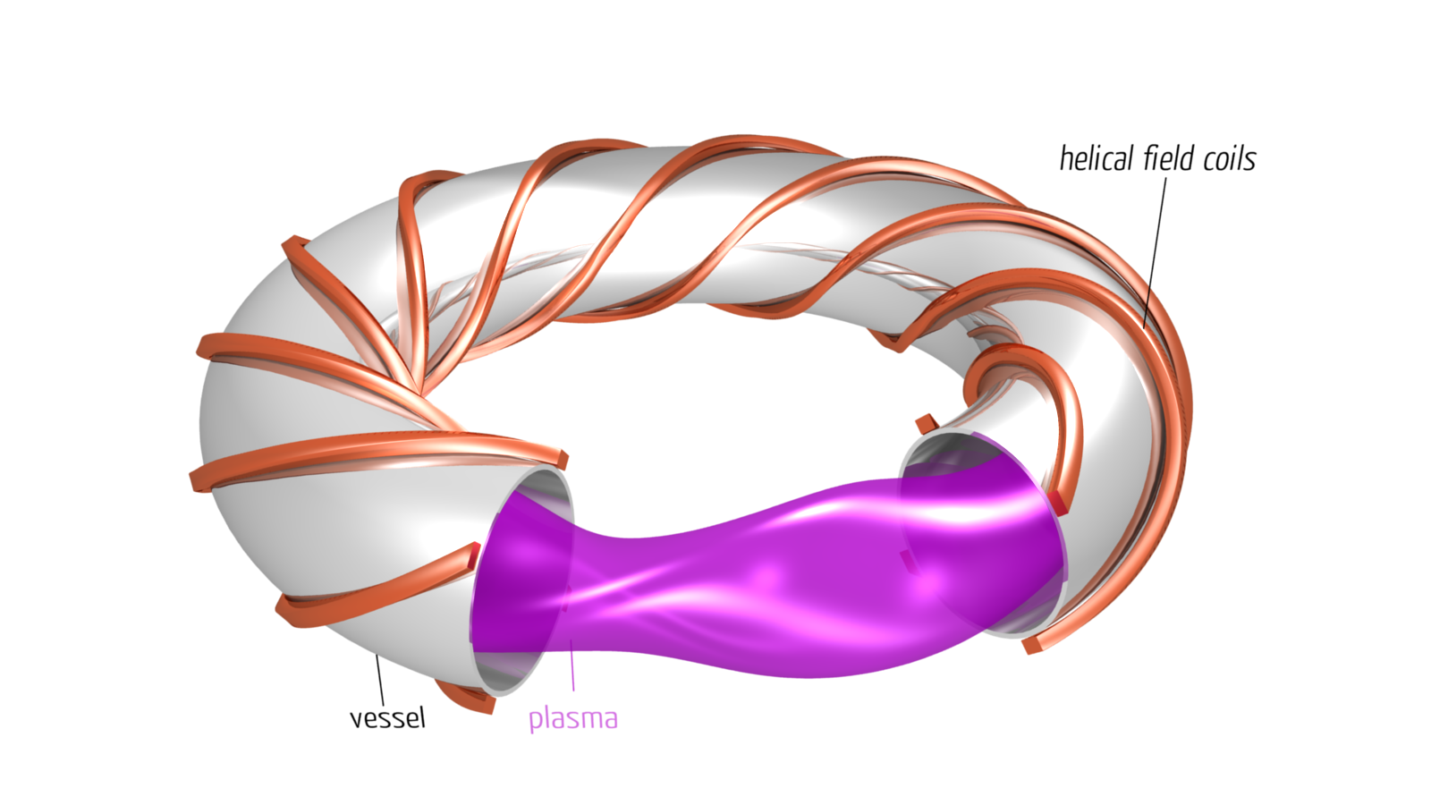
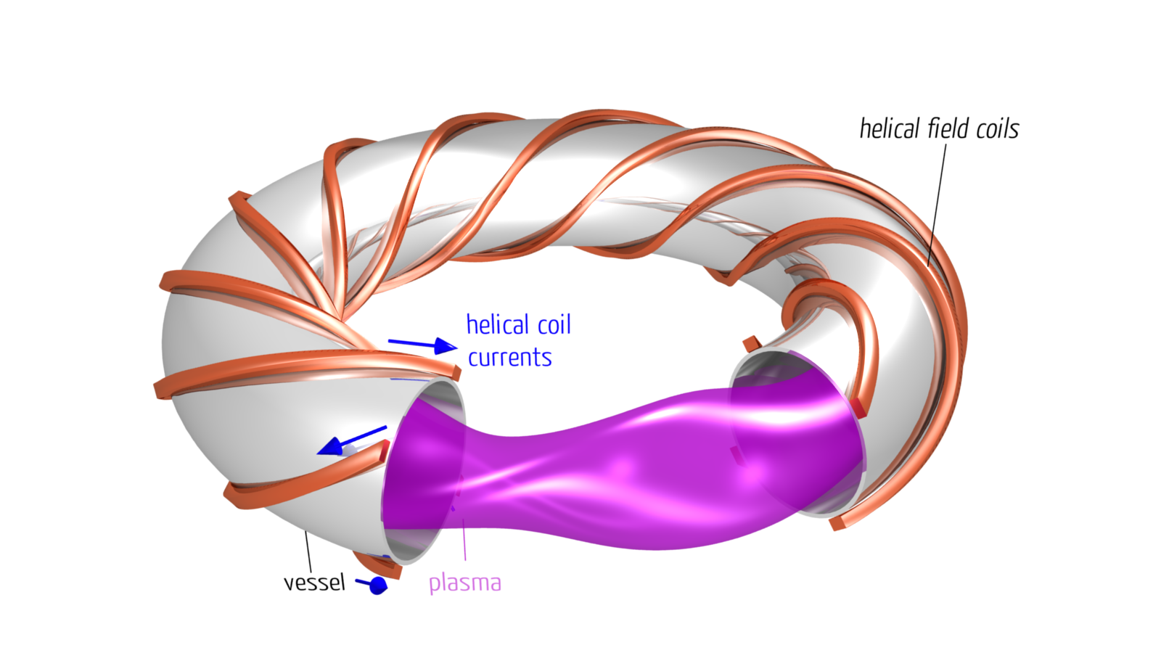
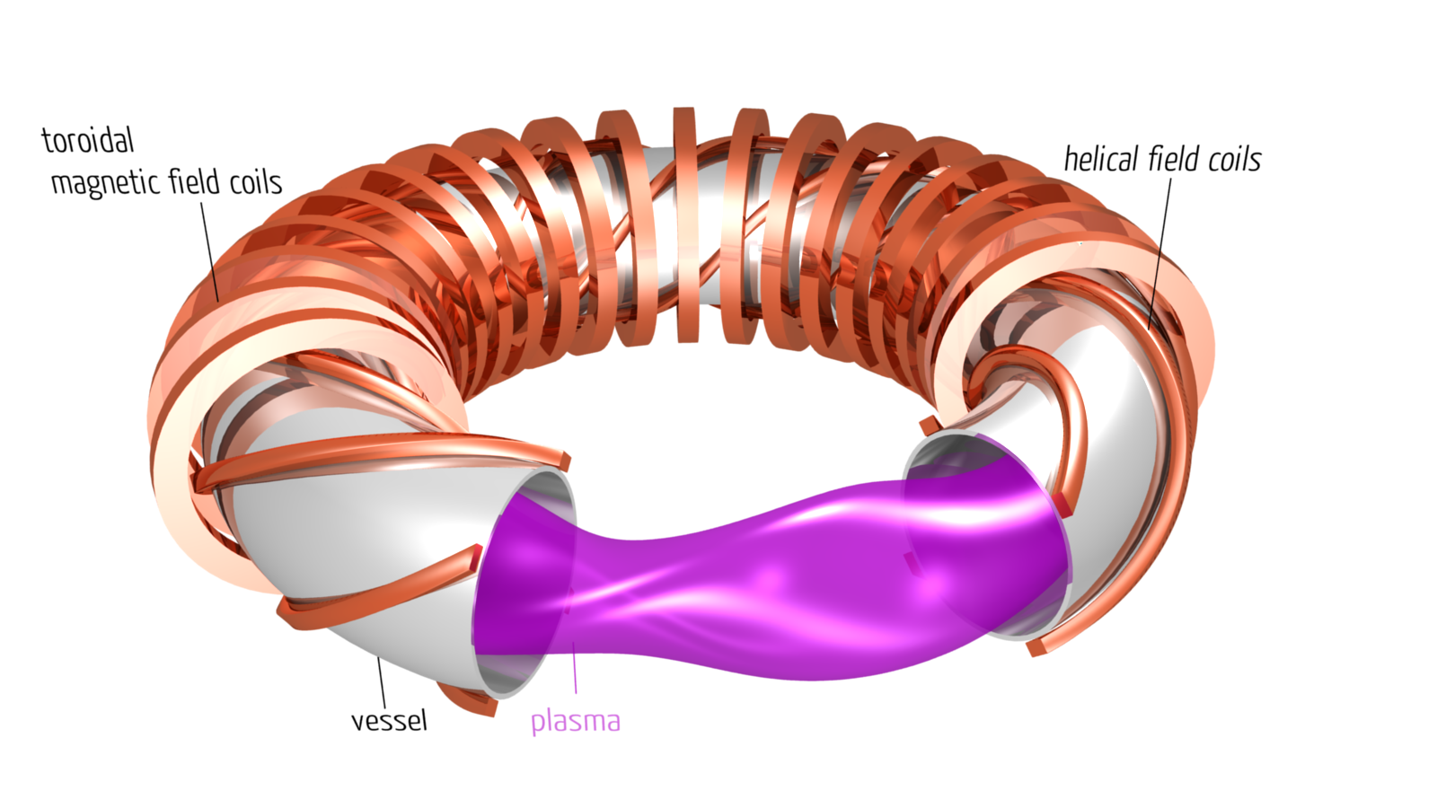
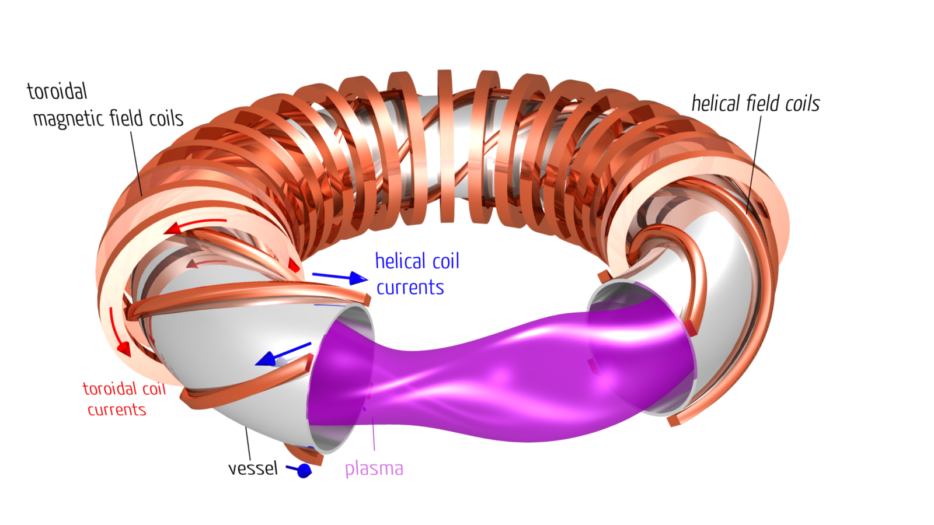
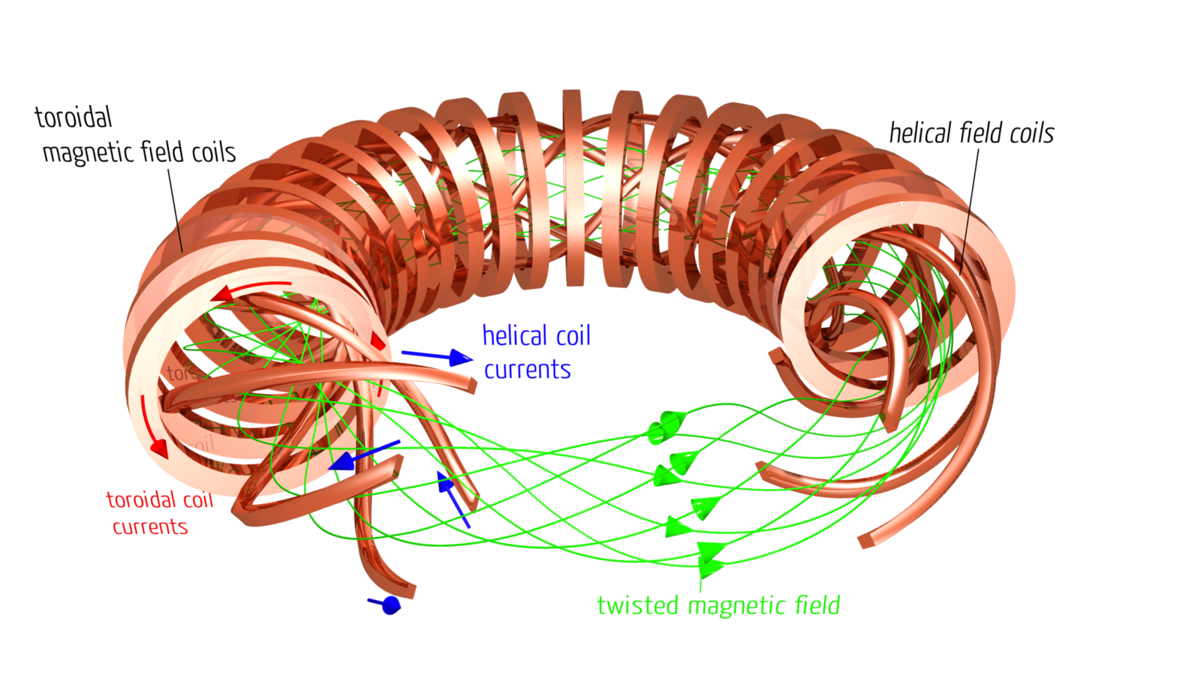
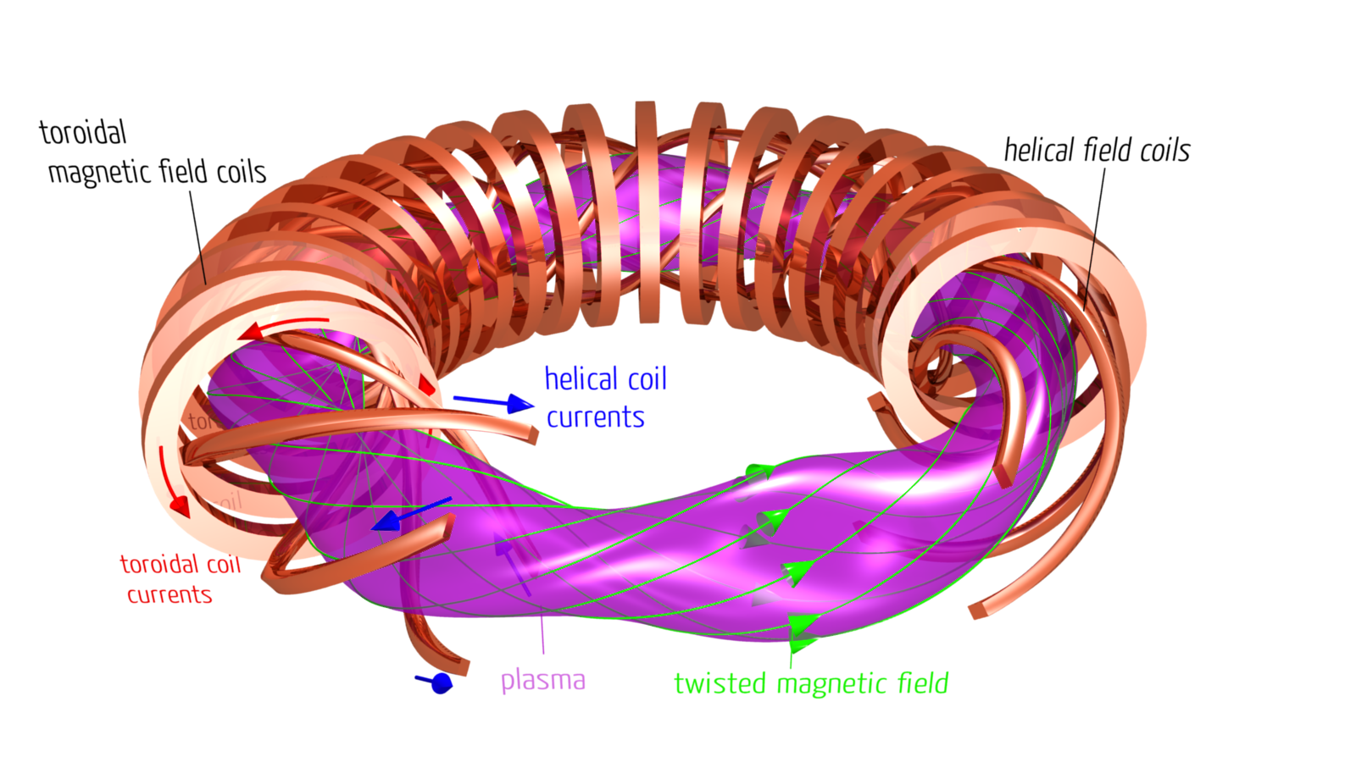
The classical stellarator
Stellarator (1951 Spitzer) Stella = the star „bringing the star“
T. Klinger on Wendelstein 7-X 4

Slide 5
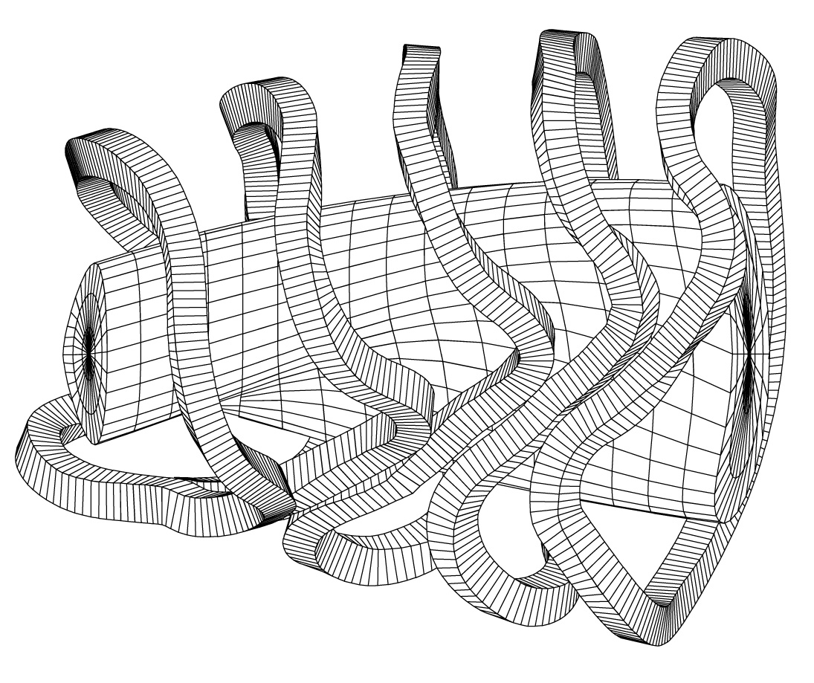
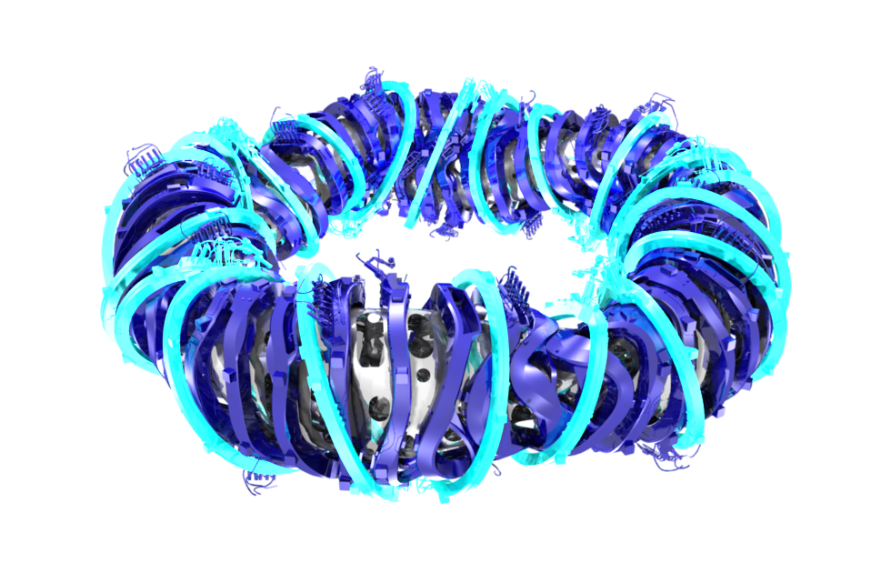
Physics optimisation
seven optimisation criteria
high quality of vacuum magnetic surfaces
good finite equilibrium properties @ <β > = 5%
good MHD stability properties @ <β > = 5%
reduced neoclassical transport in 1/ν -regime
small bootstrap current in lmfp-regime
good collisionless fast particle confinement
good modular coil feasibility
3d computer codes
vacuum field and coils
MHD equilibrium
MHD linear stability
neoclassical transport
Monte Carlo test particle
edge and divertor
T. Klinger on Wendelstein 7-X 5

Slide 6
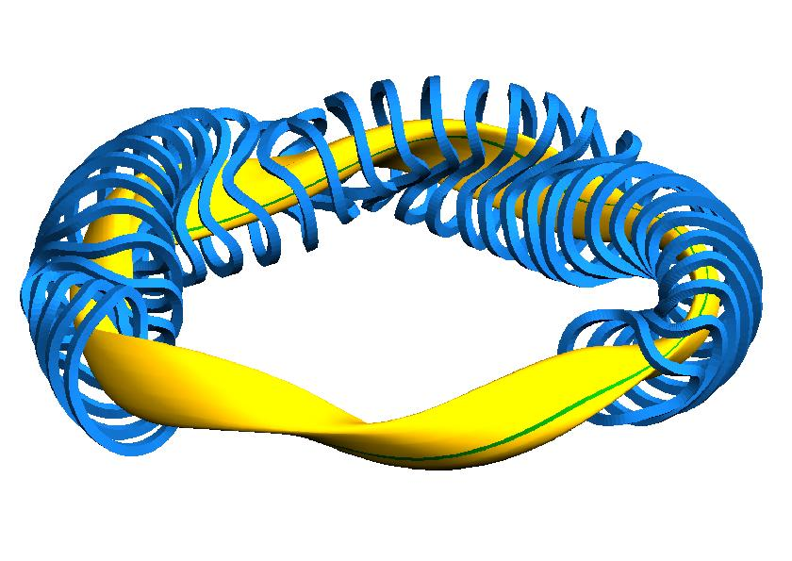
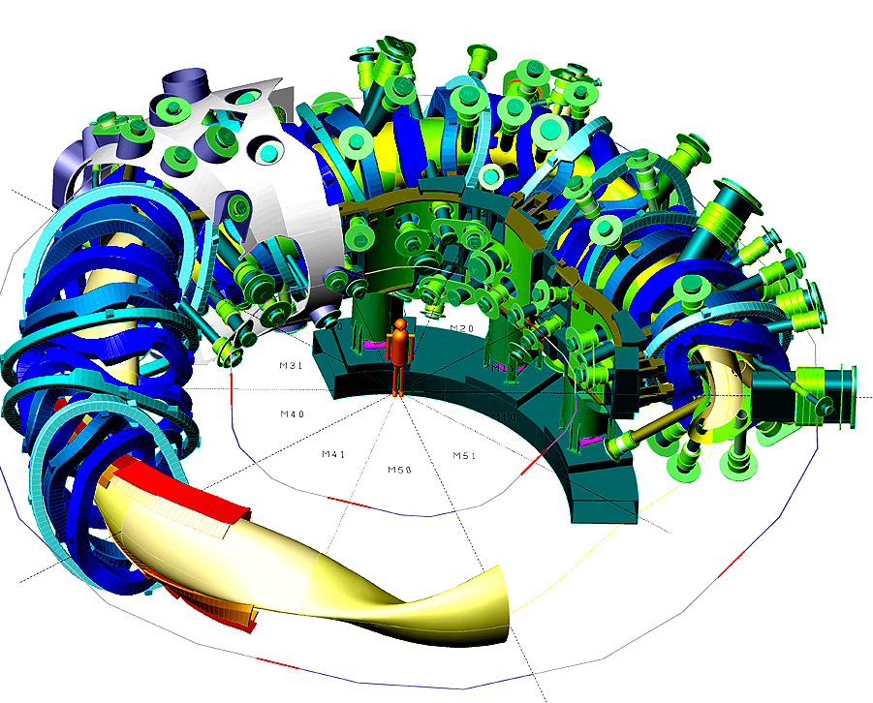
Facts and figures
five magnetic field periods
modular non-planar coils
quasi-isodynamic equilibrium
low bootstrap current <50 kA
high iota and low shear
flexible magnetic field configurations
725 t mass with 425 t cold mass
70 superconducting NbTi coils
3 T magnetic induction on axis
254 ports of 120 different types
30 m³ plasma volume
265 m² in-vessel components
height 4.5m diameter 16 m
30 min plasma operation
T. Klinger on Wendelstein 7-X 6

Slide 7
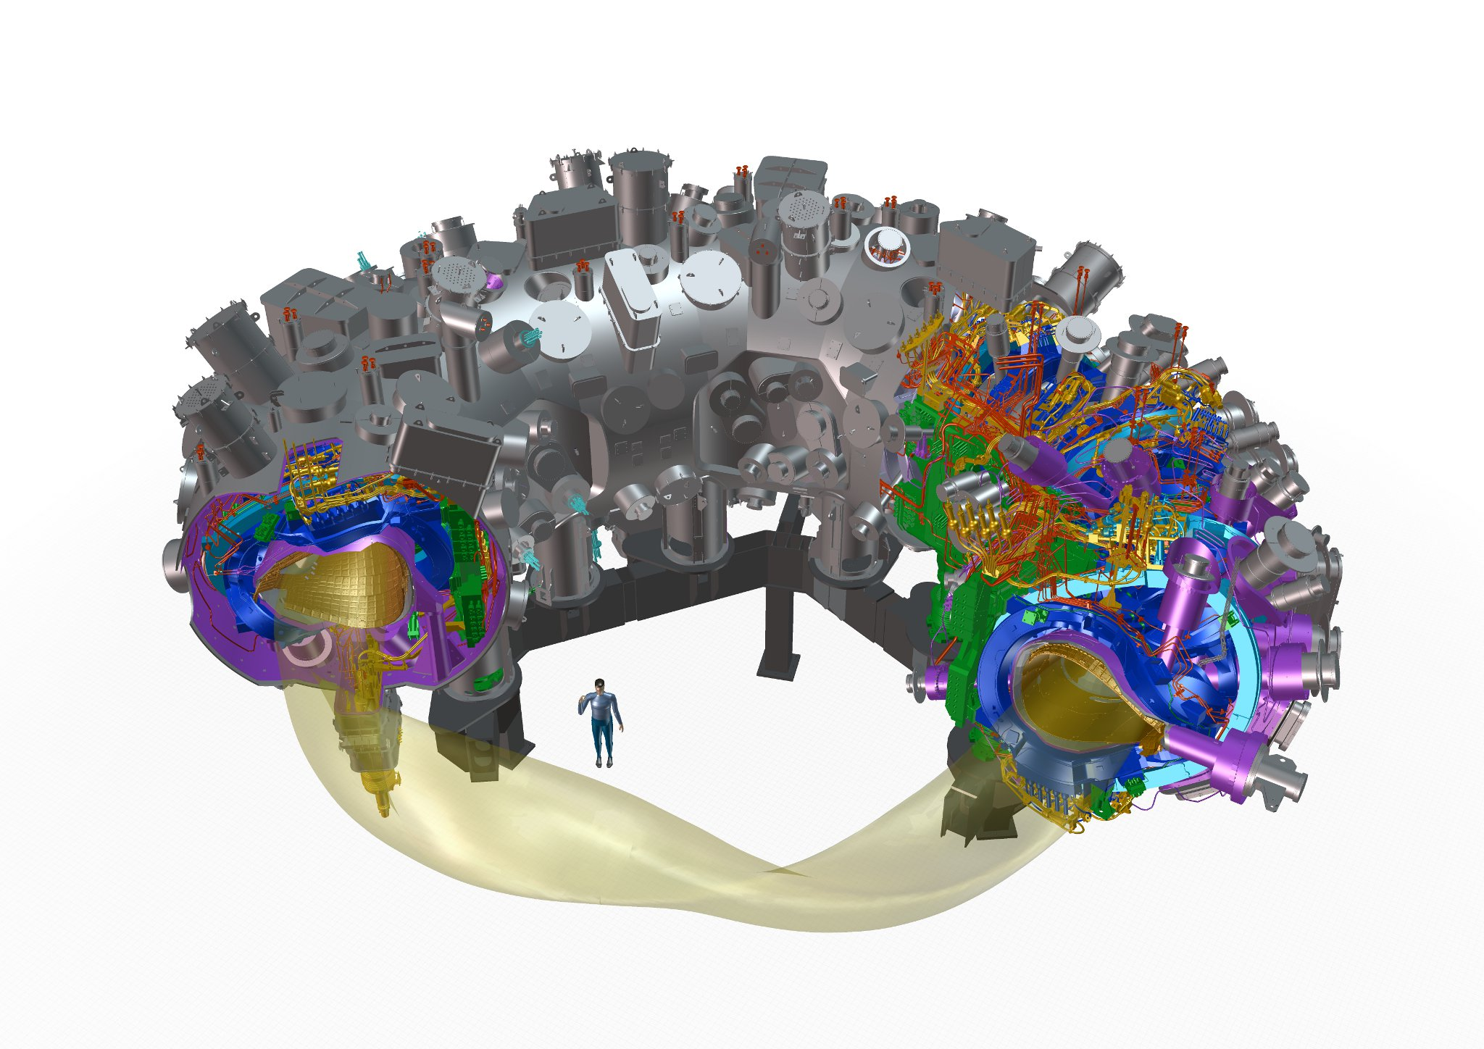
Major device components
five roughly identical modules
254 ports
access domes and instrumentation plugins
cryostat vessel ~ 500 openings
SC bus bar
3d-shaped plasma vessel
He pipes
2500 in-vessel components
cryo feet
machine base
14 HTSC current leads
plasma
50 non-planar 20 planar SC coils
thermal insulation MLI and He gas cooled shield
central support ring
T. Klinger on Wendelstein 7-X 7

Slide 8
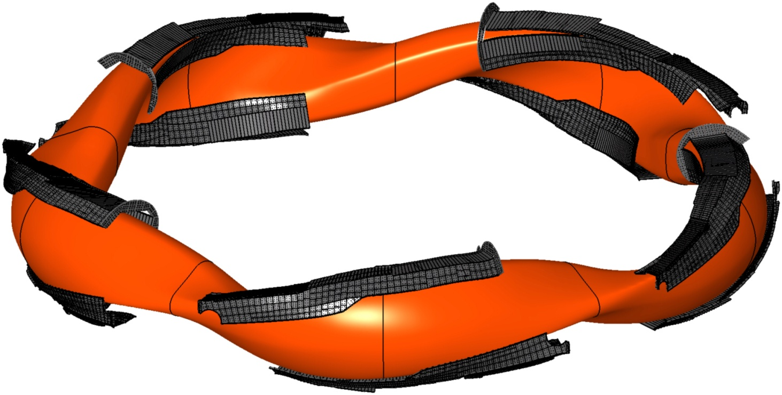
The island divertor concept
intersection of natural magnetic islands with target plates
target plates
plasma contour
divertor units
triangular plane
triangular plane
bean plane
T. Klinger on Wendelstein 7-X 8

Slide 9
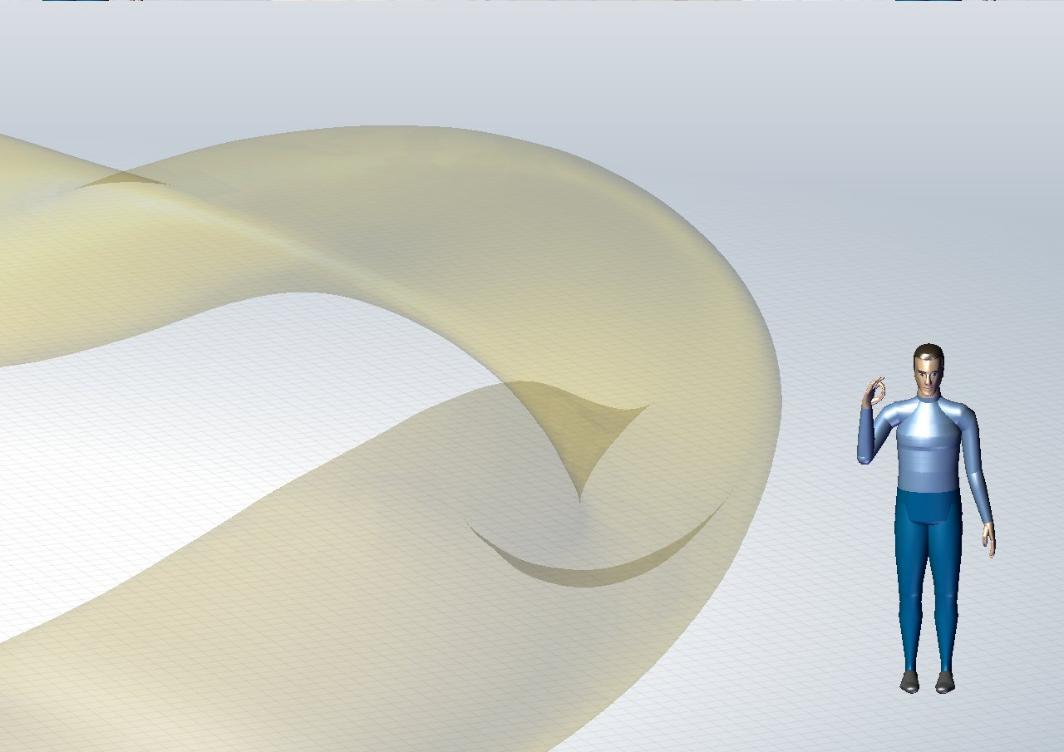
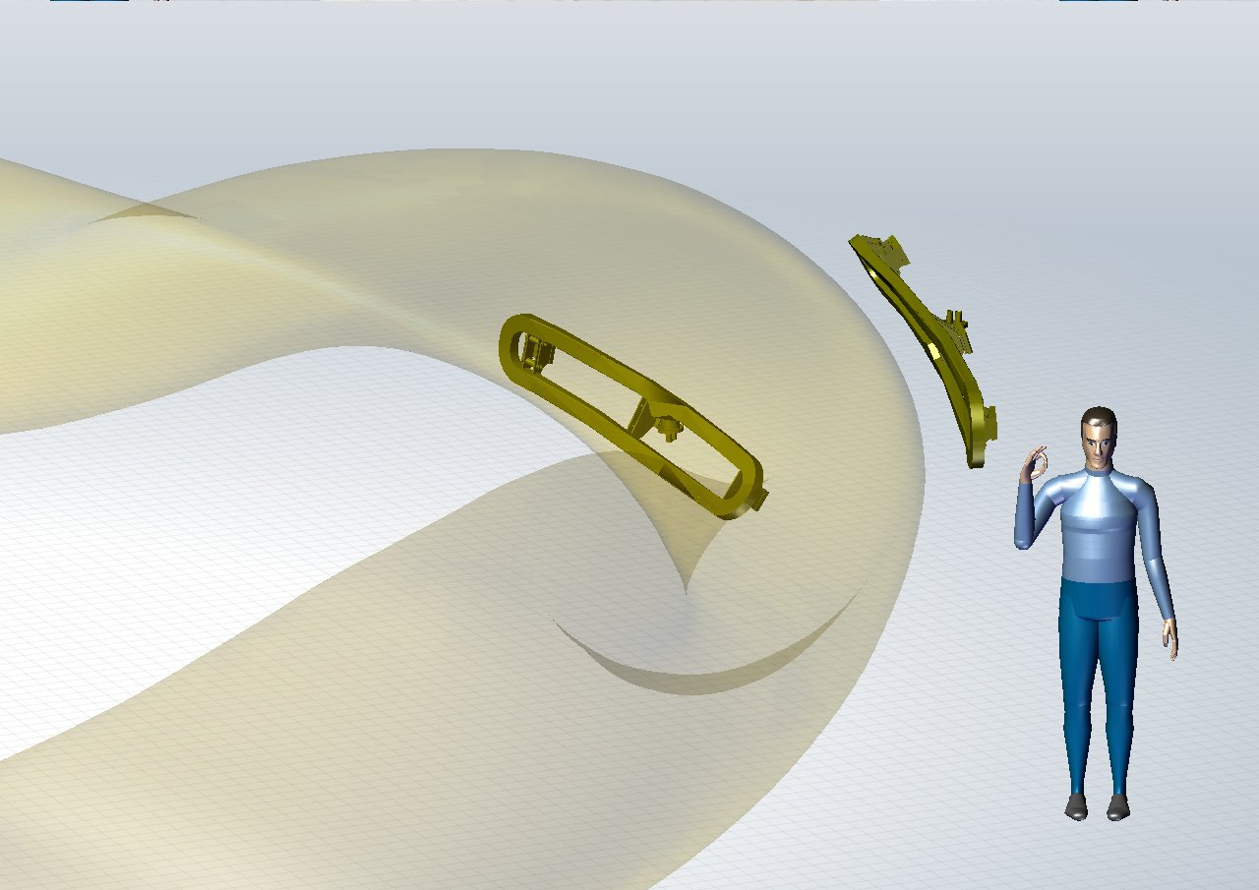
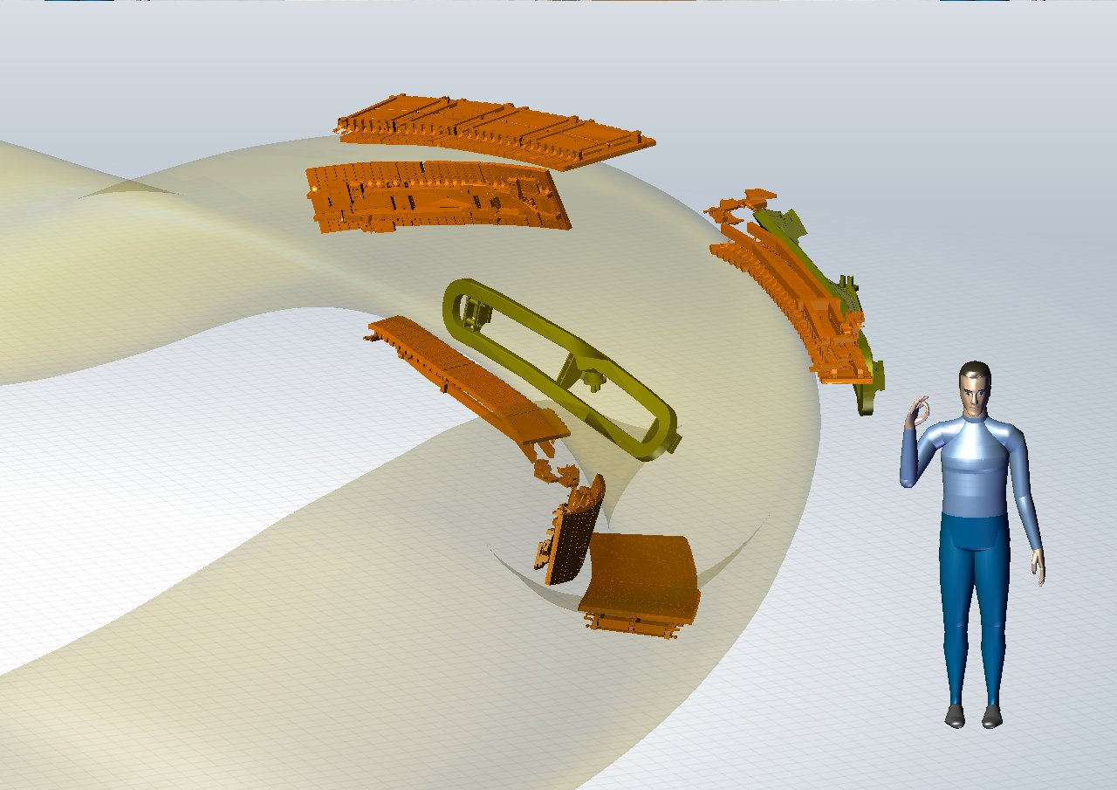
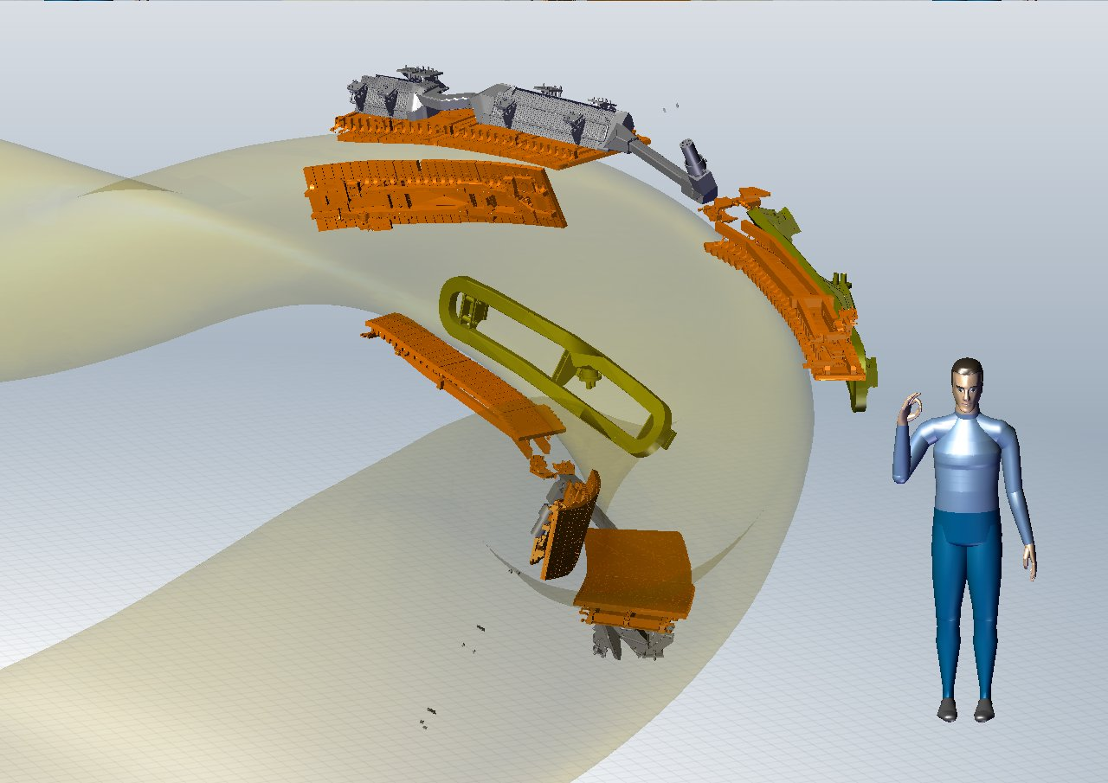
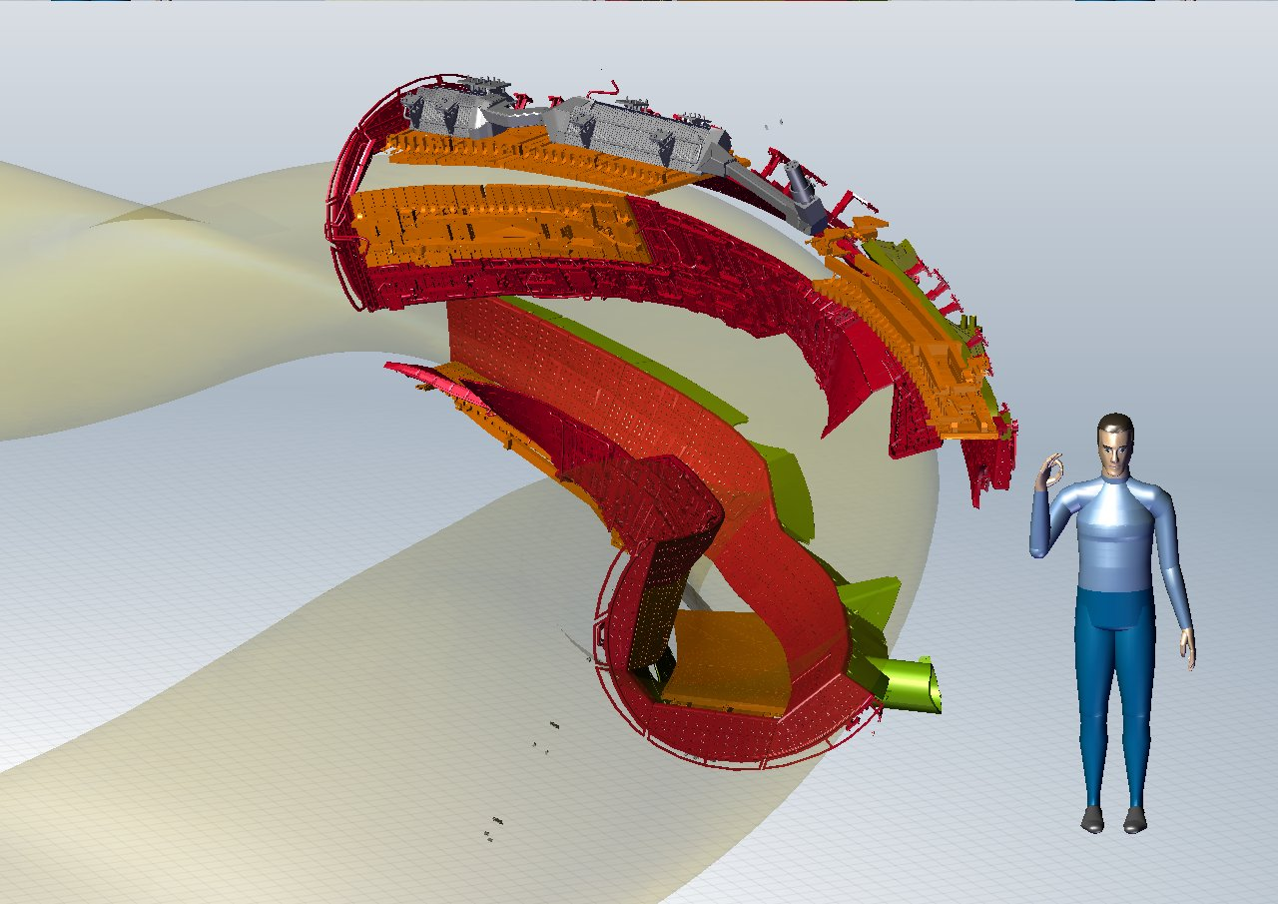
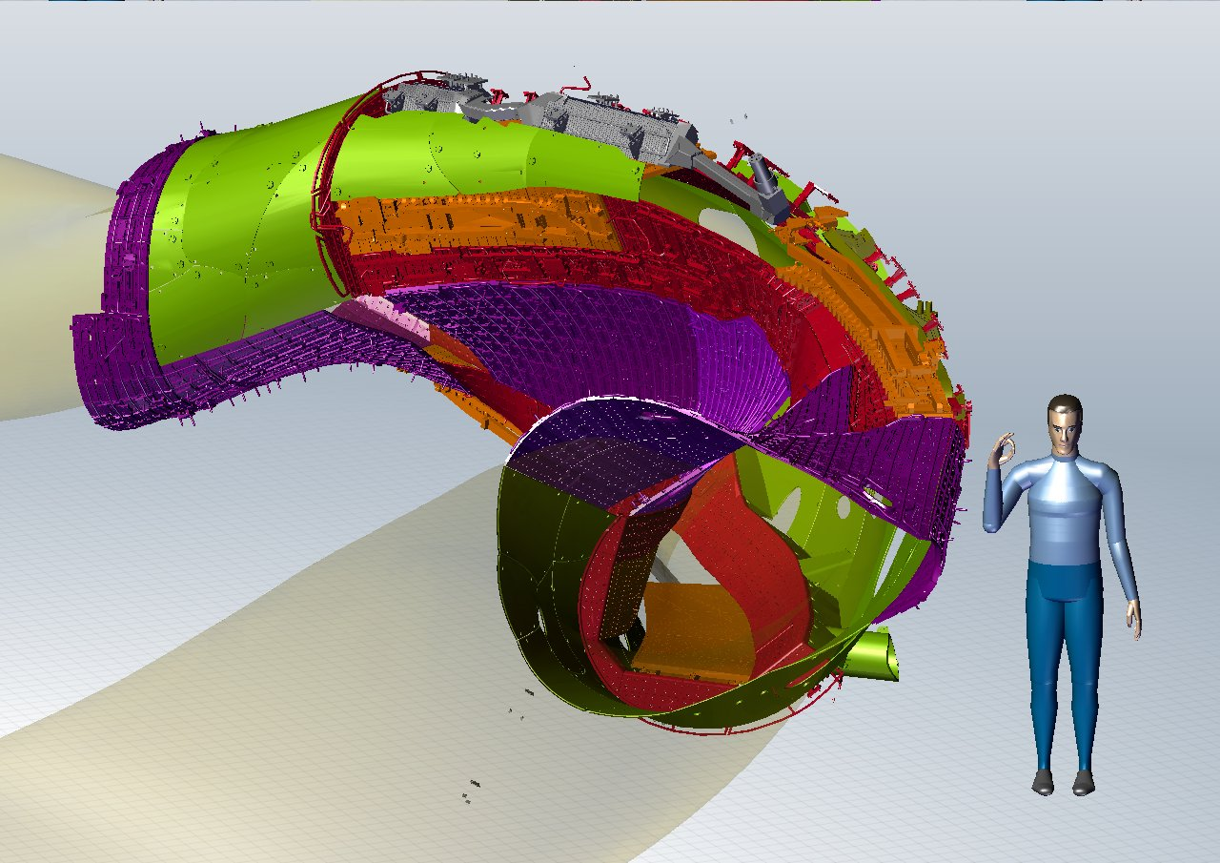
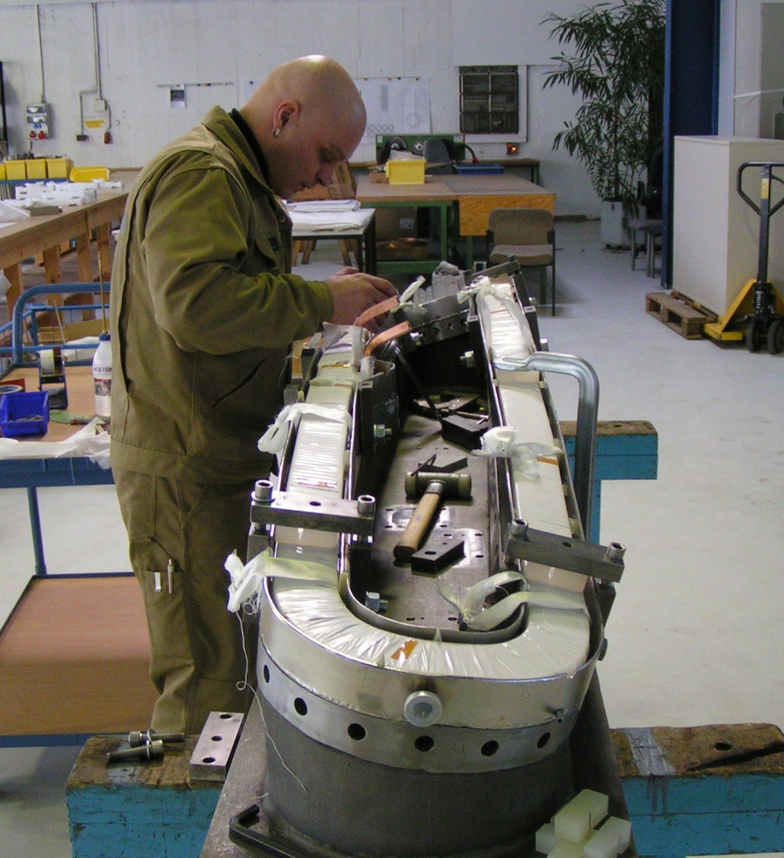
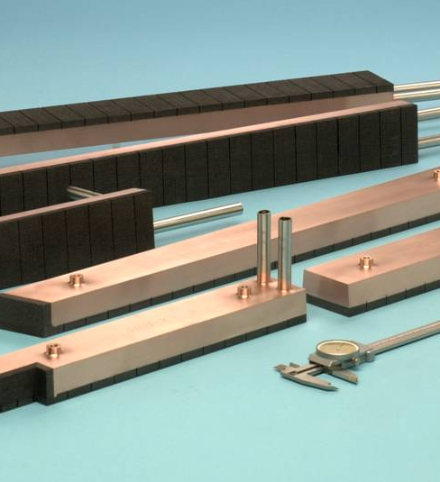
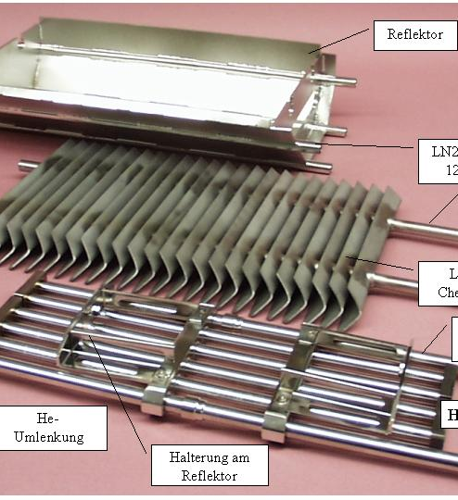
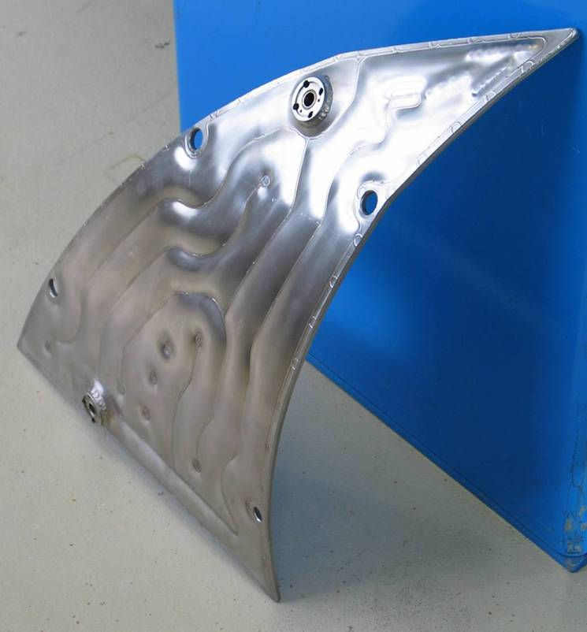
The in-vessel components
actively cooled wall elements heat load from 100kW/m² to 10MW/m²
ten water-cooled divertor control and sweep coils
20m² target elements CFC sealed on cooled CuCrZr
ten cryo pumps
20m² baffle elements graphite clamped on CuCrZr
60m² heat shields graphite bolted on CuCrZr and 60m² steel panels
T. Klinger on Wendelstein 7-X 9

Slide 10
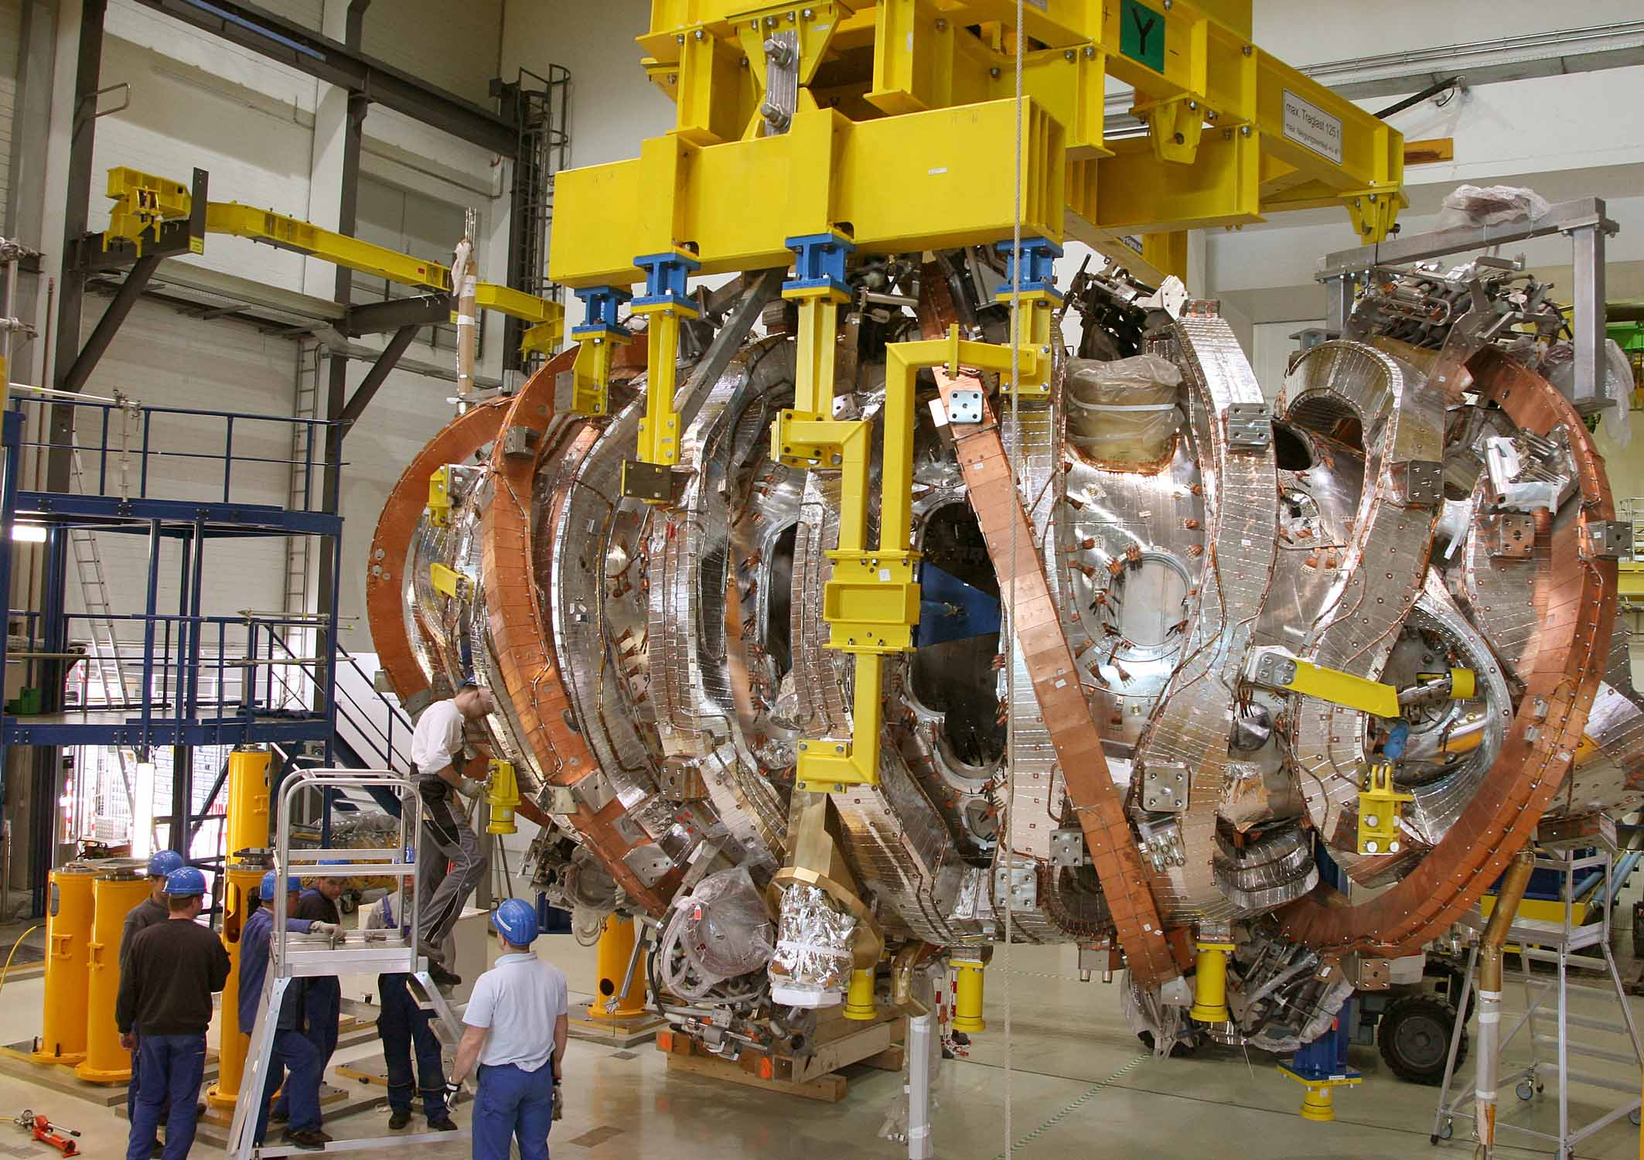
6 Years of Magnet Manufacturing
completed magnet module 14 non-planar and 4 planar coils
T. Klinger on Wendelstein 7-X 10

Slide 11
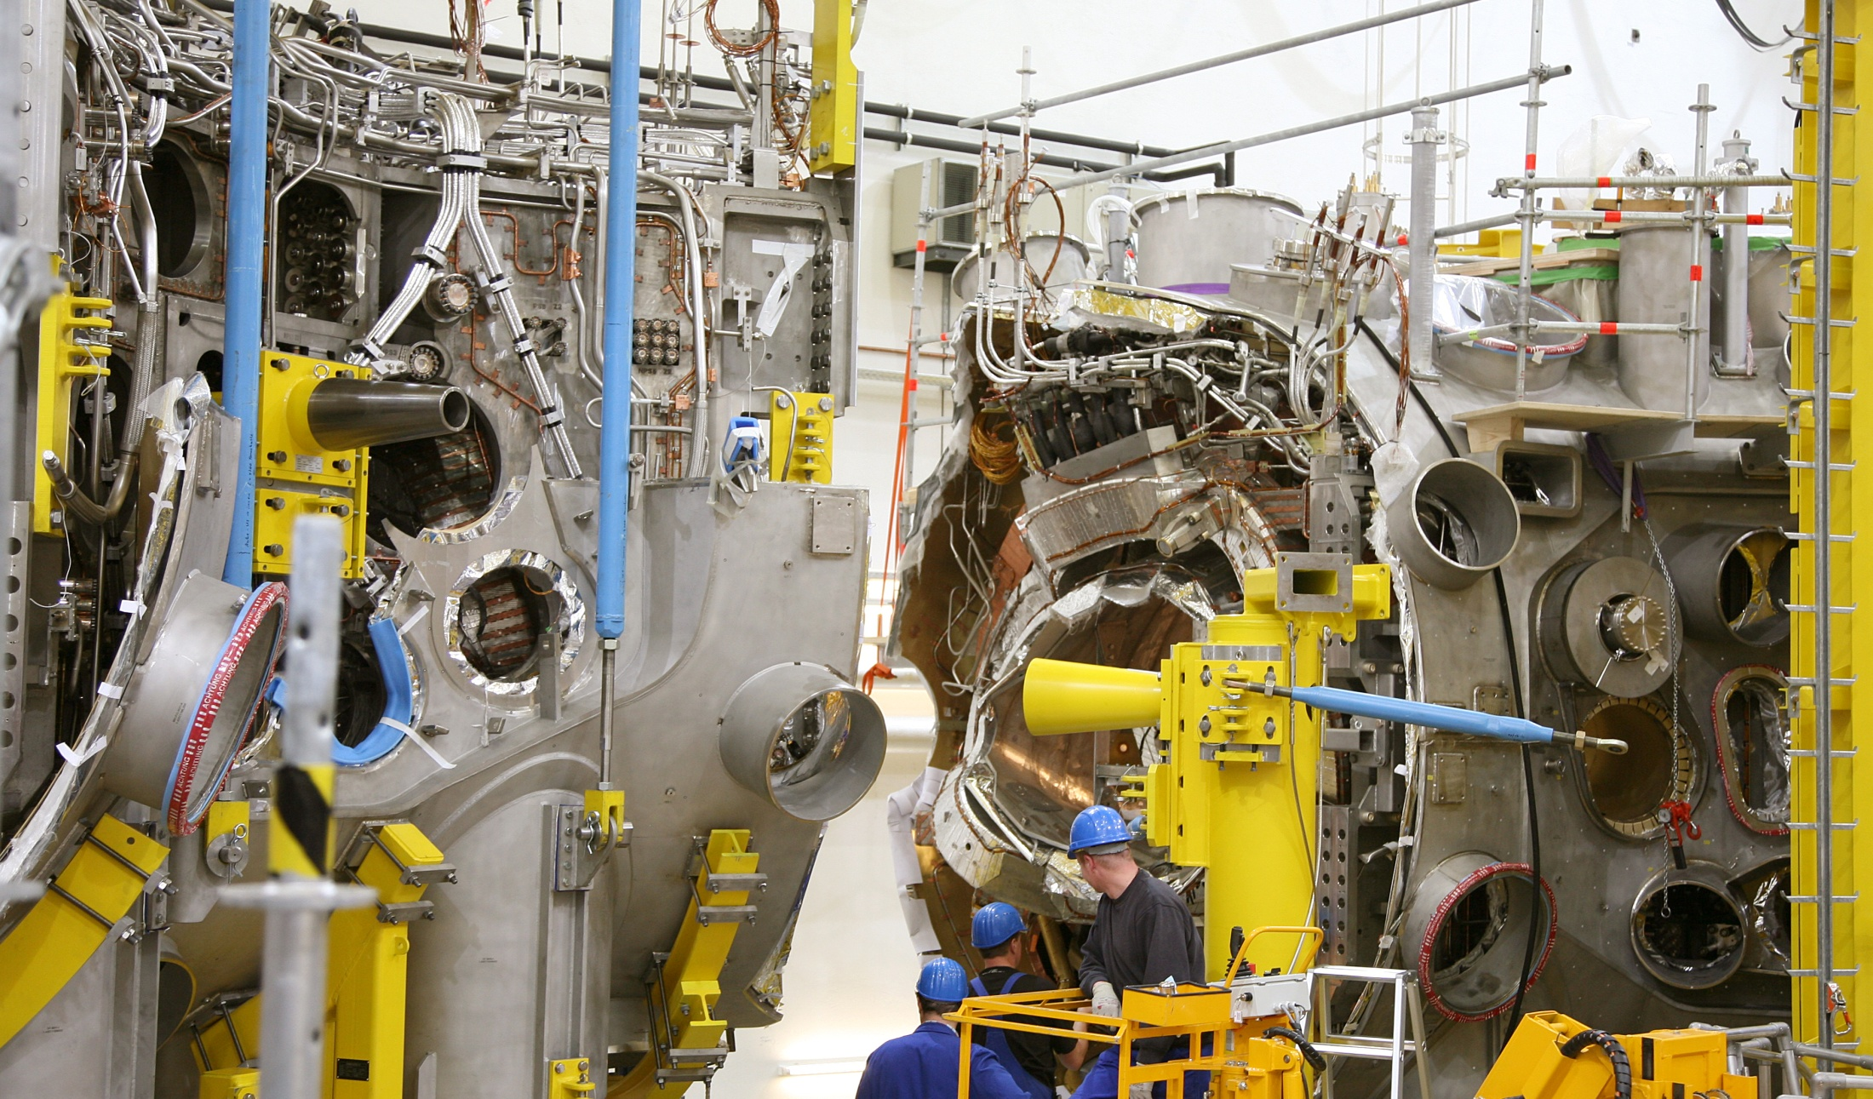
10 Years of Device Assembly
high-precision joining two magnet modules 130 t dead weight each
T. Klinger on Wendelstein 7-X 11

Slide 12
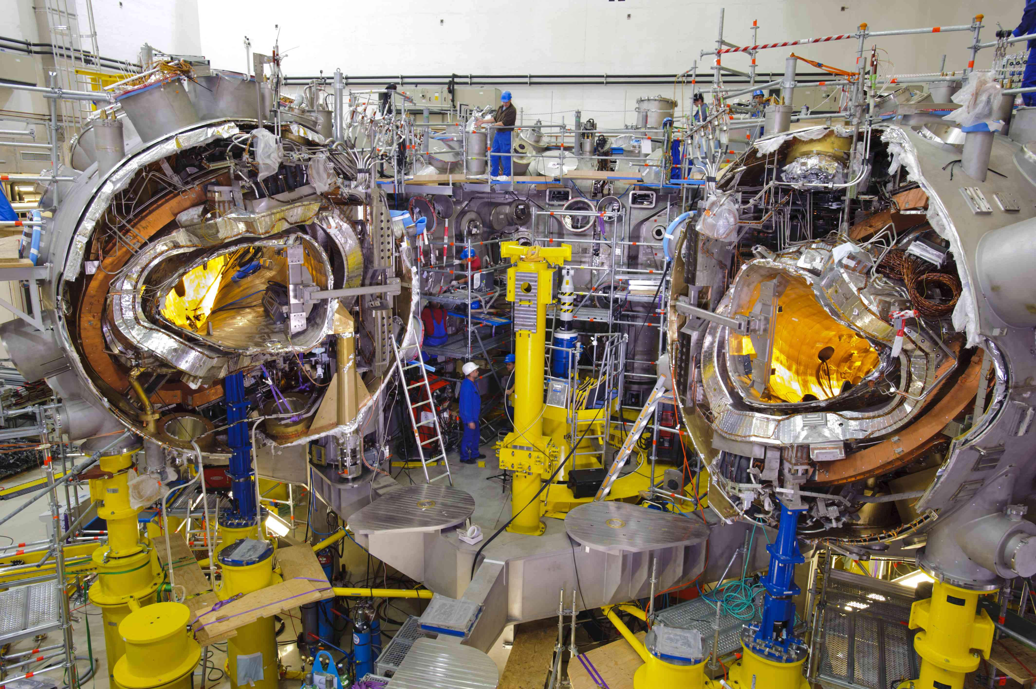
Assembly status overview
all 5 modules are completed and on the machine base
assembly of the 254 ports close to completion
all module separation planes closed
magnet system completed
in-vessel assembly works started
the project is on schedule since > 5 y
T. Klinger on Wendelstein 7-X 12

Slide 13
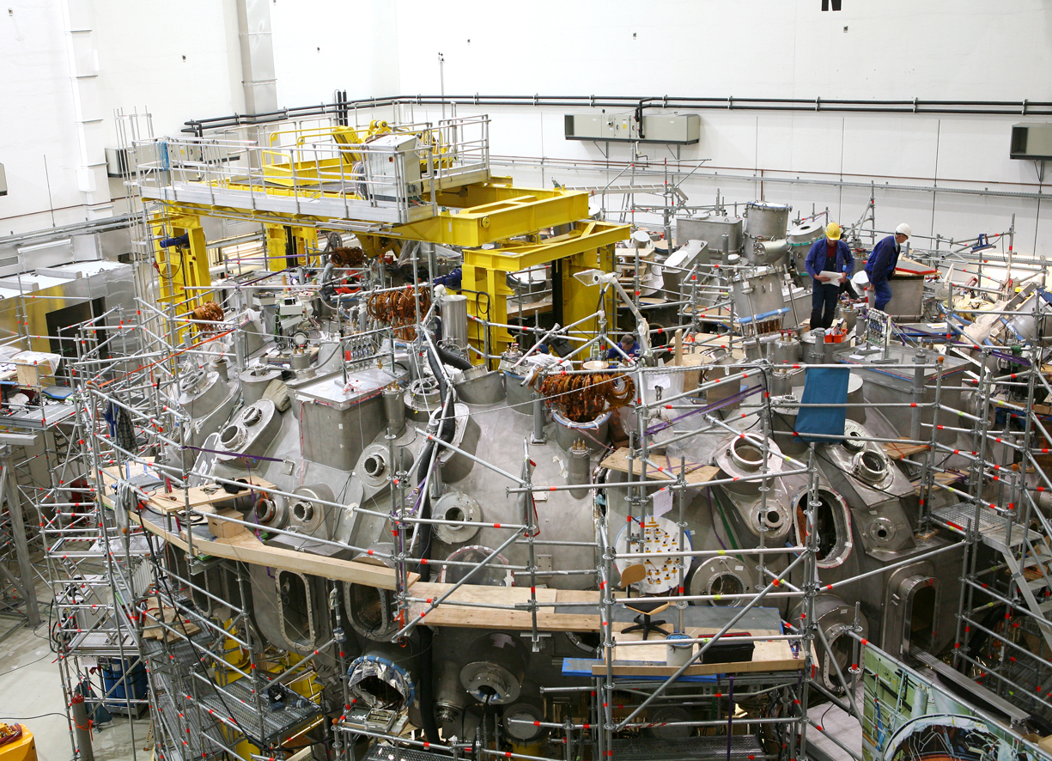
Present view of the assembly site
T. Klinger on Wendelstein 7-X 13

Slide 14
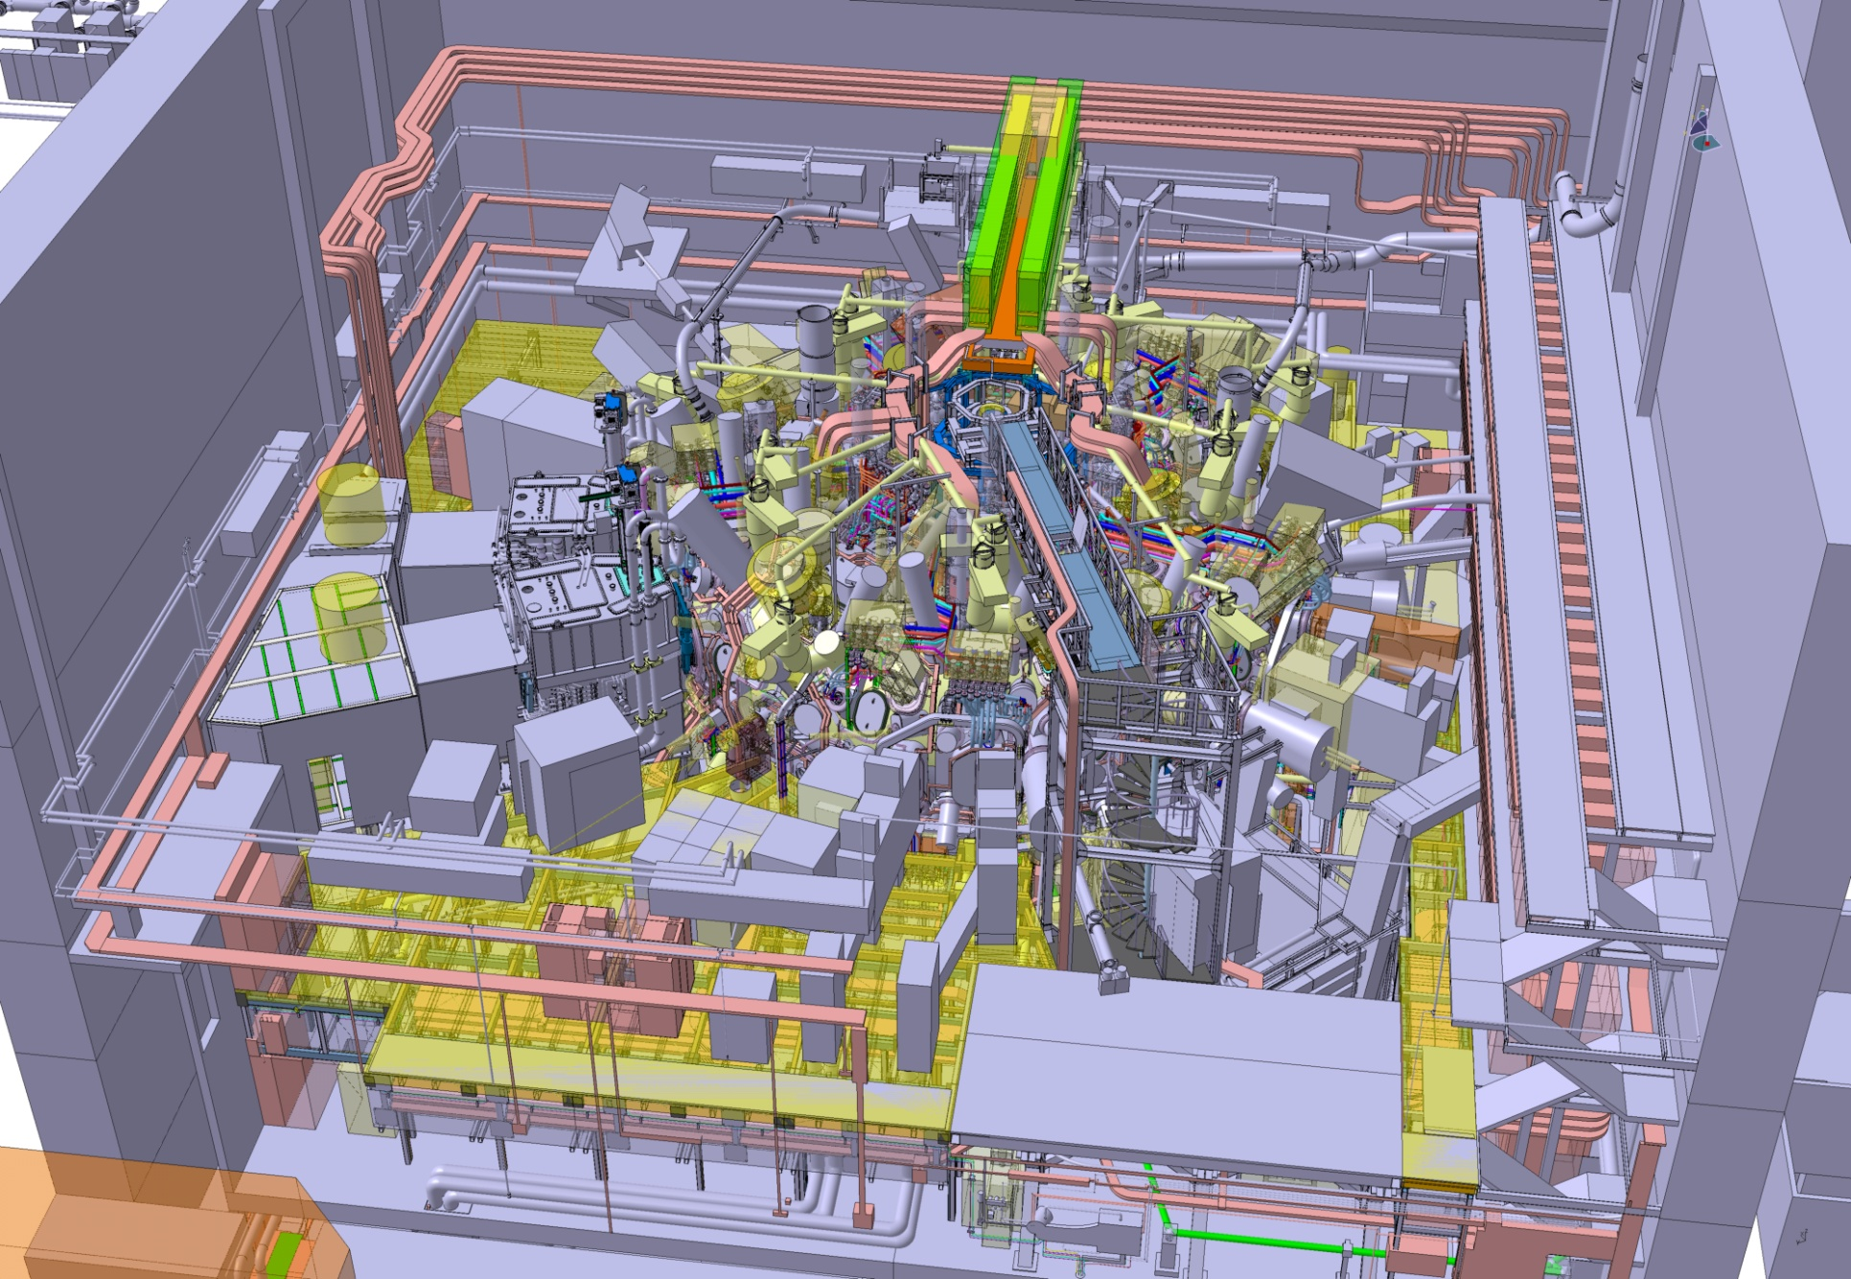
A view into the torus hall 2014
T. Klinger on Wendelstein 7-X 14

Slide 15
Research needs towards DEMO
verification of stellarator optimization points 1.-6. the physics is well understood; goals can be reached during the first few years of operation including high-β and fast particle confinement
high densities, high temperature, good energy confinement energy confinement must be as good as for a similar size tokamak at low collisionality, high-β and high-nTτ (integrated scenarios)
density control with central fuelling neoclassical thermodiffusion leads to hollow density profiles controlled high density operation with central pellet fuelling
no impurity accumulation at high densities the ambipolar electric field tends to be negative radiation collapse in ELM-free H-mode – HDH mode as solution?
viable divertor performance high density ≤ 2⋅10²⁰ m⁻³ operation with steady-state 10 MW/m³ heat load full density control, partial detachment, 90% radiated power fraction
microwave heating of high density plasmas dense plasmas with O2 and overdense plasmas with OXB
T. Klinger on Wendelstein 7-X 15

Slide 16
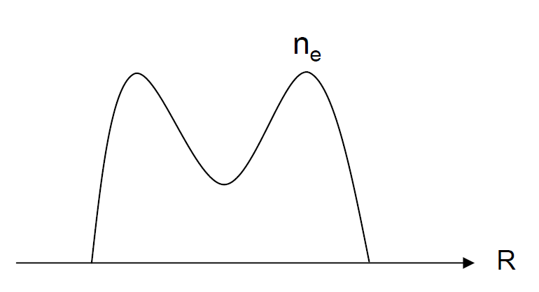
Neoclassical transport
hollow density profiles
D_{2a}>0 outward thermodiffusion
the D‘s are larger for the ions than for the electrons
(4)
inward E_{r} causing impurity accumulation
T. Klinger on Wendelstein 7-X 16

Slide 17
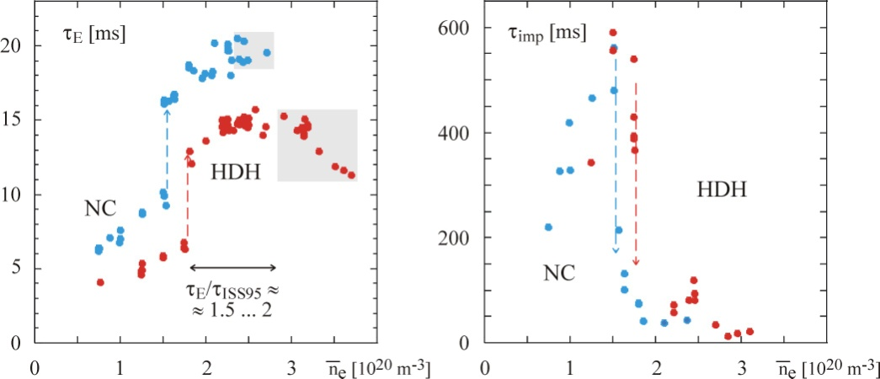
Wendelstein 7-AS HDH Mode
(4)
high density H-mode
not well understood
McCormick et al. PRL (2002)
T. Klinger on Wendelstein 7-X 17

Slide 18
Wendelstein 7-X Forecast
Numerical simulations predict good properties:
neoclassical transport strongly reduced
good MHD stability and equilibrium properties
reduced flux of trapped 50 keV particles from the core *
continuous pellet fuelling for density profile control
divertor detachment and high recycling well achievable
divertor magnetic low bootstrap current configurations
* at high <β>
• no major issue was found during the construction period
T. Klinger on Wendelstein 7-X 18

Slide 19
Research plan – first thoughts I
develop credible steady-state scenarios
1st operation phase T=5-10s
8 MW ECRH
3.5 MW H⁺-NBI
controlled high density discharges
shut down
2y
divertor loads and
operation limits
divertor detachment and high recycling
confinement and stability properties
impurity control investigations
dense plasmas with NBI and O2
end of device commissioning
X2 ECCD for edge iota control
high-β plasmas and fast particle confinement
initial impurity transport studies
1st NBI heated plasmas
1st X2-heated plasmas
T. Klinger on Wendelstein 7-X 19

Slide 20
Research plan – first thoughts II
high-power steady state operation
2nd operation phase T=30s … 30min
10 MW ECRH (steady state)
7 MW H⁺-NBI 10 MW D⁺-NBI
5 MW ICRH
HHF steady-state divertor
full scenario
integration
controlled long pulse discharges
…
HHF divertor loads and operation limits
density and impurity control
long pulse full power O2 heating
end of device commissioning
long pulse full power X2 heating and CD
density profile shaping with pellets
β-limit exploration and fast particle physics
1st ICRH heated plasmas
1st NBI heated plasmas
1st X2-heated plasmas
T. Klinger on Wendelstein 7-X 20

Slide 21
A stellarator FPP *
 | Wendelstein 7-X | Stellarator FPP
toroidal magnetic field | 3 T | 5-6 T
plasma volume | 30 m³ | 1500 m³
heating power | 20-30 MW | 600 MW (α) 3 GW (fus)
ECRH heating | X2, O2 | O1
average neutron flux |  | 1 MW/m²
average heat flux | 0.1 MW/m² | 0.4 MW/m²
a few stellarator FPP design aspects
high aspect ratio (R/a > 10) relaxes numerous technical constraints
the coils are basically 3d-shaped ITER TF coils (Nb₃Sn 12 × 7.5 m)
the divertor geometry follows a helical path
shape of wall elements is given by magnetic field topology
enough space for blanket between plasma surface and coil casing (1.3 m)
sufficiently large vertical ports (4.3 × 2.2 m²)
* Beidler et al., Coordinated Working Group Meeting (2012)
T. Klinger on Wendelstein 7-X 21

Slide 22
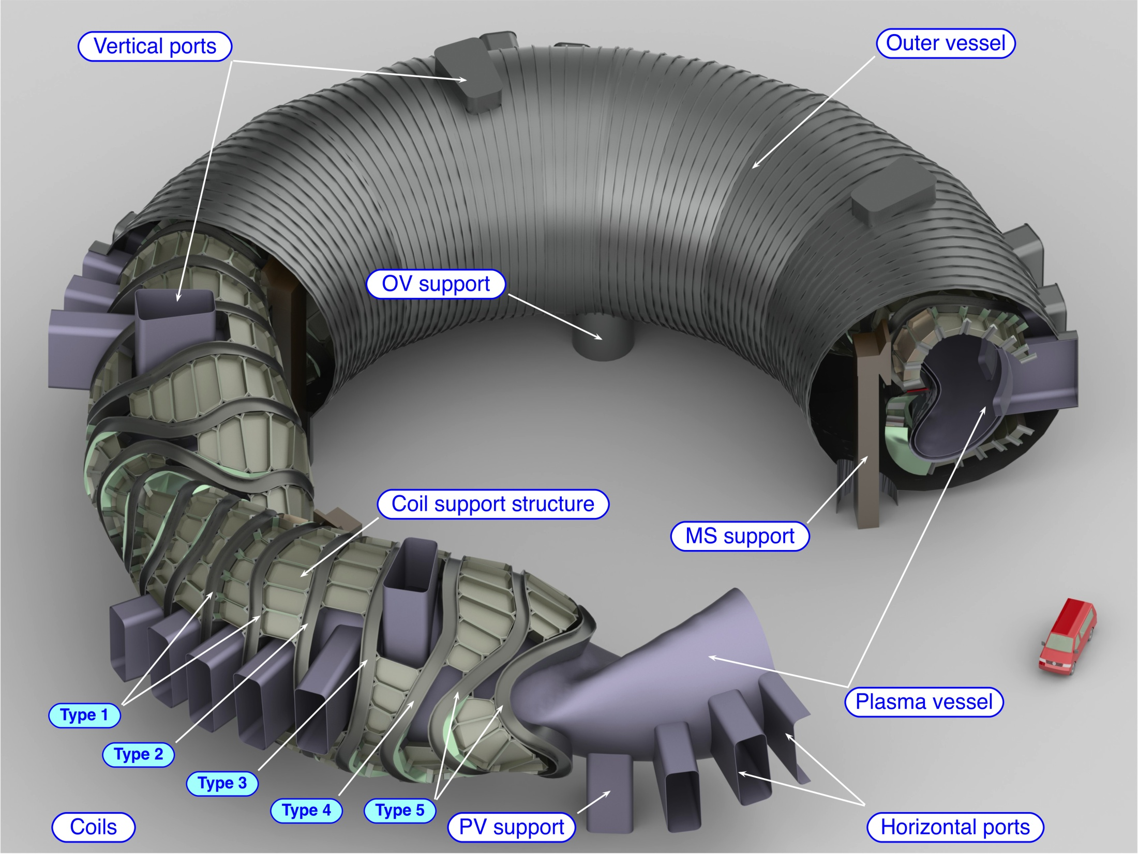
A stellarator DEMO study
Schauer et al., SOFT 2012
T. Klinger on Wendelstein 7-X 22

Slide 23
Conclusions
The construction of Wendelstein 7-X is still on track.
The last three major work packages have been launched.
Technical challanges are ahead.
There are many lessons learned.
The Wendelstein 7-X research plan is under development.
The knowlede base is continuously extended.
A research plan will be developed jointly with our partners.
The major goals are - relevant plasma performance
- high power steady-state operation
- full scenario integration
The research is targeted towards a stellarator FPP.
T. Klinger on Wendelstein 7-X 23

