Slide 1
Strongly interacting matter in an external magnetic field
Pavel Buividovich
(Regensburg University)
DPG Jahrestagung, Dresden, March 4-8, 2013

Slide 2
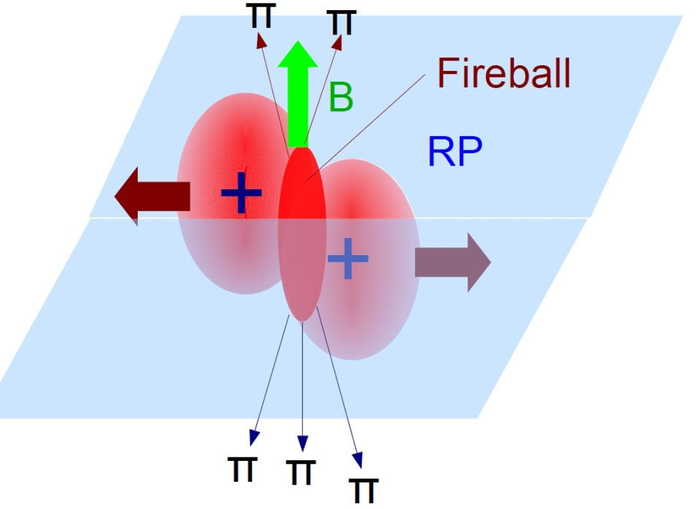
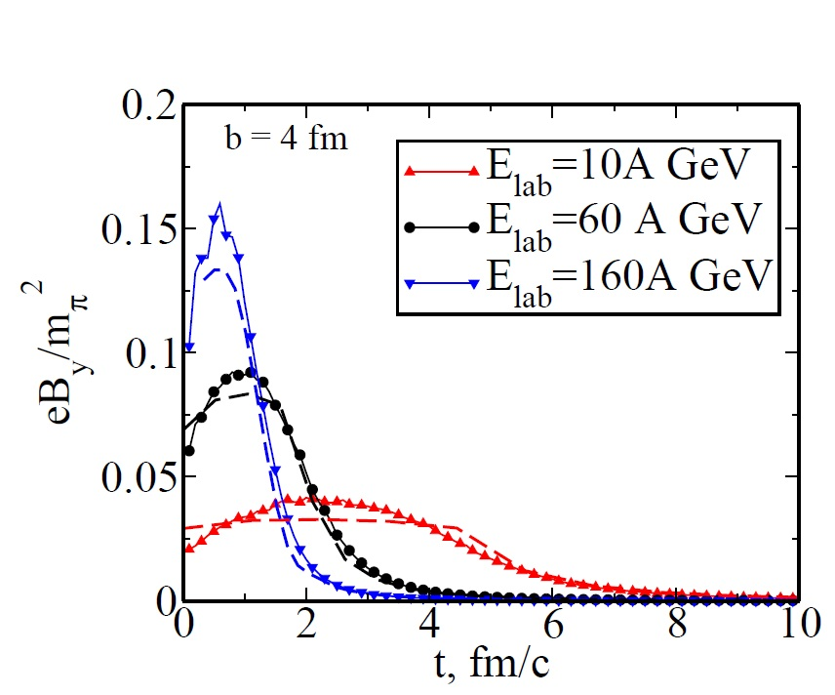
Generation of magnetic fields in heavy-ion collisions
Relative motion
of two large charges (Z ~ 100)
Large magnetic field
in the collision region
URQMD simulations Au+Au
No backreaction
From [Skokov, Toneev,
ArXiv:0907.1396]
Weak energy dependence!!!

Slide 3
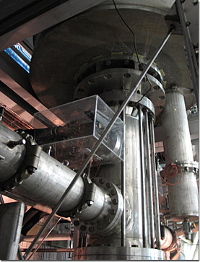
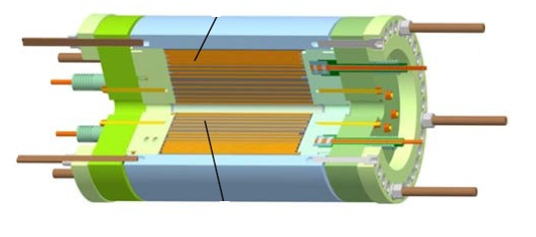
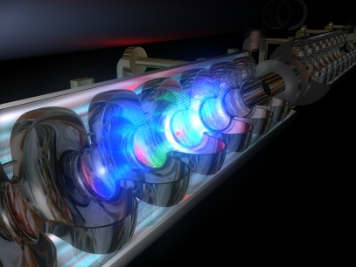
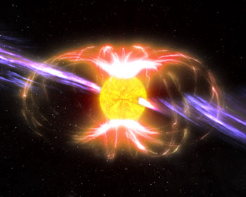
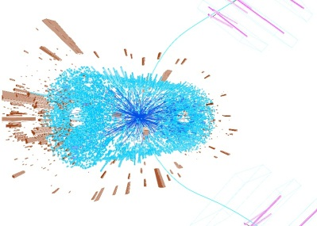
Sources of superstrong magnetic fields
Highest static magnetic fields (NHMFL, USA)
B = 45 Tl, (eB)^{1/2} ~ 10 eV
Highest pulse magnetic field (High Magnetic Field
Laboratory Dresden):
B = 91 Tl, (eB)^{1/2} ~ 10 eV, t ~ 10⁻³ s
Strong laser pulses (e.g. PHELIX (Darmstadt) or XFEL (Hamburg)):
B ~ 10⁷ Tl, (eB)^{1/2} ~ 0.01 … 0.1 MeV, I ~ 10²³ W/cm²
Magnetars: compact rotating stars
B ~ 10¹⁰ Tl, (eB)^{1/2} ~ 1 MeV
Heavy-ion collisions (RHIC, BNL, USA):
B ~ 10¹⁵ Tl, (eB)^{1/2} ~ 100 MeV - Nuclear Scale!!!

Slide 4
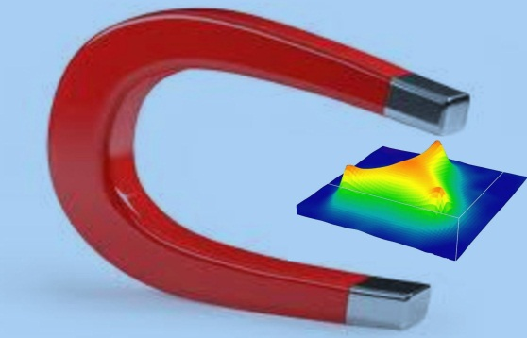
Why superstrong magnetic fields in QCD?
Potentially strong influence on the properties of quark-gluon plasma and cold hadronic matter
Possible bias in
heavy-ion collision experiments
Some decay channels could open/close
From theorist’s point of view: a nontrivial probe of QCD vacuum
Unique interplay between QED and QCD phenomena

Slide 5
Some magnetic phenomena to be considered in this talk
Chiral Magnetic Effect = Electric current along the magnetic field
Magnetically induced conductivity/superconductivity
Chiral Magnetic Wave
Shift of meson masses in magnetic field and new decay channels
Magnetic catalysis
Shift of the deconfinement phase transition

Slide 6
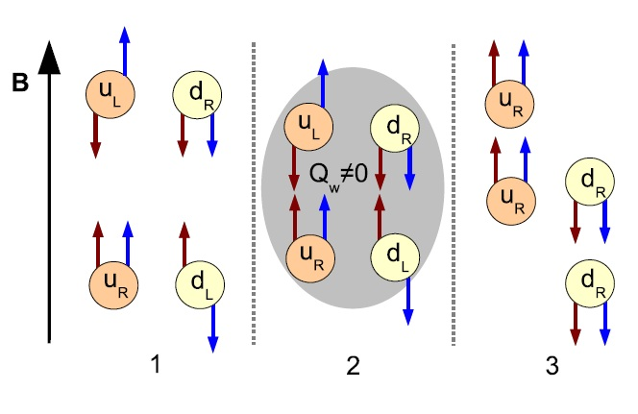
Chiral Magnetic Effect [Kharzeev, McLerran, Warringa, ArXiv:0711.0950]
Spin X Charge || Magnetic field
Chirality: spin (anti)parallel
with momentum
Topology change
Chirality flip [Atyah, Singer]
Current || Magnetic field
In real QCD vacuum:
Fluctuations of topological charge
Fluctuations of electric current
and charge
Specific anisotropies in charged hadron distributions
Spin
Momentum
[Lattice study, P. V. Buividovich]

Slide 7
Charge fluctuations in QCD vacuum with magnetic field
[P. V. Buividovich et al., ArXiv:0907.0494]

Slide 8
Chiral Magnetic Effect: experimental consequences [S. Voloshin, hep-ph/0406311]
Domains of positive/negative chirality imbalance in fireball
Preferential emission of π⁺/π⁻ above/below reaction plane
Zero for symmetric
rapidity interval
a,b = +/- labels positively/negatively charged pions
φ_{a} - Ψ, φ_{b} – Ψ – azimuthal angles w.r.t. reaction plane
Three-particle correlator: π⁺/π⁻ and reaction plane

Slide 9
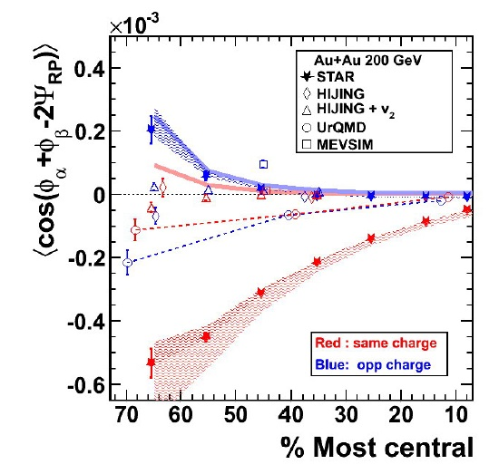
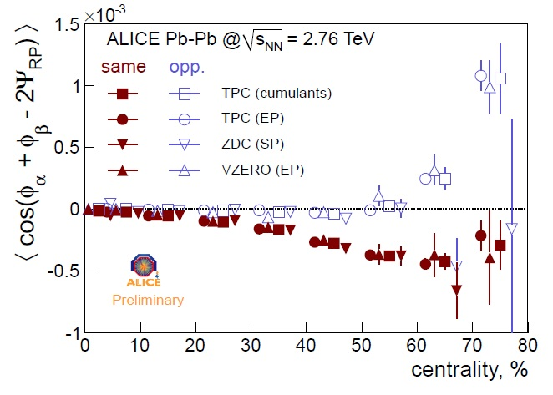
Chiral Magnetic Effect: experimental consequences
[ALICE Collaboration, ArXiv:1203.5230]

Slide 10
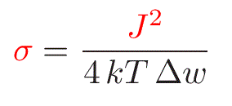
Magnetically induced conductivity [Buividovich et al., ArXiv:1003.2180]
Fluctuations of electric current at T ≠ 0
Electric conductivity
(Fluctuation-dissipation theorem)
Niquist formula
QCD
QCD vacuum: insulator below T_{c} (confinement)
Can magnetic field induce electric conductivity?
We need real-time current-current correlators!!!

Slide 11
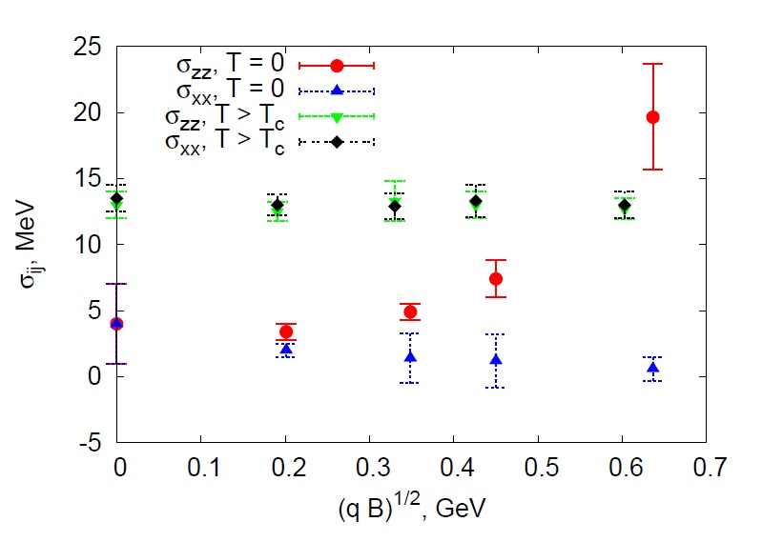
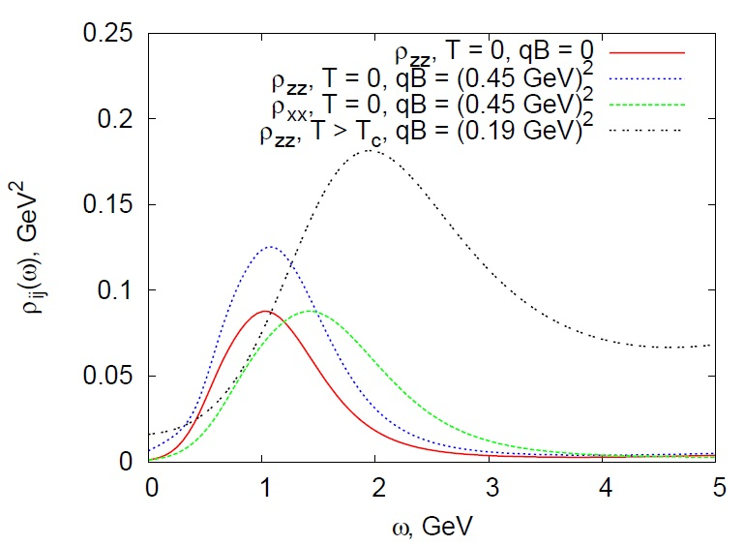
Magnetically induced conductivity: Numerics
From
[Buividovich et al.,
ArXiv:1003.2180]
Conductivity is anisotropic (along the field)
No effect in conducting phase (above T_{c})!!!
Which excitation transports electric charge???

Slide 12
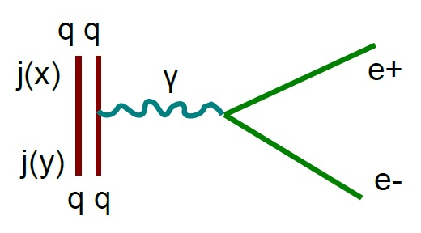
Magnetically induced conductivity: Experimental consequences
Vector spectral function:
Dilepton emission rate [McLerran,Toimela’85]:
More soft leptons in the reaction plane +
More leptons for off-central collisions

Slide 13
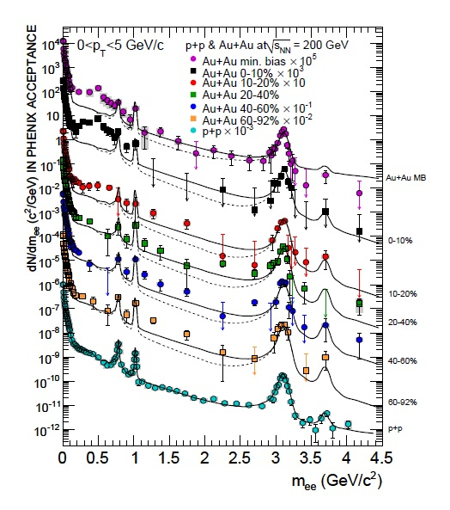
Magnetically induced conductivity: Experimental consequences
Experimental data [PHENIX, ArXiv:0912.0244]:
More dileptons for central collisions…

Slide 14
Chiral Magnetic Wave [Kharzeev, Yee, ArXiv:1012.6026]
Chiral Magnetic Effect:
Chiral Separation Effect:
Magnetic
Field
Vector Current
(Left + Right)
Axial Current
(Left - Right)
Axial Chemical Potential (Left - Right)
Vector Chemical Potential (Left + Right)
Equation of state
Current conservation

Slide 15
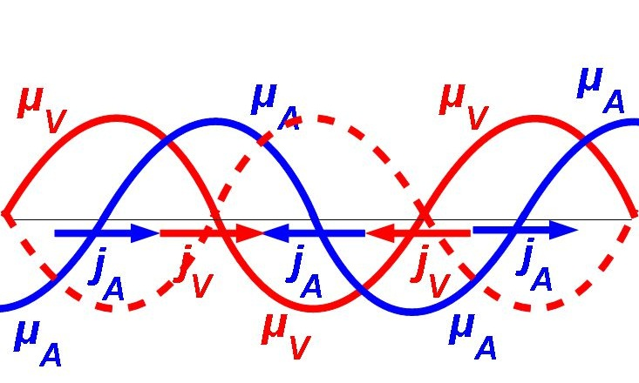
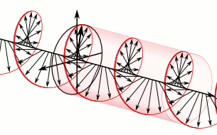
Chiral Magnetic Wave [Kharzeev, Yee, ArXiv:1012.6026]
Equation of Chiral Magnetic Wave:
Left-handed fermions move to the left
Right-handed fermions move to the right
The wave only propagates along the field

Slide 16
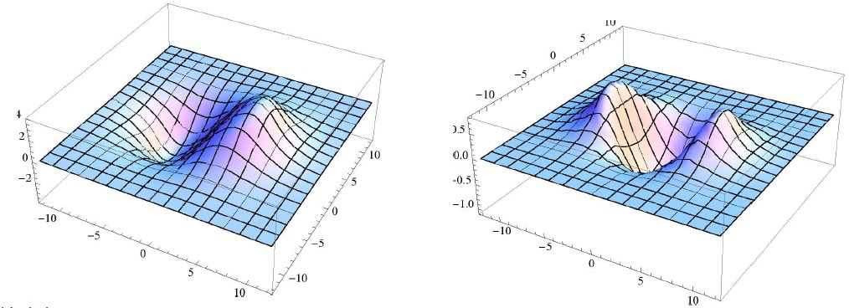
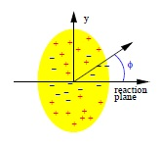
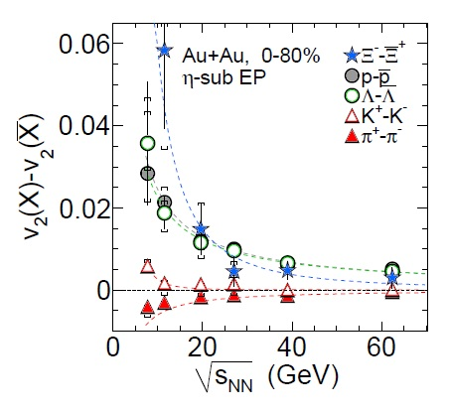
Chiral Magnetic Wave and Quadrupole Electric Moment [Y. Burnier et al., ArXiv:1103.1307]
“Standing” CMW in a nucleus:
Axial charge
Electric charge
Different elliptic flows (v2)
for π+ /π- . Indications found
in [STAR Collaboration,
ArXiv:1301.2347]

Slide 17
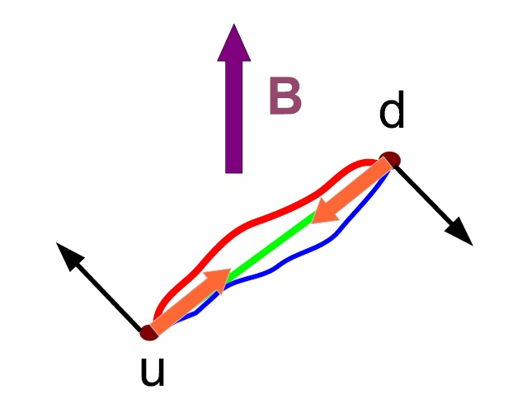
Shift of hadron masses [A prologue to magnetic superconductivity]
Landau levels for relativistic spinning particle:
g - gyromagnetic ratio, s_{z} – spin projection || B
π±-mesons: S = 0
ρ±-mesons: S = 1, g = 2
[Kroll, Lee, Zumino’ 67]
In magnetic field:
ρ± becomes lighter
π± becomes heavier
Notes:
Kroll, Lee, Zumino worked in the parton model – just quark loops

Slide 18
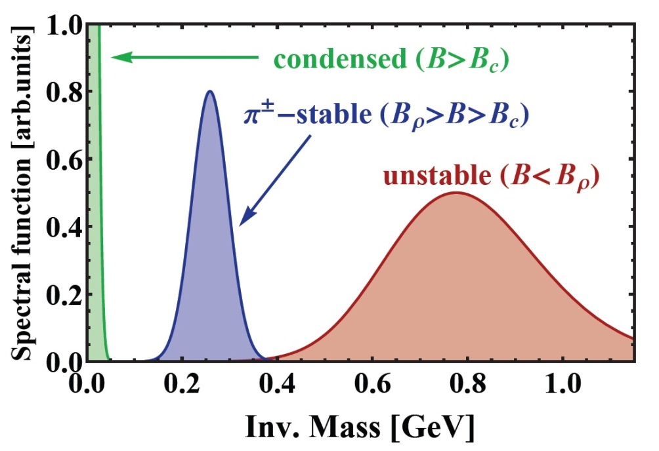
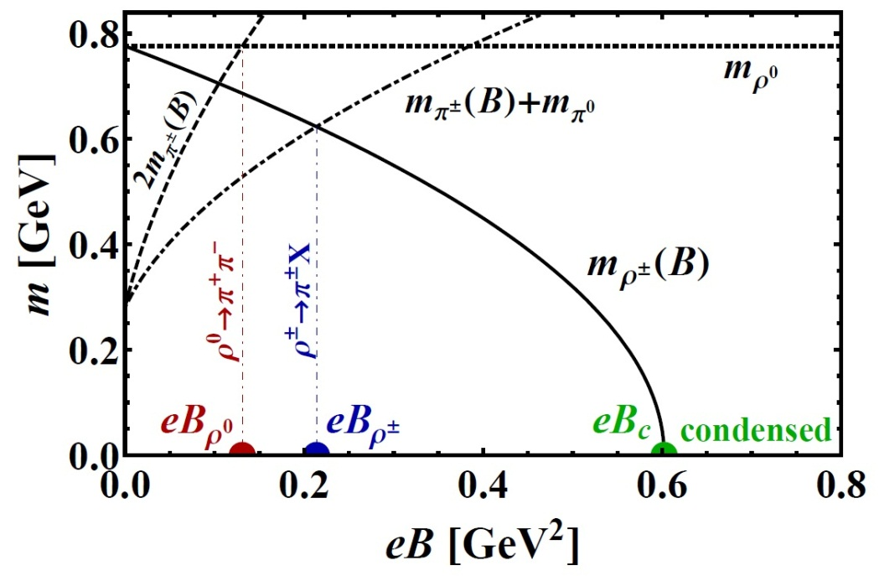
Meson widths and decay channels
π± heavier, ρ± lighter decays ρ± →π±X suppressed
X = π⁰ (99%), η, γ, πππ
Decays ρ⁰ →π⁺π⁻ suppressed
ρ± spectral function
Meson masses vs. eB
[M. Chernodub, ArXiv:1008.1055]

Slide 19
“Magnetic superconductivity” of QCD
[M. Chernodub, ArXiv:1008.1055]
Critical field eB_{c} ~ m_{ρ}²: Tachyon instability
ρ±-mesons might condense
Decays of ρ± suppressed Condensate is stable
ρ±-mesons play the role of Cooper pairs
(Anisotropic) Superconductivity of QCD vacuum
In fact, p-wave superconductivity
Indications of superconductivity from:
Lattice QCD [Braguta et al., ArXiv:1104.3767]
AdS/ QCD [Callebaut et al., ArXiv:1105.2217]
NJL models [M. Chernodub, ArXiv:1101.0117]

Slide 20
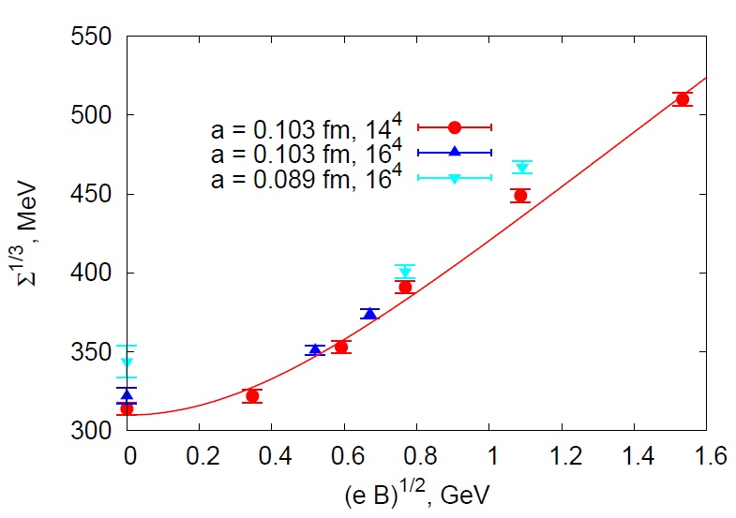
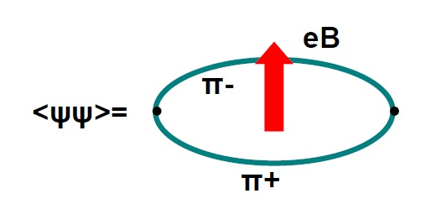
Diamagnetic effects: Magnetic catalysis of Chiral Symmetry Breaking
Dimensional reduction 4D 2D in magnetic field
Increase of the chiral condensate (Σ diverges in 2D)
Σ is saturated by pion loop [Smilga, Shushpanov, ArXiv: hep-ph/9703201] Non-analytic dependence on B in chiral limit!!!
[Buividovich et al.,ArXiv:0812.1740]

Slide 21
Shift of the deconfinement phase transition
Chiral condensate: order parameter for deconfinement phase transition in (massless) QCD
Increase of condensate with magnetic field (ChPT)
Shift of the phase transition to higher temperatures
(for most models + Lattice [D’Elia, 1005.5365])
BUT: Near T_{c} Chiral Perturbation Theory fails…
Nontrivial T_{c}(eB) dependence possible
Chiral and deconfinement transitions might split (Linear σ-model + Polyakov loop)
[Mizher, Chernodub, Fraga, ArXiv:1004.2712]

Slide 22
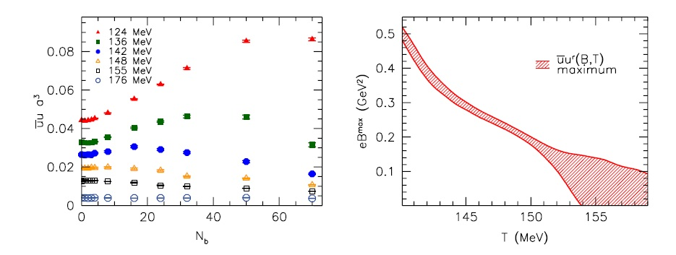
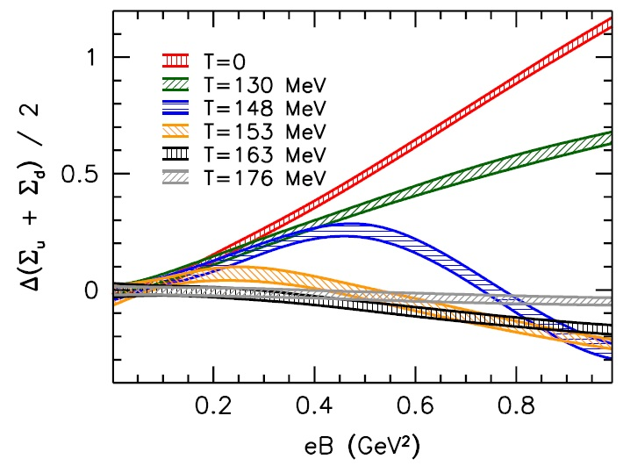
Shift of the deconfinement phase transition: Numerical study [Bali et al., ArXiv:1111.4956]
Slight decrease of the transition temperature -
“Inverse Magnetic Catalysis” (accurate chiral limit!!!)
Agrees with Nf=2 ChPT
[Agasian, Fedorov, ArXiv:0803.3156]

Slide 23
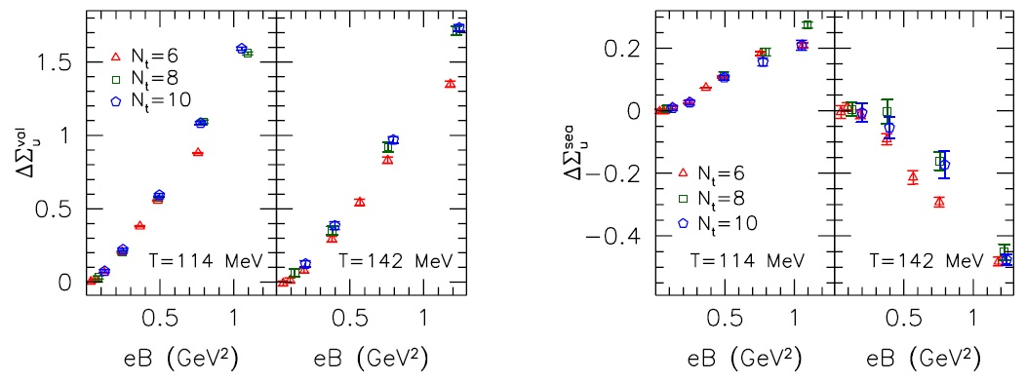
Inverse Magnetic Catalysis
Sea quarks:
suppress small Dirac
eigenvalues
Valence quarks: Chiral condensate ~ density of small Dirac eigenvalues [Banks, Casher’ 80]
[F. Bruckmann et al.’ 2013]

Slide 24
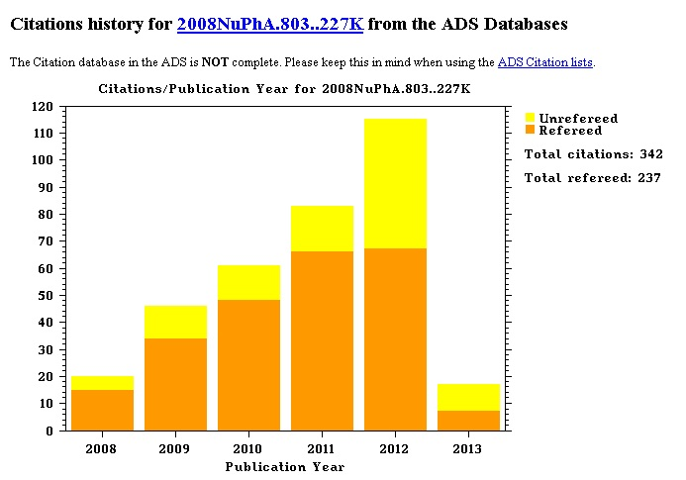
Instead of conclusions

