Slide 1

QCD
die starke Kraft am LHC
Judith Katzy (DESY)

Slide 2

QCD at LHC – motivation
QCD is one of the fundamental forces in the SM – “measure” it!
Stress the model at high precision to look for failures as hints of new physics.
QCD processes are background for almost all SM and BSM processes including Higgs! – Measure them precisely!
LHC measurements are more and more dominated by systematic uncertainties which mainly stem from QCD radiation and PDFs: constrain the parameters!

Slide 3
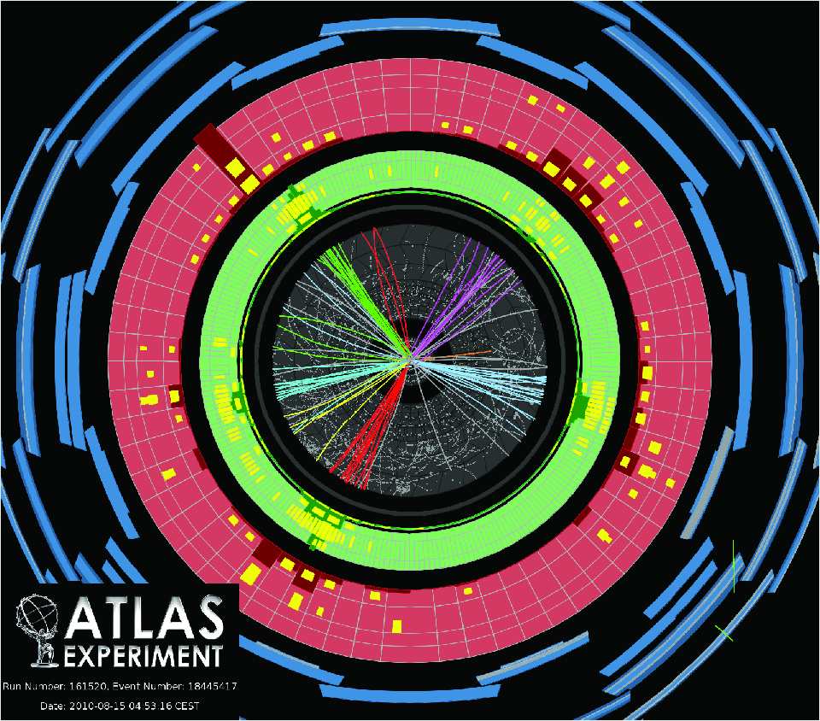
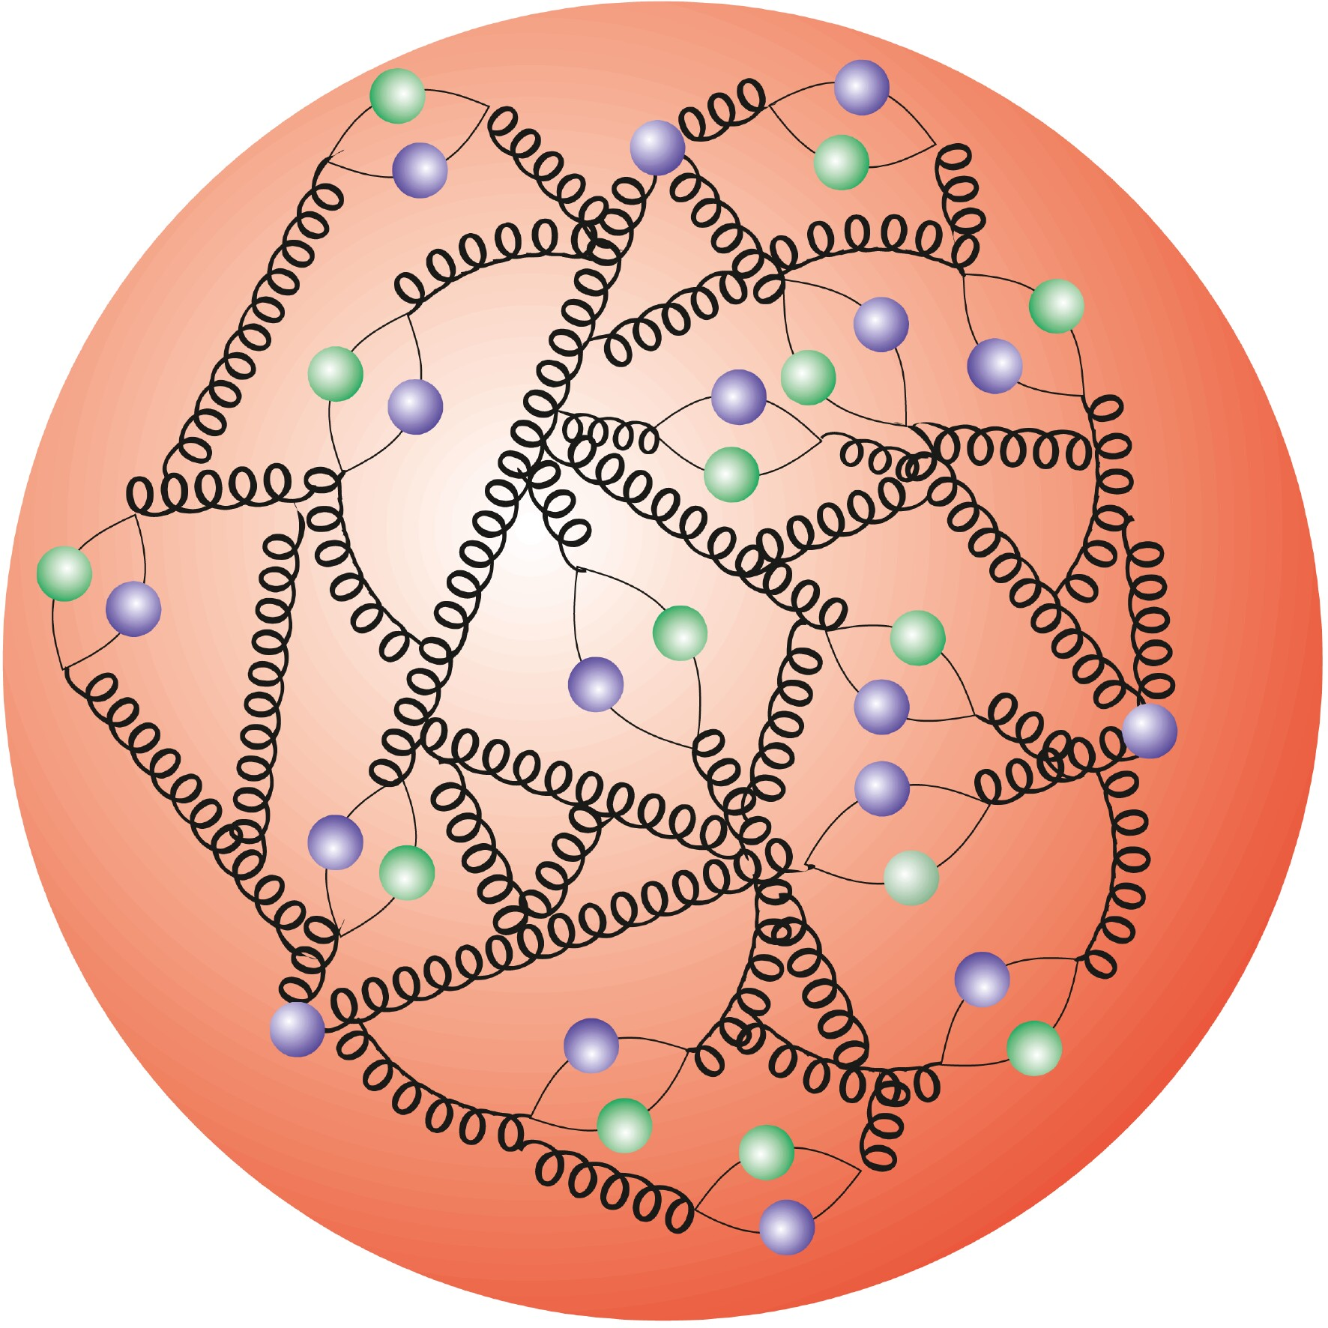
Tests of QCD at LHC
q_{i}
α_{s}
g
q_{j}
g
σ_{tot}(Q)= Σ ( σ_{ij}(Q)*f(x_{i},Q)*f(x_{j},Q))
Perturbative calculations
α_{s} and its running
Structure of the proton
Jet production
Vector Boson + jet production
Top pair production

Slide 4
Prelude: from partons to jets
Non-perturbative
corrections limit
precision at low pt
M.Cacciari

Slide 5
Test of pQCD: Jet measurement
Tevatron limit
Tevatron limit
Jet production described by pQCD up to jet pt of 2 TeV and dijet mass of 5 TeV
Experimentel uncertainty dominated by JES.
Theory uncertainty at high pt dominated by PDF uncertainties.
ATLAS: Phys.Rev. D86 (2012) 014022; CMS: Phys.Rev.D86(2012)014022
Notes:
Dijet mass limit tevatron 1.3 TeV
Production cross section measured with a precision of 6-20%

Slide 6
Test of pQCD: theory comparison
Data can be used to constrain
PDFs in the future
Huge variations in predictions from NLO generators matched to parton showers
ATLAS: Phys.Rev. D86 (2012) 014022; ATLAS-CONF-2012-128; CMS: Phys.Rev.D86(2012)014022

Slide 7
Test pQCD and α_{s}: Multi-jet ratio
R₃₂ = N(3jets)/N(2jets)
Measurement uncertainties largely suppressed by taking the ratio
Test pQCD and extract α_{s} at highest scale
^{CMS PAS QCD-11-003}
Notes:
Pt>150 GeV

Slide 8
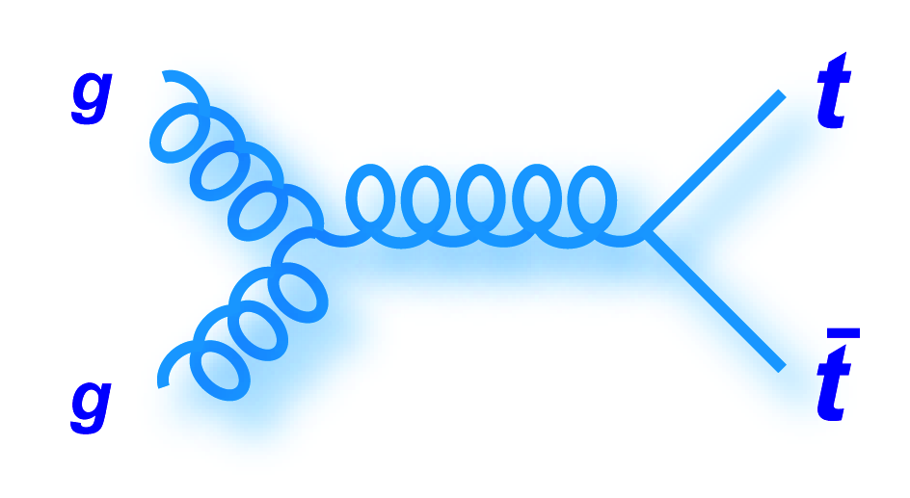
Test pQCD at high scales: Top
Top quarks (m_{top}~173 GeV) dominantly produced in top – anit-top
pairs via gluon-gluon fusion
Probe QCD – pQCD calculations at approx. NNLO exist
Constrain to gluon density at medium high x
Experimental signature b jets plus decay products of W
(single-lepton, di-lepton, all-hadronic)
Typical jet p_{t} cuts:
25-30 GeV
Precision of measurements limited by:
b tagging: efficiency ~70-85% misidentification ~10%
jet energy scale ~2-5%
uncertainty on modeling QCD radiation

Slide 9
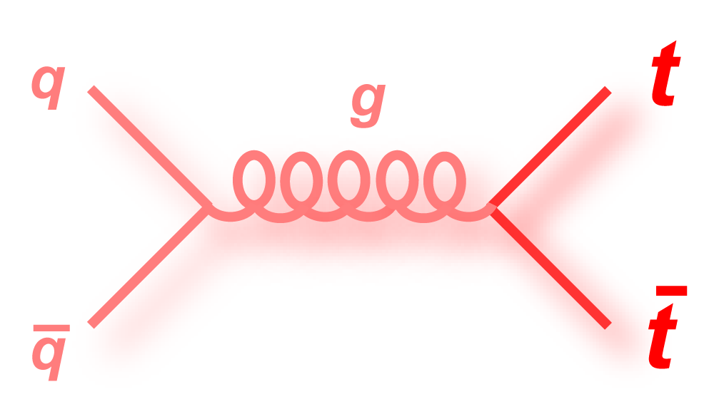
Test pQCD at high scales: Top
Top pair production cross section 7 TeV and 8 TeV in different W decay channels
Consistent experimental uncertainties of combined cross section at 7 TeV - smaller than theory
Good agreement with pQCD at NNLO
ATLAS-CONF-2012-149
Notes:
Different cross section for pp and pbarp at low cms energies due to production via qqbar pair

Slide 10
Test internal consistency of QCD
Interpretation of σ_{ttbar} with approx. NNLO calculations
Fix top mass extract α_{s}
Fix α_{s} extract top mass
α_{s} (M_{Z}) =
CMS PAS TOP-12-022; ATLAS-CONF-2011-054, CMS PAS TOP-11-008
Notes:
Hathor+Top++ exact NNLO calculations for qqbar->ttbar; approximations for other production channels; Hathor new high energy approximations using soft gluon resummations
Complementary information to top mass from top decay products -> mc mass through kinematic fits or calibrate the measurement
Theory uncertainties contain pdf, scale uncertainty; assumed to be independent of experimental uncertainty (correlation due to pdf uncertainty can be neglected)

Slide 11
Test pQCD in top production
Differential distributions of top and top pair system sensitive to production mechanism
Measure normalised distributions in visible phase space to reduce uncertainties
Reconstruct top p_{t}, m_{ttbar}, rapidity using kinematic constrains
Good description of distributions up to approx.NNLO
Notes:
~20000 events in e+mu+jets combined (require 2 bjets!)
Final event sample ~80% single lepton events
13% top from other decays
3% w+jets
Measurement in visible phase space

Slide 12
Test pQCD: Top spin correlation
Spin correlation between tops in top pair reflect helicity state of initial gluons
according to QCD
Spin correlation of top quarks transferred to leptons of W decay
->Measure angular difference of leptons – no reconstruction of top quarks needed.
A_{helicity} = 0.40+/-0.04(stat) ^{+0.09}
_{-0.08}
(sys)
Theory: A_{helicity} = 0.31 +/- 0.003
Good agreement with NLO pQCD
ATLAS: arXiv:1203.4081, CMS: CMS PAS TOP-12-004, W.Bernreuther et al. Nucl.Phys.B837,90(2010)
Notes:
Dilepton channel
Signal MC: mc@nlo
Analysis done with template fit with coefficients assuming SM (fSM) or uncorrelated spin (1-fSM)
Helicity basis: cm frame of top pair, direction of flight of top
Check paper: NLO calculation? Uncertainty due to scale+pdf 1%?

Slide 13
QCD radiation at LHC
α_{s}(Q₂)
q_{i}
g
α_{s}(Q₁)
q_{j}
g
Jet multiplicity
W/Z + jet production
Angular correlations of jets
W/Z p_{t} spectra
Jet structure
QCD radiation and its scales
Soft QCD effects

Slide 14
Hard QCD radiation: Z/W + jets
Direct measure of hard QCD radiation: measure Jet multiplicity in association with W or Z
Sensitive to different approximations made in QCD MC codes
Significant background for many measurements
Good description even of high multiplicities by QCD LO multi-parton generators and
NLO calculations (Blackhat)
CMS: arXiv:1301.1646 ; ATLAS: arXiv:1201.1276
Notes:
ATLAS results Z+jets up to >=4 using 36pb-1.

Slide 15
QCD radiation: ISR in Z + jets
Z p_{t} created from recoil of ISR radition – no FSR due to colour-less final state
Measurement profits from well to reconstruct final state
At low p_{t} sensitive to phenomenological parameters in QCD MC generators.
e,μ
e,μ
Data well described by ISR soft gluon resummations
and LO generators.
Large bins at low p_{t} due to experimental resolution.
Notes:
ATLAS results Z+jets up to >=4 using 36pb-1.

Slide 16
Soft QCD radiation: Z φ*
Low Z p_{t} region sensitive to ISR shower cut-off and intrinsic k_{T} in QCD MC generators
Precise description suffers from low experimental resolution
Well tuned parametrisation needed for high precision measurement of W mass
Define new observable φ* highly correlated to Z pt but reconstructed only from lepton scattering angles -> better resolution
Not described by any of the
QCD approximations.
Need to tune QCD MCs.
φ*

Slide 17
QCD radiation: Δφ in jets
Angle between leading jets sensitive to QCD radiation.
Measure of QCD radiation effects independent of reconstructed additional jets.
Check different approximations in common QCD MCs.
Distributions well described by NLO QCD and LO MC generators.
Notes:
Larger scale uncertainties close to pi/2 where effectively 4 jets contribute calculated at LO in NLOJet++
No fixed order NLO calculation close to pi due to large contribution from soft processes with enhanced logarithms

Slide 18
QCD radiation: Δφ in Z+jets
Measure angle between leading jet and Z boson.
Measure of ISR QCD radiation independent of reconstructed additional jets.
Check different approximations in common QCD MCs.
Z p_{t} > 0 GeV
Z p_{t} > 150 GeV
Distributions well described by NLO generators and QCD LO multi-parton generators.
LO generator with Z+1jet doesn’t describe the data except for highly boosted Z.
^{arXiv:1301.1646v1}

Slide 19
Hard QCD radiation: W+b
Sensitive to b quark content of the proton
Sensitive to DPS (W production + bbar production)
Background to W H->W bb, single top, BSM models
Good agreement of fiducial cross section with NLO calculations
Notes:
Jet pt>25 GeV
DPI correction 25%
On total cross section
Concentrated in lowest
Pt bin of 1 jet sample

Slide 20
Hard QCD radiation: top + jets
Constraint modeling of quark and gluon radiation in top events.
QCD radiation is the dominant systematic uncertainty in many top measurements.
Nr of events without additional jet p_{t}>Q₀
all ttbar events
f_{gap} =
Jet multiplicity measurement
prefers softer scale.
Tension?
Gap fraction analysis okay with
default scale.

Slide 21
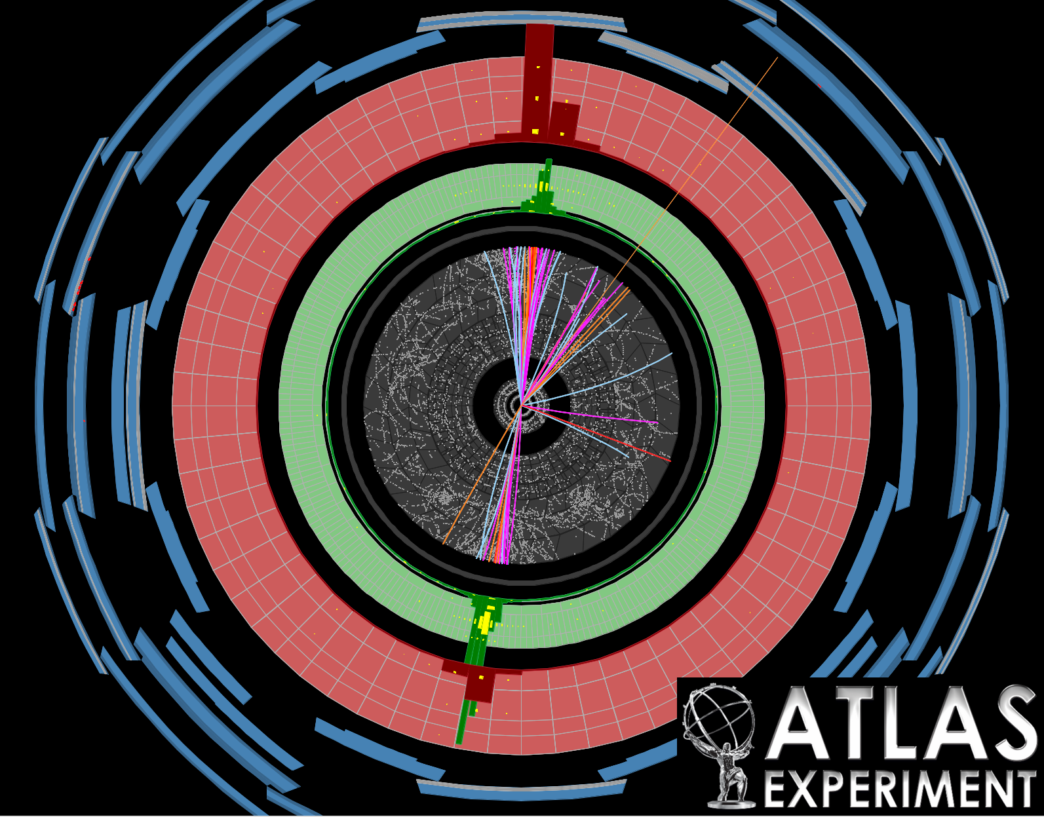
QCD at high parton densities: MPI
q_{i}
q_{i}
q_{j}
q_{k}
Hard double parton scattering: pQCD
Soft multi-parton interaction: phenomenological models
W + 2 jets
Underlying event in Z and jet production

Slide 22
Hard MPI: DoublePartonScattering
Large theoretical interest in direct measure of DPS: pQCD predictions exist for double DY, 4 jet production, W+2jets, Double-Parton PDFs
Experimentally difficult to separate from events with QCD radiation
This analysis: measure simultaneous W and dijet production.
Hard double parton scattering observed at LHC.
Effective cross section similar to measurements from Tevatron.
Notes:
Need to differentiate DP jets from W+2jets.
2 jets back-to-back most natural but suffers from experimental resolution effects
Use vector sum of 2 leading jets instead!
A+H+J = Alpgen+herwig+jimmy

Slide 23
Soft MPI: UE from DY
Phenomenological models of soft MPI are implemented QCD MC generators and are tuned to Minimum Bias and Underlying event in jet data.
Here: measure energy and particle flow in DY event by removing leptons from Z decay.
Minimize contribution from ISR by cut on Z p_{t}.
MPI is independent of the scale of the hard process
Universality of MPI model:
Tunes to UE in jet events describe DY data
^{arXiv:1204.1411v2}
Notes:
MPI has been studied in minimum bias scatters and in underlying event of dijet events.
Leading jet analysis:
FSR radiation and
Gluon induced radiation
-> softer fragmentation
->more particles
DY:
Quark induced radiation
-> harder fragmentation
->less particles

Slide 24
Soft ISR: UE from DY
Measure energy and particle flow in DY event by removing leptons from Z decay.
Measure contribution from ISR in dependence of Z p_{t}.
Compare to UE in jet events in transverse region.
Leading object
Transverse region
Similar behaviour in both processes small differences due to different types of
radiation.
^{arXiv:1204.1411v2}
Notes:
MPI has been studied in minimum bias scatters and in underlying event of dijet events.
Leading jet analysis:
FSR radiation and
Gluon induced radiation
-> softer fragmentation
->more particles
DY:
Quark induced radiation
-> harder fragmentation
->less particles

Slide 25
Soft MPI: UE with jet-areas
New method to measure UE in jet events: jet area
2010
Room for improvement
in QCD MC tunes.

Slide 26
Summary & Outlook
Tested QCD from low to highest scales in inclusive and differential distributions and compared to the relevant theory predictions. Many measurements more precise than theory calculations.
Good agreement with NNLO QCD predictions are found were available. QCD MCs work well in general in the phase space were they’re expected to work. However matched POWHEG predictions have larger systematic uncertainties than expected.
Many new QCD measurements in vector boson production were possible which allows to study QCD effects in detail.
First precise data to constrain gluon pdfs at medium and high x available.
Most of the 20fb-1 delivered by LHC are not yet analysed and let expect even higher precision analysis and more stringent QCD test in the future
Stay tuned!

Slide 27
QCD@LHC 2013
DESY, September 2-6, 2013

Slide 28
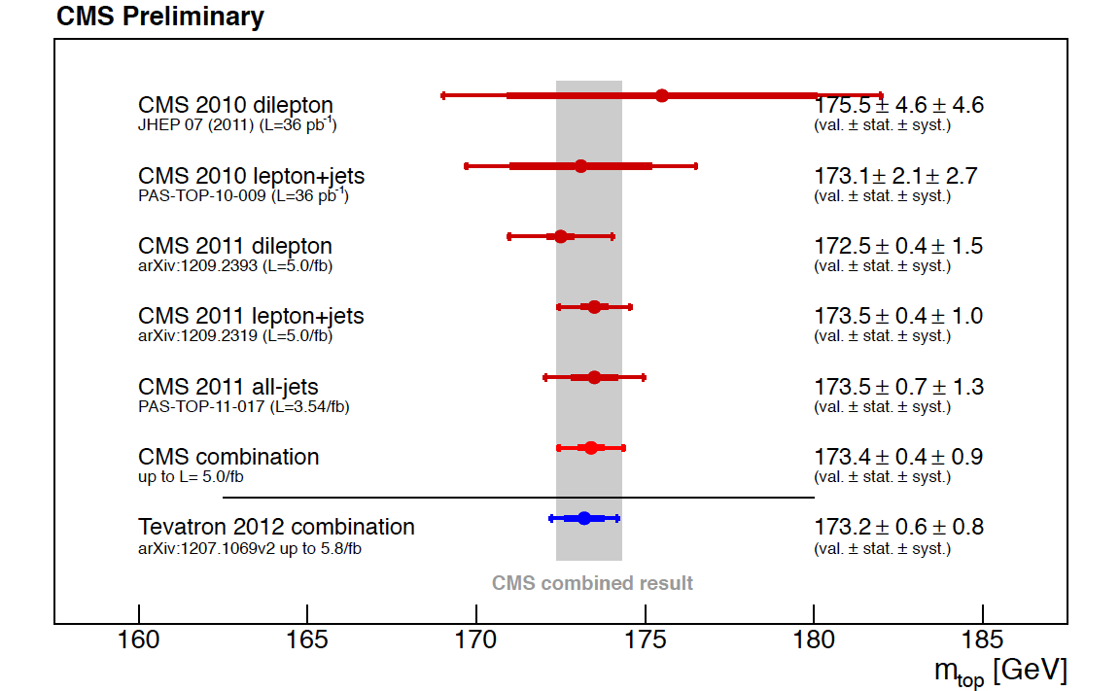
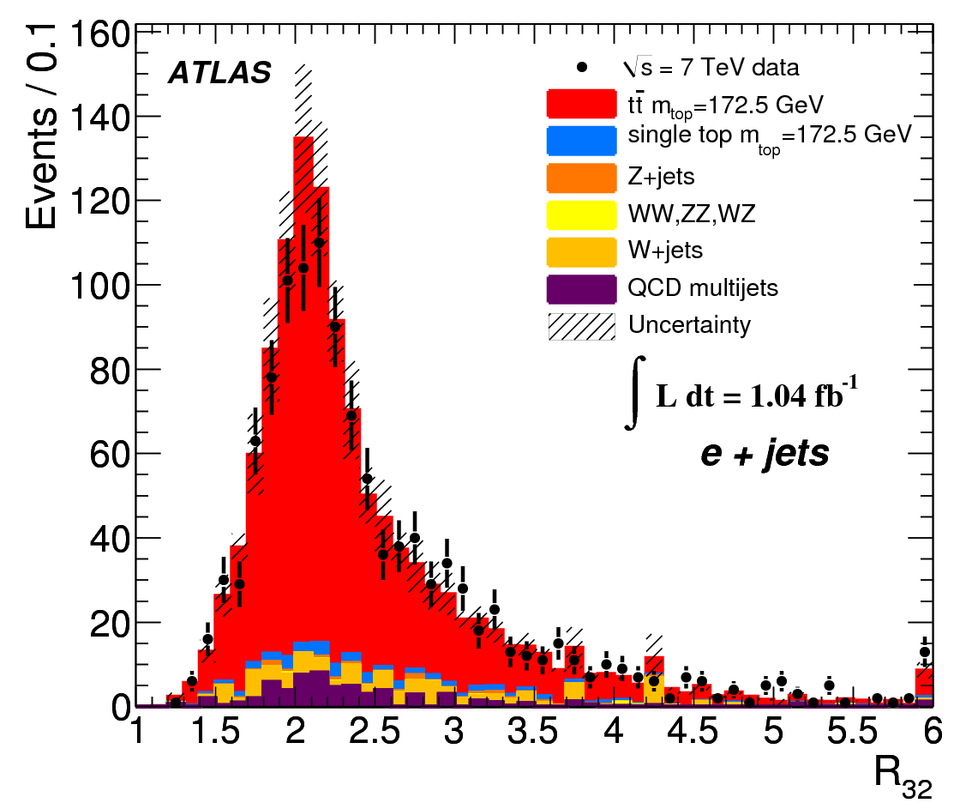
Precision measurements despite QCD: Top mass
R32 = Mtop / MW
ICHEP2012
Single lepton channel
Mass difference between top and anti-top should be 0 for CPT conservation
CMS measured: ∆mt = −0.44 ± 0.46 (stat.) ± 0.27 (syst.) GeV

Slide 29
Test of pQCD: Jet measurement
Measured jet production
up to jet pt of 2 TeV and
dijet masses of 5 TeV
Tevatron limit
Tevatron limit
Non-perturbative
corrections limit
precision at low pt
ATLAS: Phys.Rev. D86 (2012) 014022; CMS: Phys.Rev.D86(2012)014022
Notes:
Dijet mass limit tevatron 1.3 TeV

Slide 30
Test of pQCD: theory comparison
Data can be used to constrain
PDFs in the future
Huge variations in predictions from NLO generators matched to parton showers
ATLAS: Phys.Rev. D86 (2012) 014022; CMS: Phys.Rev.D86(2012)014022

Slide 31
Test of pQCD: Jet production
pQCD at NLO works very well
Up to jet pt of 2 TeV and dijet
Masses of 5 TeV
Discrimination between PDFs
Tevatron limit
Tevatron limit: 600GeV
Open issues today:
Non-perturbative corrections limit
Precision at low pt
Comparison to NLO generators
suffers from matching
ATLAS: Phys.Rev. D86 (2012) 014022; CMS: Phys.Rev.D86(2012)014022

Slide 32

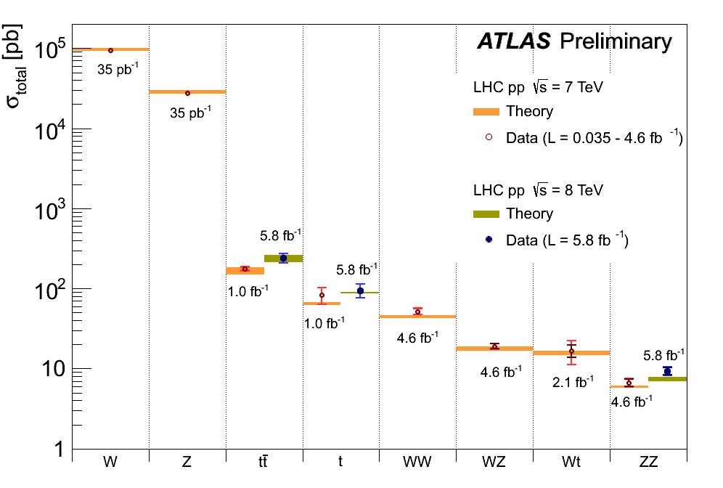
LHC data sets
7 TeV: 35 pb−1 2010 data low pile-up
7 TeV: 5 fb-1 2011 data medium pile-up ~9 pp interaction per event
8 TeV: 2X fb-1, analysed up to 2.3 fb-1
Z + jets : well to reconstruct final state, no FSR, PDFs
W->enu + jets: no FSR, more statistics, cross check for Z+jets,
different sensitivity to PDFs than Z
Jet events: huge phase space to probe QCD with the same process, PDF, alpha_s
Ttbar: QCD at high scales, quark properties without hadronisation
Lumi plot
Pile-up discussion + event display

Slide 33
Systematic uncertainties
CMS uncertainty on cross section single lepton channel
8 TeV
7 TeV
ATLAS single lepton cross section 7 TeV

