Slide 1

Beschleunigerprojekte für das zukünftige Teilchenphysikprogramm*
Hadron Colliders
Lepton Colliders
Hadron-Lepton
others (µ, Plasma accelerators, γ-γ,…)
Higgs-Factories
* or how to put 50 years into 30 minutes!

Slide 2
Contents
Introduction
Hadron Colliders
  LHC up to 2020
  LHC after 2020: HE-LHC
Lepton Colliders
  Linear e+e- Colliders: ILC and CLIC
  Circular e+e- colliders: LEP3, DLEP, TLEP, SuperTRISTAN
  Muon Collider
Hadron-Lepton Colliders
  LHeC
  eRHIC
Plasma accelerators
Higgs Factories : Linear, circular, γ-γ, muon colliders

Slide 3
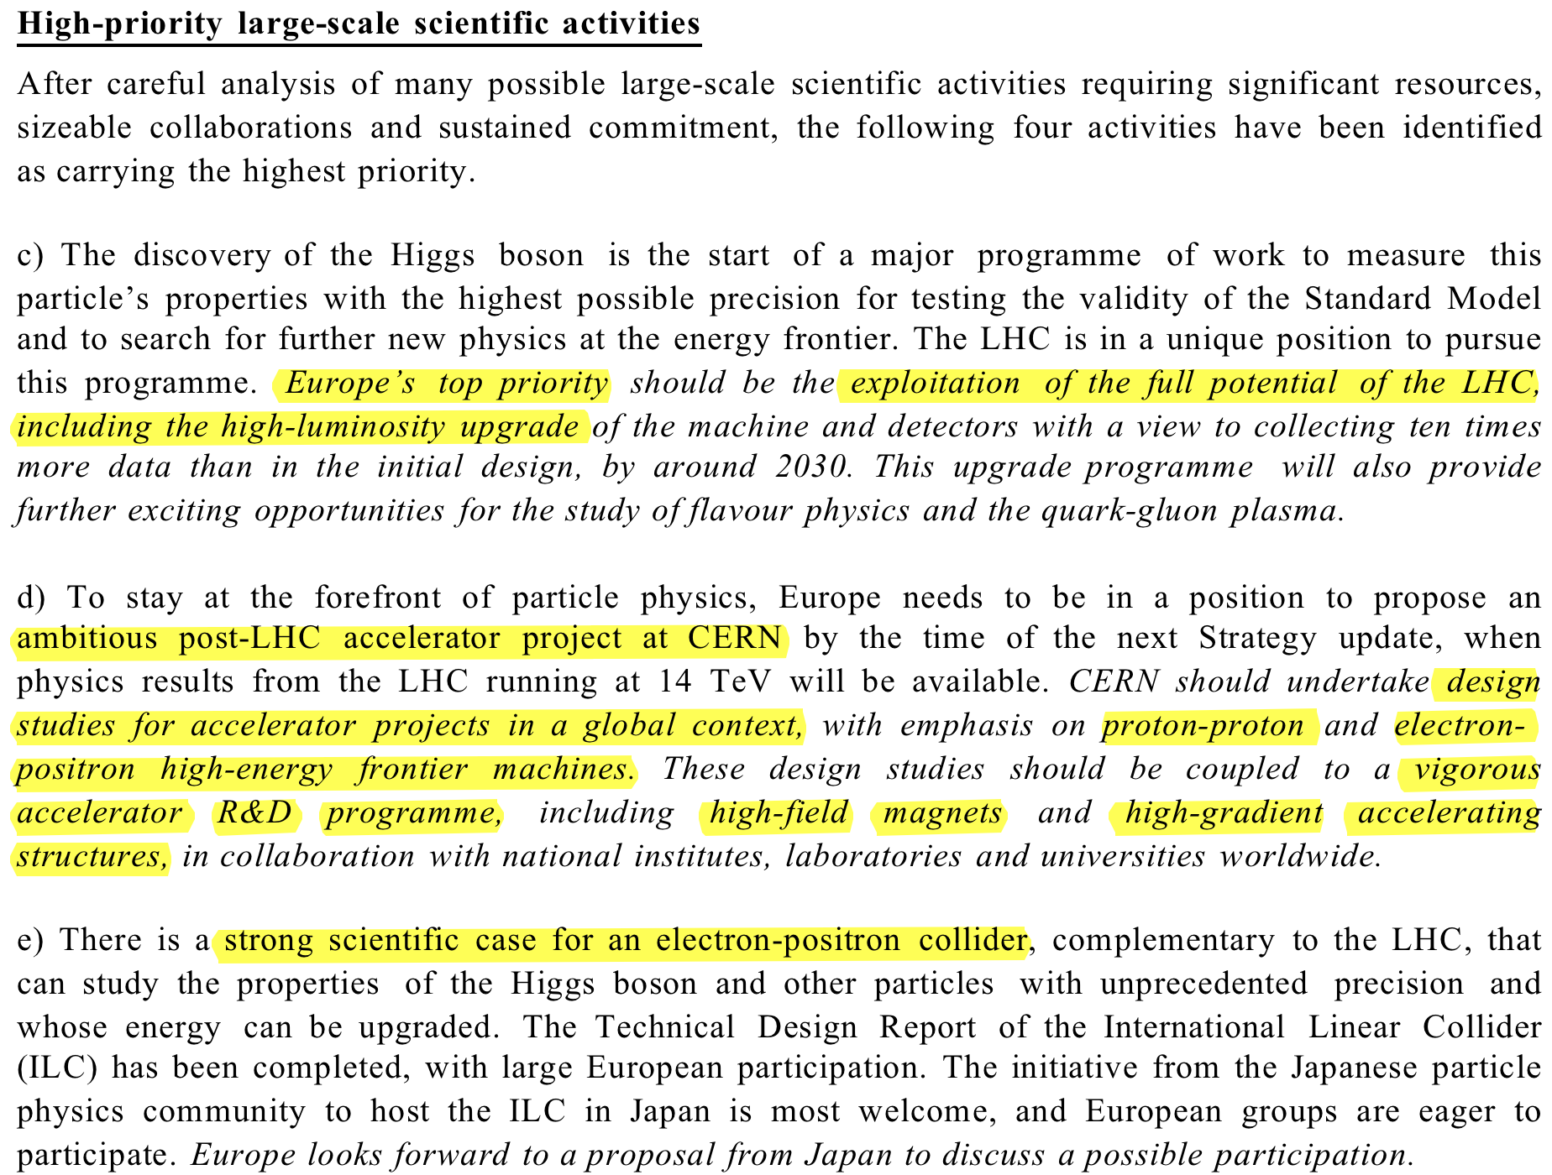
European Strategy Update
Proposed Update of the European Strategy for Particle Physics:

Slide 4
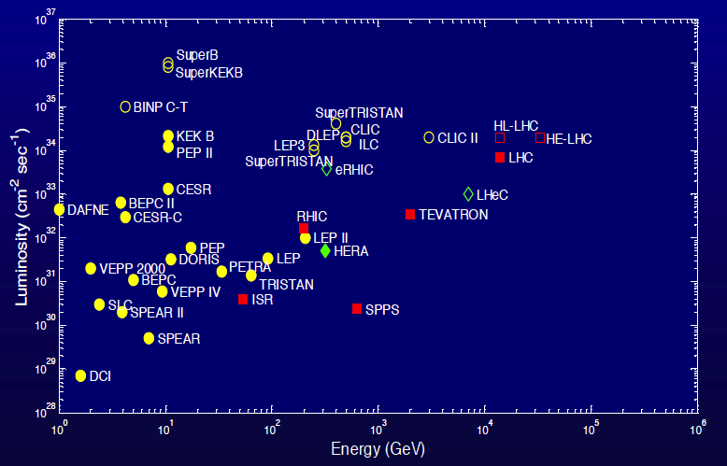
High Energy Colliders

Slide 5
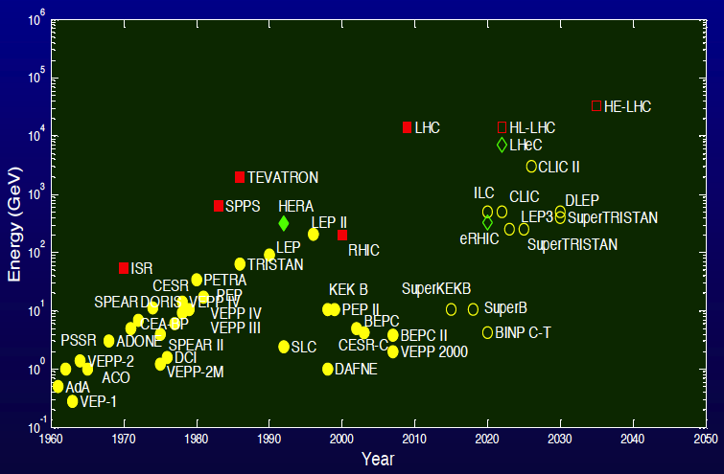
High Energy Colliders

Slide 6
Hadron Colliders
HL-LHC
HE-LHC
VHE-LHC

Slide 7
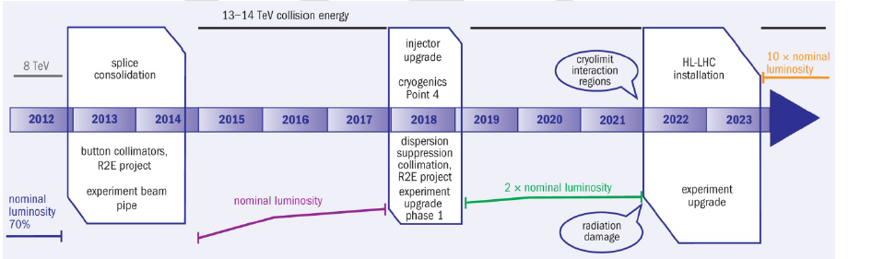
LHC Timeline
LS2
secure L ~ 10³⁴ and reliability
Aiming at L ~ 2 10³⁴
Start LIU
LS3 : HL-LHC
New IR
levelled L ~ 5 10³⁴
Experiment upgrades
LS1
INCREASE ENERGY TO
13-14 TeV
100-200 fb⁻¹/3years
Lower emitt
250-600 fb⁻¹/3years
+ higher intensity
300 fb⁻¹/year

Slide 8

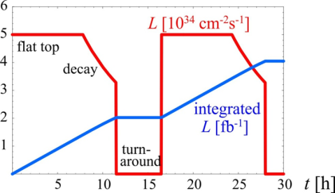
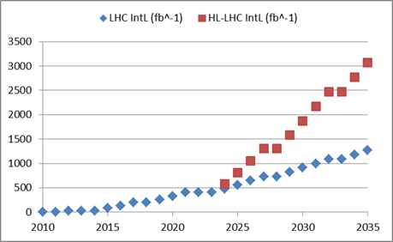
HL-LHC goal : 3000 fb⁻¹ by 2030’s…
5 10³⁴ levelled lumi
(25 10³⁴ virtual peak lumi)
140 pile up (average)
3 fb-1 per day
60% of efficiency
250 fb-1 /year
300 fb-1/year as «ultimate»
Full project
Just continue improving
performance through
vigorous consolidation

Slide 9
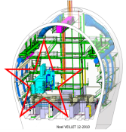
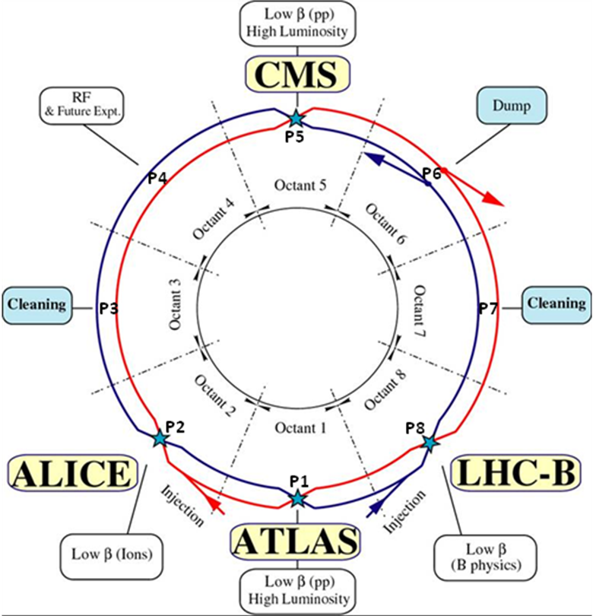
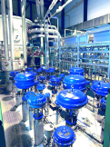

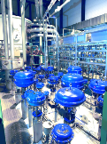
1.2 km of new equipment in the LHC…
6.5 kW@4.5K cryoplant
2 x 18 kW @4.5K cryoplants for IRs

Slide 10
HiLumi: Two branches (with overlap)
PIC - Performance Improving Consolidation upgrade (∼1000 fb⁻¹)
  IR quad change (rad. Damage, enhanced cooling)
  Cryogenics (P4, IP4, IP5) separation Arc-RF and IR(?)
  Enhanced Collimation (11T?)
  SC links (in part) and rad. Mitigation (ALARA)
  QPS and Machine Prot.
    Kickers
    Interlock system
FP- Full Performance upgrade (3000 fb⁻¹)
  Crab Cavities
  HB feedback system (SPS)
  Advanced collimation systems
  E-lens (?)
  SC links (all)
  R2E and remote handling for 3000 fb⁻¹

Slide 11
R&D on high field SC magnets
High field magnets essential to obtain the luminosity
NbTi
Robust, ductile, well extablished techology
B < 10 T
Nb₃Sn
Heat treatment, brittleness
B < 15 T
HTS
B up to 45 T
US-LARp, Bruker - Prototyping
R&D on wires , still long road for High fields magnets
Mechanical weakness
Nb₃AL
KEK, Hitachi
Subscale Magnet for demonstration (B = 13 T)

Slide 12
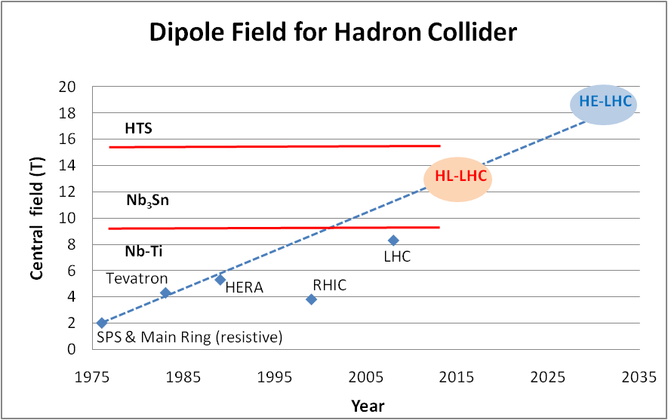
Main dipole field
Looking at performance offered by practical SC, considering tunnel size and basic engineering (forces, stresses, energy) the practical limits is around 20 T. Such a challenge is similar to a 40 T solenoid (μ-C)
LBNL, with large bore
Spring 2013
Nb-Ti operating dipoles
Nb3Sn cosϑ test dipoles
Nb3Sn block test dipoles

Slide 13
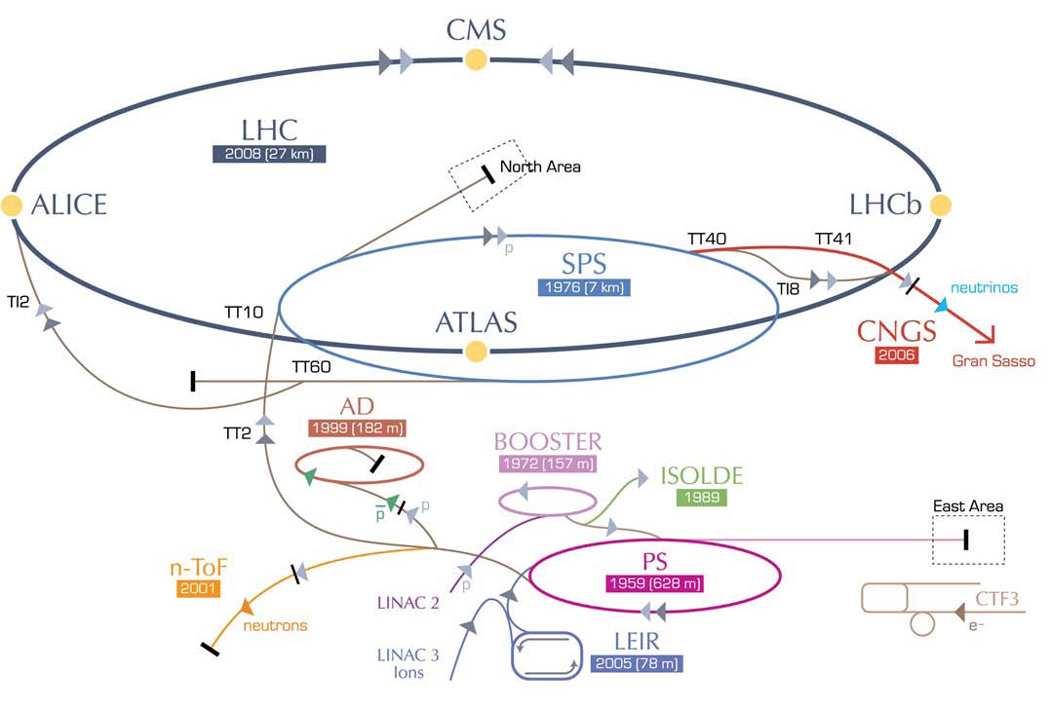
HE-LHC - High Energy LHC
HE-LHC
20-T dipole magnets
S-SPS?
higher energy
transfer lines
2-GeV Booster
Linac4

Slide 14
HE-LHC (High Energy LHC)
Increasing proton energy beyond 7 TeV (2010: study group and workshop)
  reuse of the CERN infrastructure
  “ease” in producing luminosity with proton circular collider
  practical and technical experience gained with LHC
Beam energy set by SC magnets dipole field:
=> 16-20 T == 26 to 33 TeV in the centre of mass
Performance targets:
  proton beam energy 16.5 TeV in LHC tunnel
  peak luminosity 2x10³⁴ cm⁻²s⁻¹
  also heavy ion collisions at equivalent energy
  eventually high-energy ep collisions?
 | LHC | HE-LHC
beam energy [TeV] | 7 | 16.5
dipole field [T] | 8.33 | 20
dipole coil aperture [mm] | 56 | 40
#bunches | 2808 | 1404
IP beta function [m] | 0.55 | 1 (x), 0.43 (y)
number of IPs | 3 | 2
beam current [A] | 0.584 | 0.328
SR power per ring [kW] | 3.6 | 65.7
arc SR heat load dW/ds [W/m/ap] | 0.21 | 2.8
peak luminosity [10³⁴ cm⁻²s⁻¹] | 1.0 | 2.0
events per crossing | 19 | 76

Slide 15
HE-LHC Challenges
20-T dipole magnets
  intense R&D program, profits from HL-LHC developments
HE-LHC needs substantial advance in many other domains:
  accelerator physics
  collimation (with increased beam energy and energy density)
  beam injection – strong Injector upgrade (…SPS 1 TeV)
  beam dumping
  handling a synchrotron radiation = 20 LHC > challenge for vacuum and cryogenics.
Synchrotron radiation will also constitute a real advantage for HE-LHC design:
for the first time a hadron collider will benefit of a short damping time 1-2 hours instead of 13-25 h (longitudinal and transverse respectively) of the present LHC

Slide 16
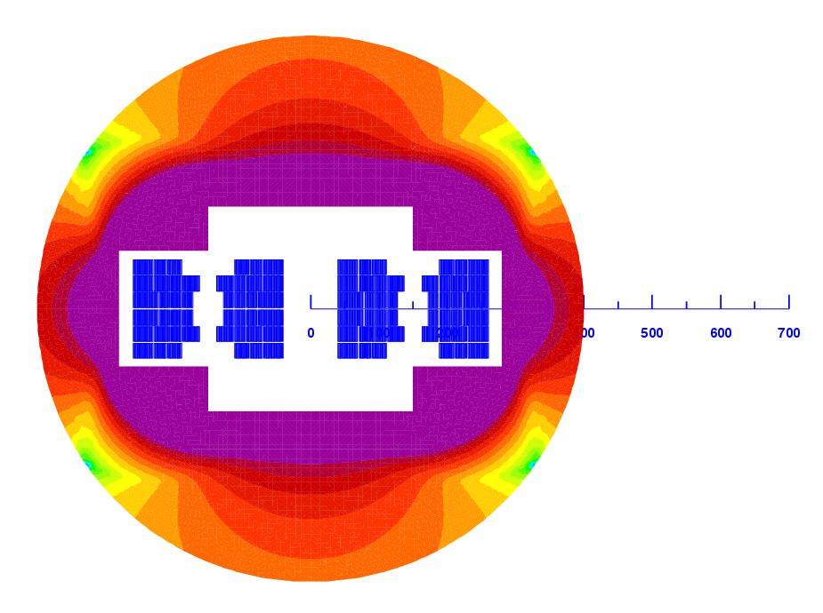
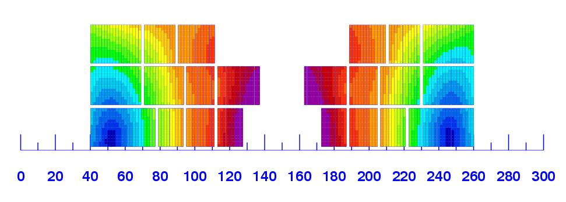
First consistent conceptual design
Using multiple SC material (cost optimized)
L. Rossi
20 T field!
Magnet design: 40 mm bore (depends on injection energy: > 1 Tev)
Approximately 2.5 times more SC than LHC: 3000 tonnes! (~4000 long magnets)
Multiple powering in the same magnet for FQ (and more sectioning for energy)
Only a first attempt: cosϑ and other shapes will be also investigated

Slide 17
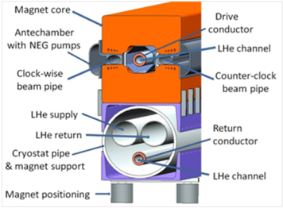
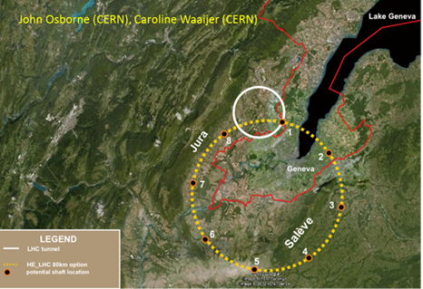
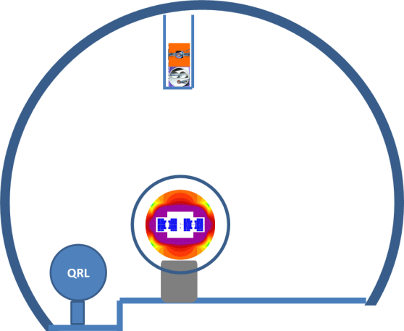
Beyond HE-LHC: VHE-LHC
new 80 km ring
VHE-LHC with 100 TeV cms
injector in the same tunnel
possibility for TLEP/VLHeC
From H. Piekarz
Malta Prooc. Pag. 101

Slide 18
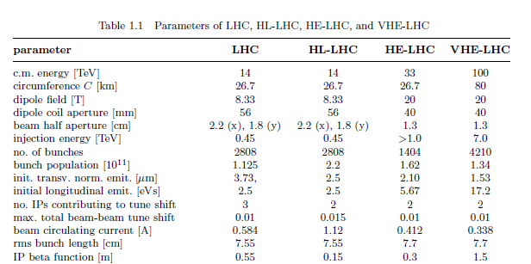
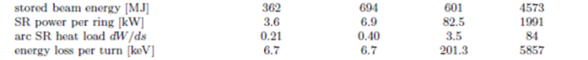
Parameters list of LHC upgrades
(O. Dominguez and F. Zimmermann)

Slide 19
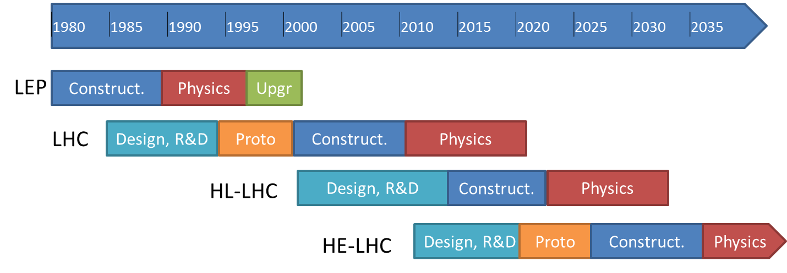
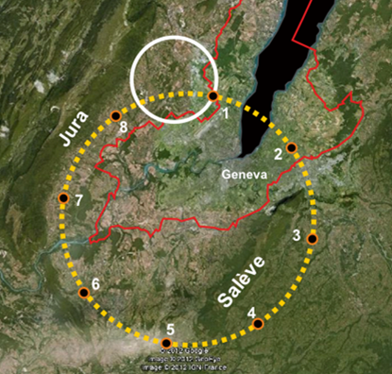
Proton-Proton Timeline
Either using existing
LEP/LHC tunnel to reach 26-32 TeV collisions
Or build (or reuse) a 80km tunnel to reach 80-100 TeV collisions
In both cases, SC challenge to develop 16-20 Tesla magnets!
Magnets for HL_LHC is an indispensable first step

Slide 20

LHeC - Large Hadron electron Collider
RR LHeC:
new ring
in LHC tunnel,
with bypasses
around
experiments
LR LHeC:
recirculating
linac with
energy
recovery
RR LHeC
e-/e+ injector
10 GeV,
10 min. filling time
Performance targets
  e- energy ≥60 GeV
  luminosity ~10³³ cm⁻²s⁻¹
  total electrical power for e⁻: ≤100 MW
  e+p collisions with similar luminosity
  simultaneous with LHC pp physics
  e⁻/e⁺ polarization
  detector acceptance down to 1º

Slide 21
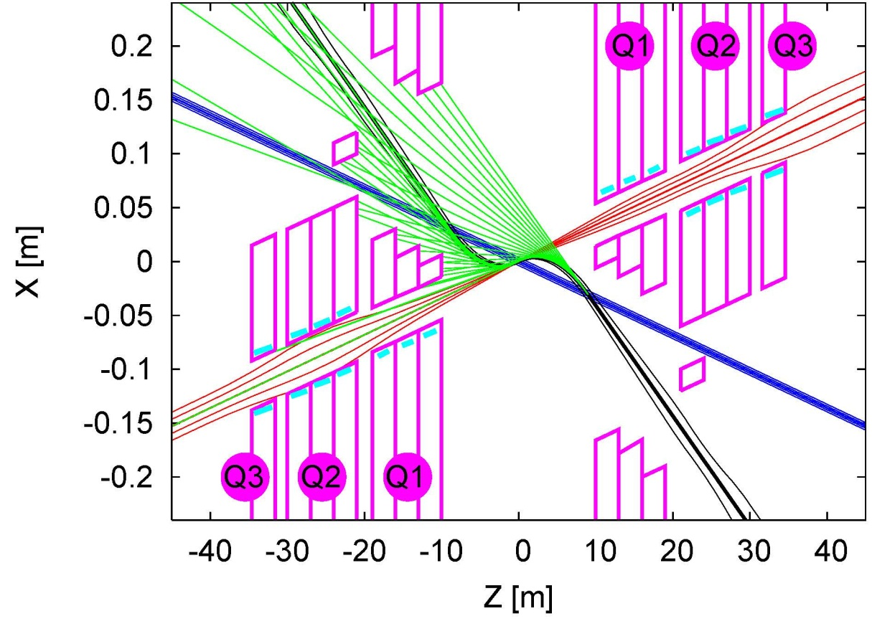
LHeC challenges
Common for L-R and R-R
  Interaction region layout for 3 beams
  Final quadrupole design
  IR synchrotron radiation shielding
Ring-Ring Option
  bypassing the main LHC detectors
  integration into the LHC tunnel
  installation matching LHC circumference
  installation within LHC shutdown schedule
Linac-Ring Option
  2 x 10 GeV SC Energy Recovery Linacs
  return arcs
  e+ production & recycling
    IP e+ rate ~400/100 times higher
    than for CLIC or ILC
    several schemes proposed to achieve this
Synchrotron radiation
Q2
Electron beam
Q1
colliding proton beam
Non-colliding proton beam
Inner triplets
Inner triplets
tune-up dump
10-GeV linac
comp. RF
injector
0.12 km
0.17 km
comp. RF
1.0 km
2.0 km
10, 30, 50 GeV
C ~9 km
20, 40, 60 GeV
dump
LHC p
10-GeV linac
0.26 km
IP
0.03 km
e- final focus

Slide 22
eRHIC
e-ion detector
20 (30) GeV energy recovery linacs to accelerate and to collide polarized and unpolarized electrons with hadrons in RHIC
The center-of-mass energy of eRHIC will range from 30 to 200 GeV
Possible locations
for additional e-ion
detectors
eRHIC
PHENIX
Main ERL
(1.9 GeV)
Beam
dump
STAR
Low energy
recirculation pass
Electron
source

Slide 23


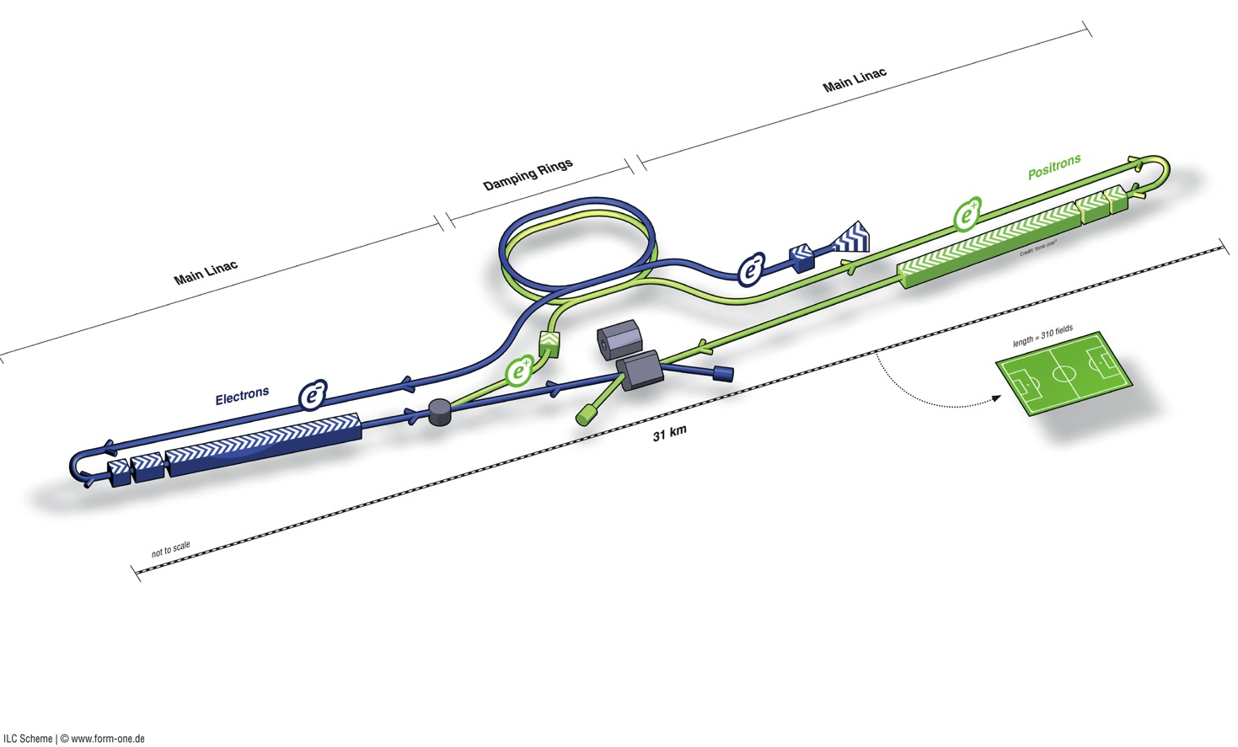
Linear e⁺e⁻ Colliders: ILC + CLIC
ILC (Internat. Linear Collider)
  Superconducting cavities, 1.3 GHz, 31.5 MV/m
  500 GeV (upgrade to 1 TeV)
ILC schematic
~31 km total length
CLIC
  Room-temperature cavities
  12 GHz, 100 MV/m
  500 – 3000 GeV

Slide 24
Parameter comparison (500 GeV)
 | SLC | TESLA | ILC | J/NLC | CLIC
Technology | NC | Supercond. | Supercond. | NC | NC
Gradient [MeV/m] | 20 | 25 | 31.5 | 50 | 100
CMS Energy E [GeV] | 92 | 500-800 | 500-1000 | 500-1000 | 500-3000
RF frequency f [GHz] | 2.8 | 1.3 | 1.3 | 11.4 | 12.0
Luminosity L [10³³ cm⁻²s⁻¹] | 0.003 | 34 | 20 | 20 | 23
Beam power P_{beam} [MW] | 0.035 | 11.3 | 10.8 | 6.9 | 4.9
Grid power P_{AC} [MW] |  | 140 | 230 | 195 | 270
Bunch length σ_{z}* [mm] | ~1 | 0.3 | 0.3 | 0.11 | 0.07
Vert. emittance γε_{y} [10⁻⁸m] | 300 | 3 | 4 | 4 | 2.5
Vert. beta function β_{y}* [mm] | ~1.5 | 0.4 | 0.4 | 0.11 | 0.1
Vert. beam size σ_{y}* [nm] | 650 | 5 | 5.7 | 3 | 2.3
Parameters (except SLC) at 500 GeV

Slide 25

Global SCRF Technology
TRIUMF, Canada
◉
IHEP, China
◉
STFC
◉
FNAL, ANL
◉
Cornell
◉
◉
◉
KEK, Japan
SLAC
JLAB
LAL
Saclay
◉
DESY
◉
◉
◉
INFN Milan
◉
BARC, RRCAT India
GDE
Well extablished SC rf technology (TESLA, FLASH, XFEL…)

Slide 26
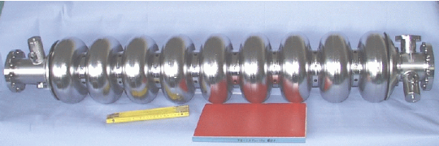
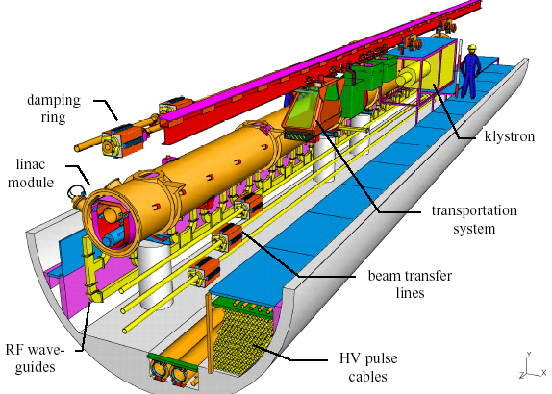
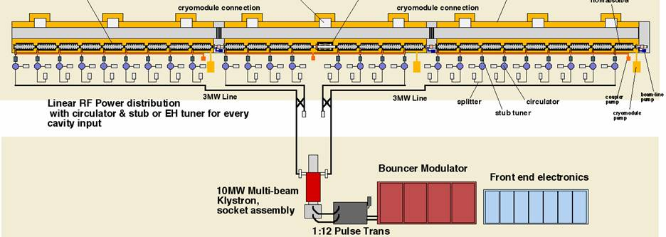
ILC Main Linac Cavity / RF Unit
Solid niobium, standing wave, 9-cell
Operated at 2 K (LHe), 31.5 MV/m, Q₀ ≥ 10¹⁰
560 RF units each:
1 Modulator
1 Klystron (10 MW, 1.6 ms)
3 Cryostats (26 cavities)
1 Quadrupole at the center
Total of 1680 cryomodules
14 560 SC RF cavities

Slide 27
The Path to High Performance
Intense R&D program to systematically understand and set procedures for the production process
goal: 90% production yield
2nd pass of surface treatment depending on achieved gradient
Control of niobium material
Mechanical construction
  electron-beam welding (EBW)
Preparing RF (inner) surface ultra-clean mirror surface
  electro-polishing (EP)
Removing hydrogen from the surface layer
  800 deg C bake
Removing surface contamination
  alcohol and/or detergent rinsing
  2-4 bar high-pressure rinsing (HPR)
2nd Pass

Slide 28
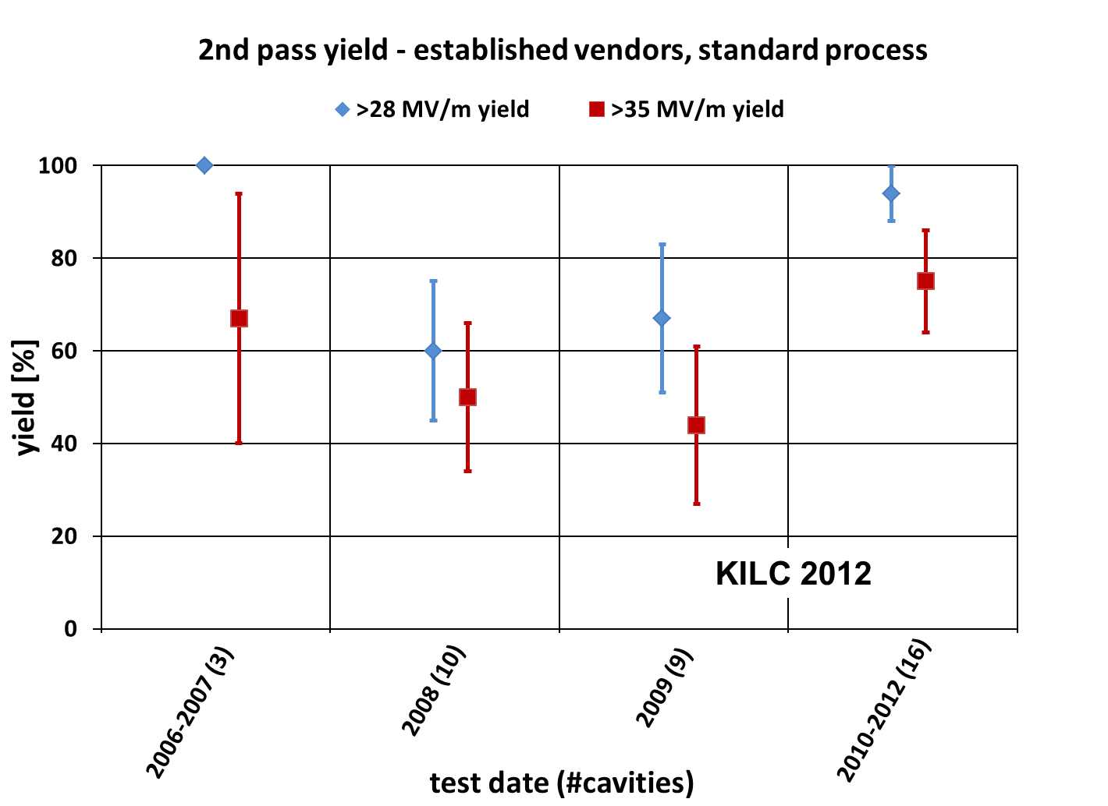
ILC Cavity Gradient Yield
94% (±6%)
for >28MV/m
acceptable for ILC mass production

Slide 29
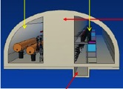


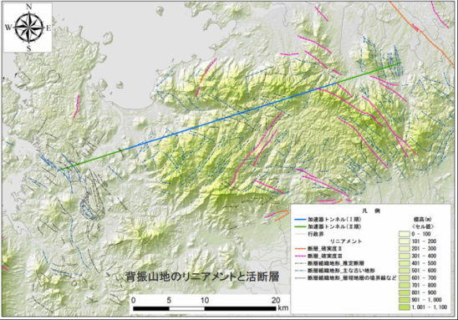
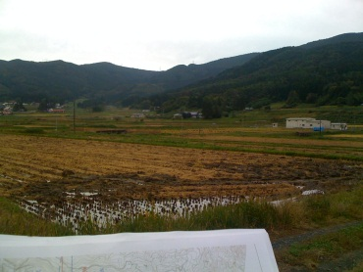
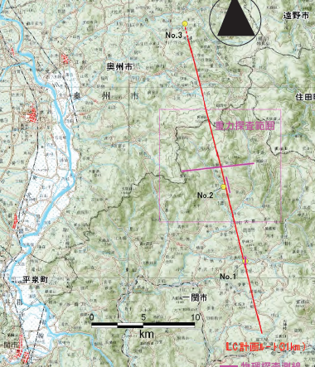
Two Japanese Candidate Sites
5 m
Japanese HEP community proposes to host ILC based on the “staging scenario” to the Japanese Government.

Slide 30


























Current CLIC Collaboration
CLIC multi-lateral collaboration - 48 Institutes from 25 countries
On-going discussions with 5 more groups …
Detector and Physics Studies for CLIC being organized in a similar manner, but with less formal agreements – yet allowing a collaboration like structure to organize the work, elections and making decisions about priorities and policies
ACAS (Australia)
Aarhus University (Denmark)
Ankara University (Turkey)
Argonne National Laboratory (USA)
Athens University (Greece)
BINP (Russia)
CERN
CIEMAT (Spain)
Cockcroft Institute (UK)
ETH Zurich (Switzerland)
FNAL (USA)
Gazi Universities (Turkey)
Helsinki Institute of Physics (Finland)
IAP (Russia)
IAP NASU (Ukraine)
IHEP (China)
INFN / LNF (Italy)
Instituto de Fisica Corpuscular (Spain)
IRFU / Saclay (France)
Jefferson Lab (USA)
John Adams Institute/Oxford (UK)
Joint Institute for Power and Nuclear Research SOSNY /Minsk (Belarus)
John Adams Institute/RHUL (UK)
JINR
Karlsruhe University (Germany)
KEK (Japan)
LAL / Orsay (France)
LAPP / ESIA (France)
NIKHEF/Amsterdam (Netherland)
NCP (Pakistan)
North-West. Univ. Illinois (USA)
Patras University (Greece)
Polytech. Univ. of Catalonia (Spain)
PSI (Switzerland)
RAL (UK)
RRCAT / Indore (India)
SLAC (USA)
Sincrotrone Trieste/ELETTRA (Italy)
Thrace University (Greece)
Tsinghua University (China)
University of Oslo (Norway)
University of Vigo (Spain)
Uppsala University (Sweden)
UCSC SCIPP (USA)

Slide 31
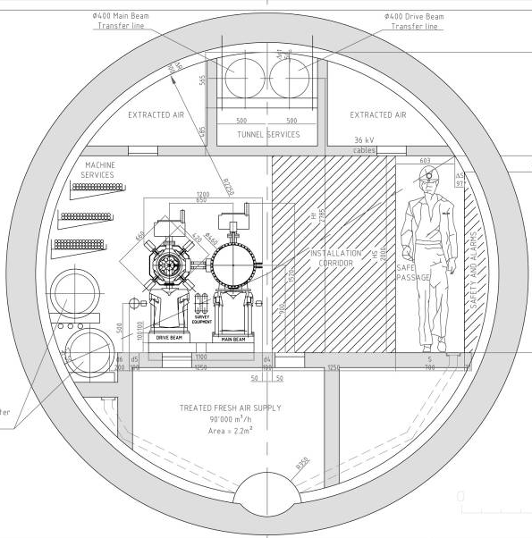
CLIC two beam scheme
High charge Drive Beam (low energy)
Low charge Main Beam (high collision energy)
=> Simple tunnel, no active elements
=> Modular, easy energy upgrade in stages
CLIC TUNNEL
CROSS-SECTION
Drive beam - 101 A, 240 ns
from 2.4 GeV to 240 MeV
Transfer lines
Main beam – 1 A, 156 ns
from 9 GeV to 1.5 TeV
Drive Beam
Main Beam
5.6 m diameter

Slide 32
CLIC – overall layout 3 TeV
Drive Beam Generation Complex
Main Beam Generation Complex

Slide 33
CLIC – layout for 500 GeV
only one DB complex
shorter main linac
Drive Beam Generation Complex
Drive beam
Main beam
Main Beam Generation Complex

Slide 34
CLIC Layout at various energies
Linac 1
I.P.
Linac 2
0.5 TeV Stage
Injector
Complex
4 km
4 km
~13 km
1 TeV Stage
Linac 1
I.P.
Linac 2
Injector
Complex
7.0 km
7.0 km
~20 km
3 TeV Stage
Linac 1
I.P.
Linac 2
Injector
Complex
21.1 km
2.75 km
2.75 km
21.1 km
48.3 km

Slide 35
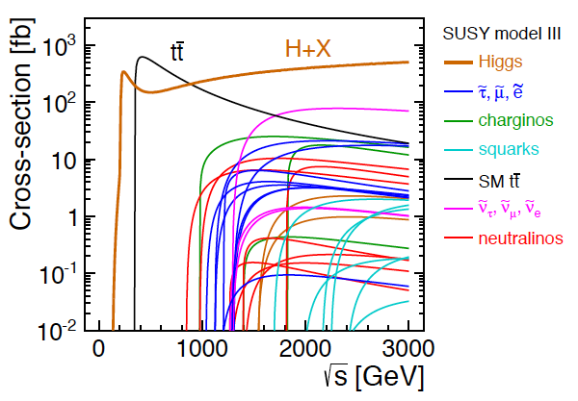
CLIC physics potential
LHC complementarity at the energy frontier:
How do we build the optimal machine given a physics scenario (partly seen at LHC ?)
Examples highlighted in the CDR:
Higgs physics (SM and non-SM)
Top
SUSY
Higgs strong interactions
New Z’ sector
Contact interactions
Extra dimensions
Detailed studies at 350, 500, 1400,
1500 and 3000 GeV for these processes
Operation at lower than nominal energy
Stage 1: ~500 (350) GeV => Higgs and top physics
Stage 2: ~1.5 TeV => ttH, ννHH + New Physics (lower mass scale)
Stage 3: ~3 TeV => New Physics (higher mass scale)

Slide 36
CLIC Drive Beam generation
Drive Beam Accelerator
efficient acceleration in fully loaded linac
Delay Loop x 2
gap creation, pulse compression & frequency multiplication
RF Transverse Deflectors
Combiner Ring x 3
pulse compression &
frequency multiplication
Combiner Ring x 4
pulse compression &
frequency multiplication
CLIC RF POWER SOURCE LAYOUT
Drive Beam Decelerator Section (2 x 24 in total)
Power Extraction
Drive beam time structure - initial
Drive beam time structure - final
240 ns
240 ns
5.8 μs
140 μs train length – 24 x 24 sub-pulses
4.2 A - 2.4 GeV – 60 cm between bunches
24 pulses – 101 A – 2.5 cm between bunches

Slide 37
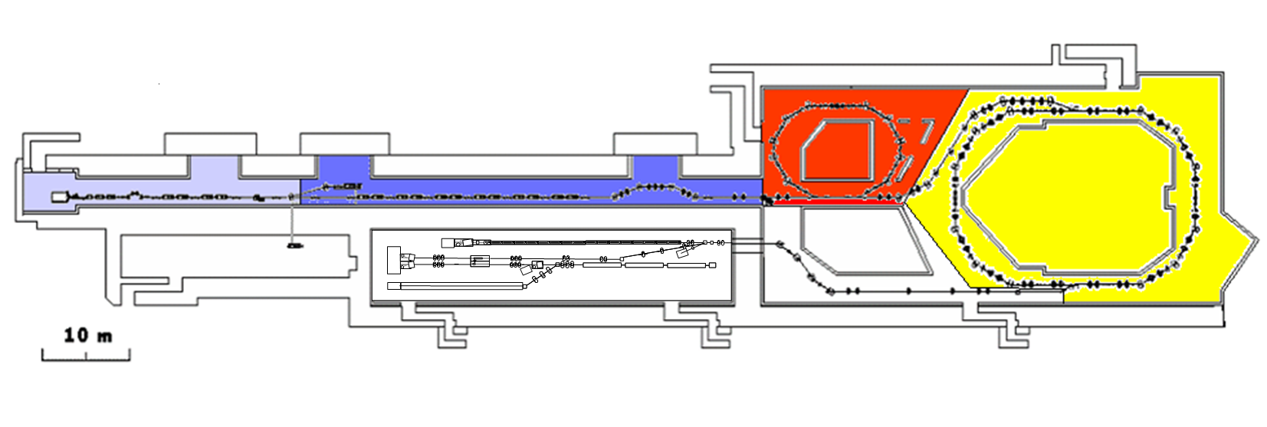
CTF 3
demonstrate remaining CLIC feasibility issues, in particular:
  Drive Beam generation (fully loaded acceleration,
  bunch frequency multiplication)
  CLIC accelerating structures
  CLIC power production structures (PETS)
30 GHz “PETS Line”
Bunch length
chicane
Delay Loop – 42m
Combiner Ring – 84m
RF deflector
TL1
Injector
Linac
4A – 1.2µs
150 MeV
Laser
30 GHz test area
32A – 140ns
150 MeV
CLEX
TL2

Slide 38
Drive beam generation achieved
combined operation of Delay Loop and Combiner Ring (factor 8 combination)
~26 A combination reached, nominal 140 ns pulse length
=> Full drive beam generation, main goal of 2009, achieved
DL
CR
30A

Slide 39
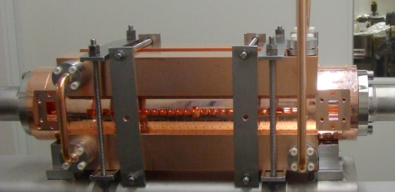
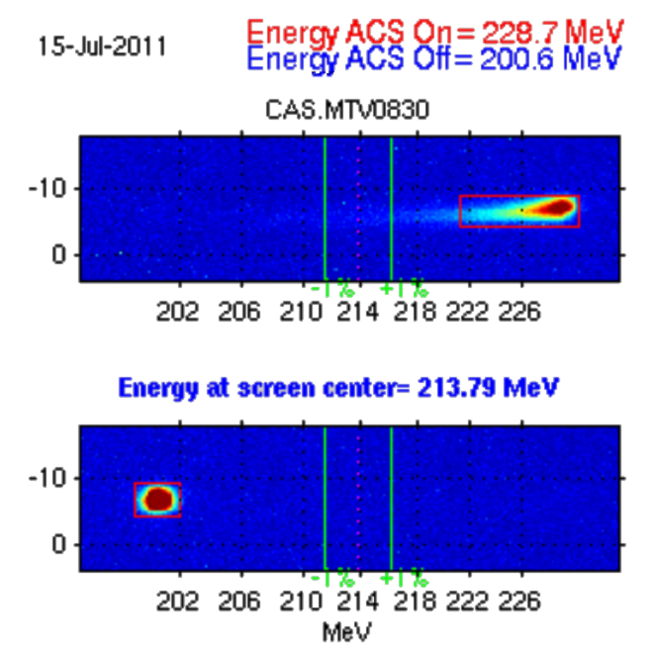
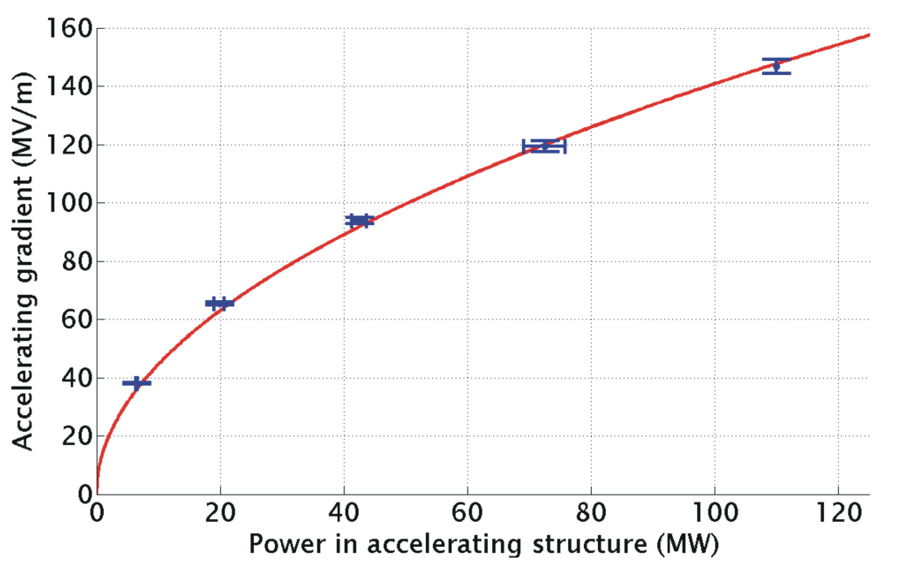
Achieved Two-Beam Acceleration
Maximum probe beam acceleration measured: 31 MeV
⇒ Corresponding to a gradient of 145 MV/m
TD24
Drive beam ON
Drive beam OFF

Slide 40
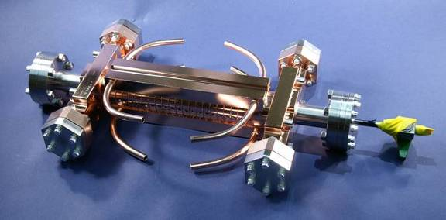
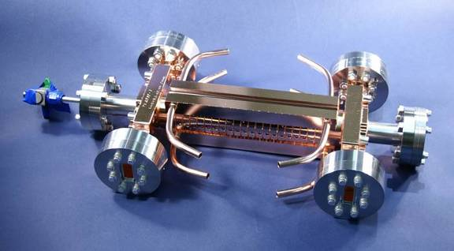
Accelerating Structure Results
RF breakdowns
can occur
=> no acceleration
and deflection
Goal: 3 10⁻⁷/m
breakdowns
at 100 MV/m loaded gradient
at 230 ns pulse length
latest prototypes (T24 and TD24)
tested (SLAC and KEK)
=> TD24 reached 106 MV/m at
nominal CLIC breakdown rate
(without damping material)
Undamped T24 reaches 120MV/m
S. Doebert et al.
Breakdown probability (1/m)
T24
TD24
CLIC goal
Average unloaded gradient (MV/m)

Slide 41
CLIC CDRs published
Vol 1: The CLIC accelerator and site facilities (H.Schmickler)
- CLIC concept with exploration over multi-TeV energy range up to 3 TeV
- Feasibility study of CLIC parameters optimized at 3 TeV (most demanding)
- Consider also 500 GeV, and intermediate energy range
- Complete, presented in SPC in March 2011, in print: https://edms.cern.ch/document/1234244/
Vol 2: Physics and detectors at CLIC (L.Linssen)
- Physics at a multi-TeV CLIC machine can be measured with high precision, despite challenging background conditions
- External review procedure in October 2011
- Completed and printed, presented in SPC in December 2011 http://arxiv.org/pdf/1202.5940v1
Vol 3: “CLIC study summary” (S.Stapnes)
- Summary and available for the European Strategy process, including possible implementation stages for a CLIC machine as well as costing and cost-drives
- Proposing objectives and work plan of post CDR phase (2012-16)
- Completed and printed, submitted for the European Strategy Open Meeting
in September http://arxiv.org/pdf/1209.2543v1
In addition a shorter overview document was submitted as input to the European Strategy update, available at:
http://arxiv.org/pdf/1208.1402v1

Slide 42
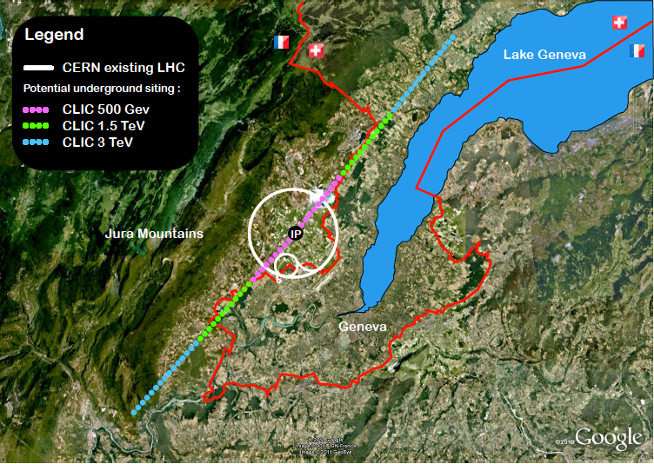
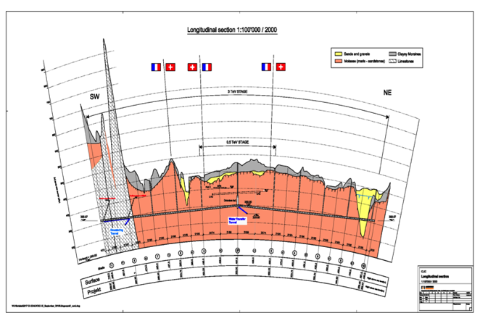
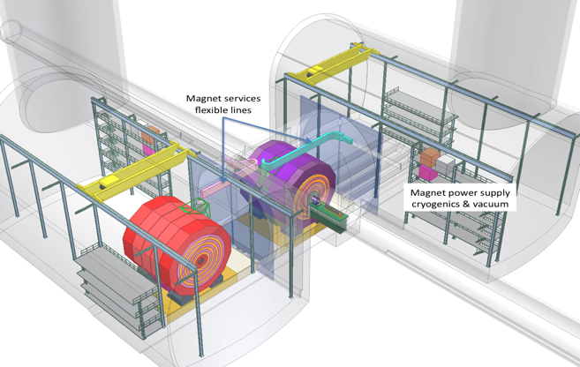
CLIC near CERN
Tunnel implementations (laser straight)
Central MDI & Interaction Region

Slide 43

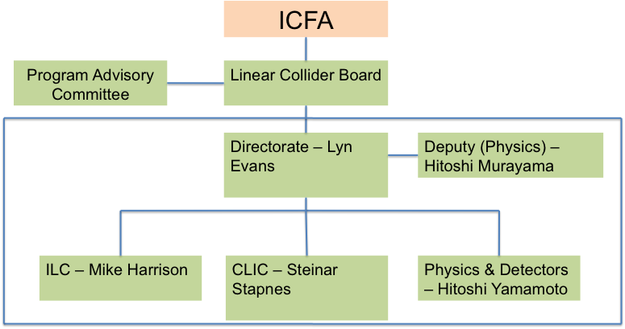
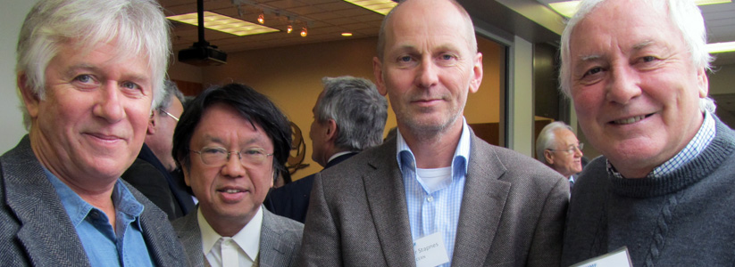
Linear Collider Collaboration
Sources (common working group on positron generation)
Machine Detector Interfaces
Damping rings
Beam dynamics (covers along entire machine)
Beam delivery systems
Physics and detectors
since 2008 strong collaboration between ILC+CLIC groups (acc+det)
21.2.2013: launch of the LCC (Linear Collider Collaboration)
  coordinate and advance the global development work for the linear collider
  In addition common working groups on: Cost and Schedule, Civil Engineering and Conventional Facilities, Technical systems – and a General Issues Working Group

Slide 44
Circular e+e- Colliders
Heard in the last decades:
‘No other e+e- circular collider after LEP’
BUT … Now
Constant SR Power/beam
50 MW
Proposals for CERN site
LEP3, 27 km
120 GeV/beam
TLEP, 80 km
Proposal from Japan
SuperTristan
New
proposals
TLEP-Z,
45 GeV/beam
TLEP-t,
175 GeV/beam
TLEP-H,
120 GeV/beam
L = 10^36
L = 5 10^34
L = 7 10^33
L = 10^34
DLEP, 50 km
40 km
60 km
L = 10^34
L = 10^34

Slide 45
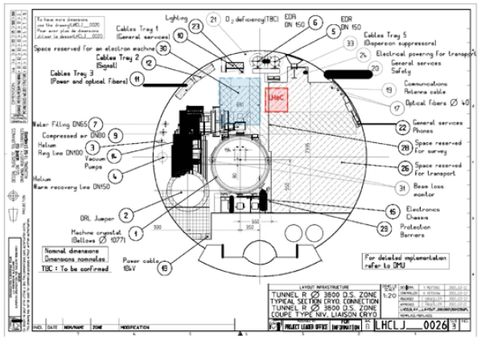
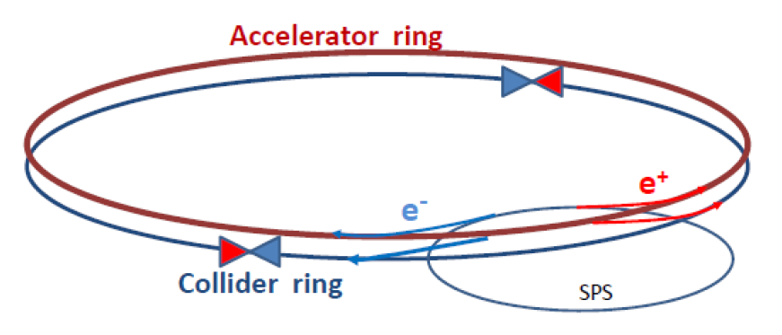
LEP3 (in LHC tunnel)
existence of the tunnel with associated infrastructure and high-performance detectors
L 10³⁴
Beam lifetime τ =18 min
=> Need of booster + collider ring: two rings in LHC tunnel, lightweight magnets
Energy loss per turn : 7 GeV (3.5 @ LEP2)
Rf voltage: 12 GV, 1.3GHz (3.6 @ LEP2 , 350 MHz)
Synchroton radiation : 100 MW (7.2 mA) total
Integration and cohabitation
with LHC, HL-LHC, HE-LHC
LHC tunnel

Slide 46
LEP3/TLEP parameters - 1
 | LEP2 | LHeC | LEP3 | TLEP-Z | TLEP-H | TLEP-t
beam energy Eb [GeV] circumference [km] beam current [mA] #bunches/beam #e−/beam [10¹²] horizontal emittance [nm] vertical emittance [nm] bending radius [km] partition number J_{ε} Momentum comp. α_{c}[10⁻⁵] SR power/beam [MW] β∗_{x} [m] β∗_{y} [cm] σ∗_{x} [μm] σ∗_{y} [μm] hourglass F_{hg} ΔE^{SR}_{loss}/turn [GeV] | 104.5 26.7 4 4 2.3 48 0.25 3.1 1.1 18.5 11 1.5 5 270 3.5 0.98 3.41 | 60 26.7 100 2808 56 5 2.5 2.6 1.5 8.1 44 0.18 10 30 16 0.99 0.44 | 120 26.7 7.2 4 4.0 25 0.10 2.6 1.5 8.1 50 0.2 0.1 71 0.32 0.59 6.99 | 45.5 80 1180 2625 2000 30.8 0.15 9.0 1.0 9.0 50 0.2 0.1 78 0.39 0.71 0.04 | 120 80 24.3 80 40.5 9.4 0.05 9.0 1.0 1.0 50 0.2 0.1 43 0.22 0.75 2.1 | 175 80 5.4 12 9.0 20 0.1 9.0 1.0 1.0 50 0.2 0.1 63 0.32 0.65 9.3

Slide 47
LEP3/TLEP parameters - 2
 | LEP2 | LHeC | LEP3 | TLEP-Z | TLEP-H | TLEP-t
V_{RF,tot} [GV] δ_{max,RF} [%] ξ_{x}/IP ξ_{y}/IP f_{s} [kHz] E_{acc} [MV/m] eff. RF length [m] f_{RF} [MHz] δ^{SR}_{rms} [%] σ^{SR}_{z,rms} [cm] L/IP[10³²cm⁻²s⁻¹] number of IPs Rad.Bhabha b.lifetime [min] ϒ_{BS} [10⁻⁴] n_{γ}/collision Δδ^{BS}/collision [MeV] Δδ^{BS}_{rms}/collision [MeV] | 3.64 0.77 0.025 0.065 1.6 7.5 485 352 0.22 1.61 1.25 4 360 0.2 0.08 0.1 0.3 | 0.5 0.66 N/A N/A 0.65 11.9 42 721 0.12 0.69 N/A 1 N/A 0.05 0.16 0.02 0.07 | 12.0 5.7 0.09 0.08 2.19 20 600 700 0.23 0.31 94 2 18 9 0.60 31 44 | 2.0 4.0 0.12 0.12 1.29 20 100 700 0.06 0.19 10335 2 74 4 0.41 3.6 6.2 | 6.0 9.4 0.10 0.10 0.44 20 300 700 0.15 0.17 490 2 32 15 0.50 42 65 | 12.0 4.9 0.05 0.05 0.43 20 600 700 0.22 0.25 65 2 54 15 0.51 61 95
at the Z pole repeating LEP physics programme in a few minutes…

Slide 48
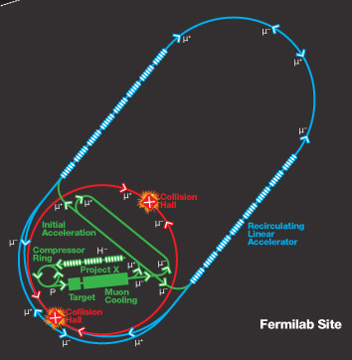
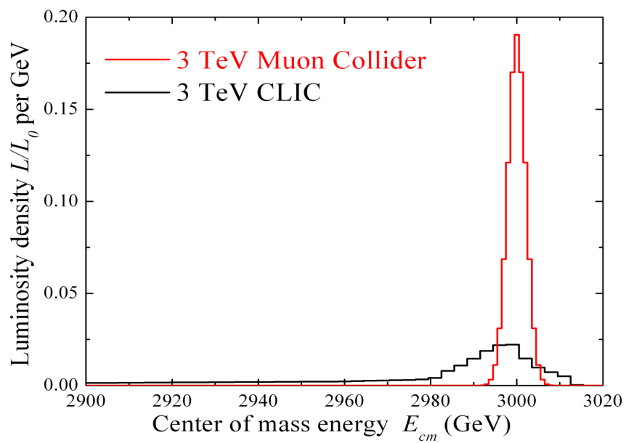
Muon Collider
Much less synchrotron radiation than e+e-
Attractive ‘clean’ collisions at full E_{cms}
High production cross section for Higgs
The challenge: Cooling the µ beam!!
+ multi MW proton driver
Emittance reduction 10⁻⁷
  ~1000 in each transverse plane
  ~40 in longitudinal
  => Ionisation cooling
  requires 30-40T solenoids
  + high gradient RF cavities
6-year Feasibility Assessment Program
www.fnal.gov/pub/muon_collider
Beamstrahlung in
any e+e- collider
δE/E ∝ γ²
Initial Acceleration
In a dozen turns, accelerate µ to 20 GeV
Compressor Ring
Reduce size of beam (2±1 ns).
Recirculating Linear Accelerator
In a number of turns, accelerate
muons up to Multi-TeV using SRF
techlnology.
Target
Collisions lead to muons with energy
of about 200 MeV.
Muon Capture and Cooling
Capture, bunch and cool muons to
create a tight beam.
Collider Ring
Bring positive and negative muons into collision at two locations 100munderground.

Slide 49
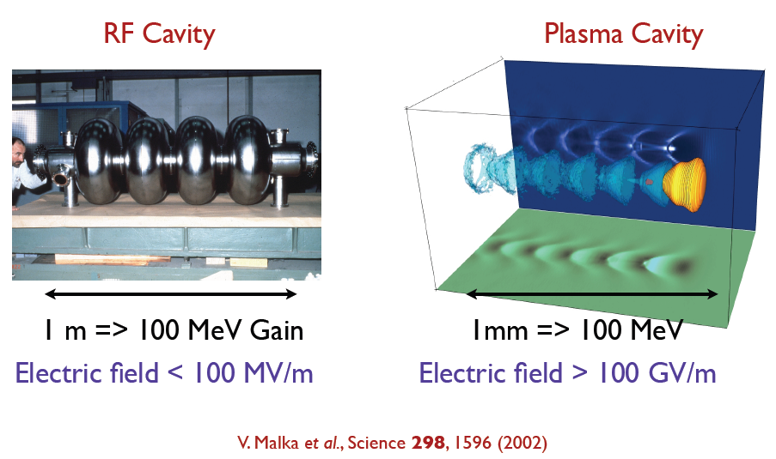
Plasma acceleration
Plasma
accelerators:
Transform transverse fields into longitudinal fields
Laser driven
e- driven
p driven
Dielectric wakefields
Demonstrated accelerating Gradients up to 3 orders of magnitudes beyond presently used RF technologies.
Still far away from possible LC project

Slide 50

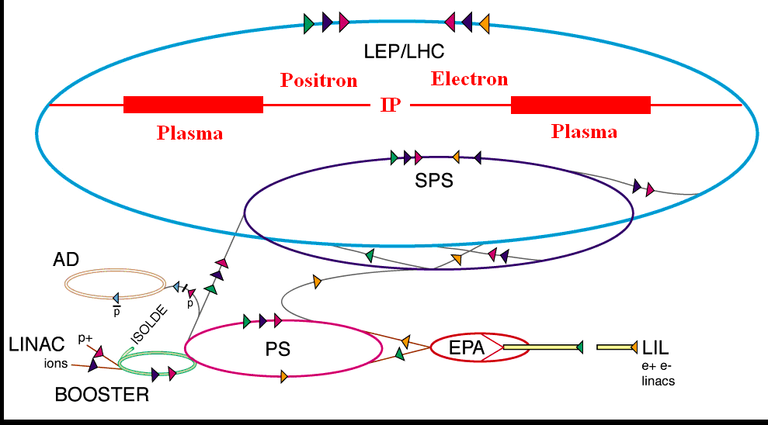
Example: p-driven plasma acceleration
Simulations and proposal for CERN experiment
Need of 1 TeV p beam, high current to produce 600 GeV e- in 450 m plasma
Very high energy transfer
Awake collaboration at CERN for proof-of-principle experiment
SPS beam 450 GeV, with 5-20 MeV e- beam, CDR planned for 2013
Laser
e⁻ spectrometer
RF gun
e⁻
Proton beam dump
Plasma-cell
SPS
protons
~3m
10m
Laser
dump
OTR
Streak camera
CTR
EO diagnostic
20m
10m
15m?
10m?

Slide 51

γ-γ collider Higgs-Factories
laser system close to IP for Compton backscattering off the high energy electron beams
electron beam energy lower than for the e+e− colliders: 80 GeV, instead of 120
high cross section for Higgs production (about 200 fb )
positrons are not required
equivalent e-e- luminosity of few 10³⁴cm⁻²s⁻¹ yielding several 10000 Higgs bosons/year
possibility of high polarization in both the primary e− and the colliding γ beams
Different proposals: ILC/CLIC based, ERL
Example: SAPPHiRE
LHeC e beam ERL as γ−γ collider
total electric power | P | 100 MW
beam energy | E | 80 GeV
beam polarization | P_{e} | 0.80
bunch population | N_{b} | 10¹⁰
repetition rate | f_{rep} | 200 kHz
bunch length | s_{z} | 30 mm
crossing angle | q_{c} | ≥20 mrad
normalized horizontal emittance | γe_{x} | 5 mm
normalized vertical emittance | γe_{y} | 0.5 mm
e-e- geometric luminosity | L_{ee} | 2x10³⁴ cm⁻²s⁻¹
Challenges: ERLs physics (emittance preservation…)
Laser pulses at 200 kHz
Total energy few Joules (1 TW peak power,
5 ps pulse length == 1 MW average power)

Slide 52

HIGGS FACTORIES e+e-
e+ e-
Linear
Colliders
CLIC
Circular Colliders
CERN
Super
TRISTAN
ILC
375 GeV Klystron based
500 GeV
250 GeV– 40, 60 km tunnel
400 GeV
500 GeV
250 GeV
500 GeV
LEP3 in LHC tunnel
> 500 GeV
DLEP – New tunnel, 53 km
TLEP – New tunnel, 80 km

Slide 53
HIGGS F. e+e- R&D & main issues
e+ e-
Linear Colliders
CLIC
Circular Colliders
CERN
Super
TRISTAN
ILC
Low E : X-band Klystron technology
Demonstrated High gradient cavities
Synergy with XFELs
≥ 500, CDR, need of >10 years R&D
CTF3 test facility
Technology assessed,
tunnel & site ???
Almost ready SC rf technology, need of opt for low energy, TDR by end ‘12, XFEL as test facility
Low E - Tunnel ready (not available) , technology ok , SCrf cavities ok
Long tunnel, high costs, environment impact

Slide 54
Summary
Quite a variety of high-energy machines proposed
  HL-LHC and HE-LHC for protons
  ILC, CLIC, LEP3, Super-Tristan,… for electrons/positrons
  LHeC/eRHIC for lepton/hadron
  other projects (µ-collider, plasma acceleration, γ-γ collider,…)
LHC discoveries (Higgs-like boson + new findings?)
will tell the path to go…
Many thanks to:
C.Biscari, L.Rossi, F.Zimmermann, N.Walker, S.Stapnes, E.Gschwendtner, everyone else I took some slides from!

Slide 55
Reserve

Slide 56
Approximate dates
Uncertainties increase with time
Approximate Timelines of HE projects
 | 2012 |  |  | 2015 |  |  |  |  | 2020 |  |  |  |  | 2025 |  |  |  |  | 2030 |  |  |  |  | 2035
LHC
HL-LHC
HE-LHC
RHIC
LHeC
eRHIC
Higgs factory ILC
ILC 0.5 TeV*
CLIC Higgs fact klys
CLIC 0.5 TeV*
CLIC E Upgrades
LEP3
SuperTristan - TLEP
γ−γ collider
MUON COLLIDER
LWFA LC
RDR (CDR) R&D TDR/Preparation Construction Operation
APPROVED
* In the hypothesis of a first stage at 250GeV
Not Approved

